Slide 1
Chapter Five
Circuits

Slide 2
6-1 SINGLE-LOOP CIRCUITS
You are surrounded by electric circuits. You might take pride in the number of electrical devices you own and might even carry a mental list of the devices you wish you owned.
“Pumping” Charges
To produce a steady flow of charge, you need a “charge pump,” a device that—by doing work on the charge carriers—maintains a potential difference between a pair of terminals. We call such a device an emf device, and the device is said to provide an emf (electromotive force ) ξ. A common emf devices are the battery, electric generator, solar cells and fuel cells.

Slide 3
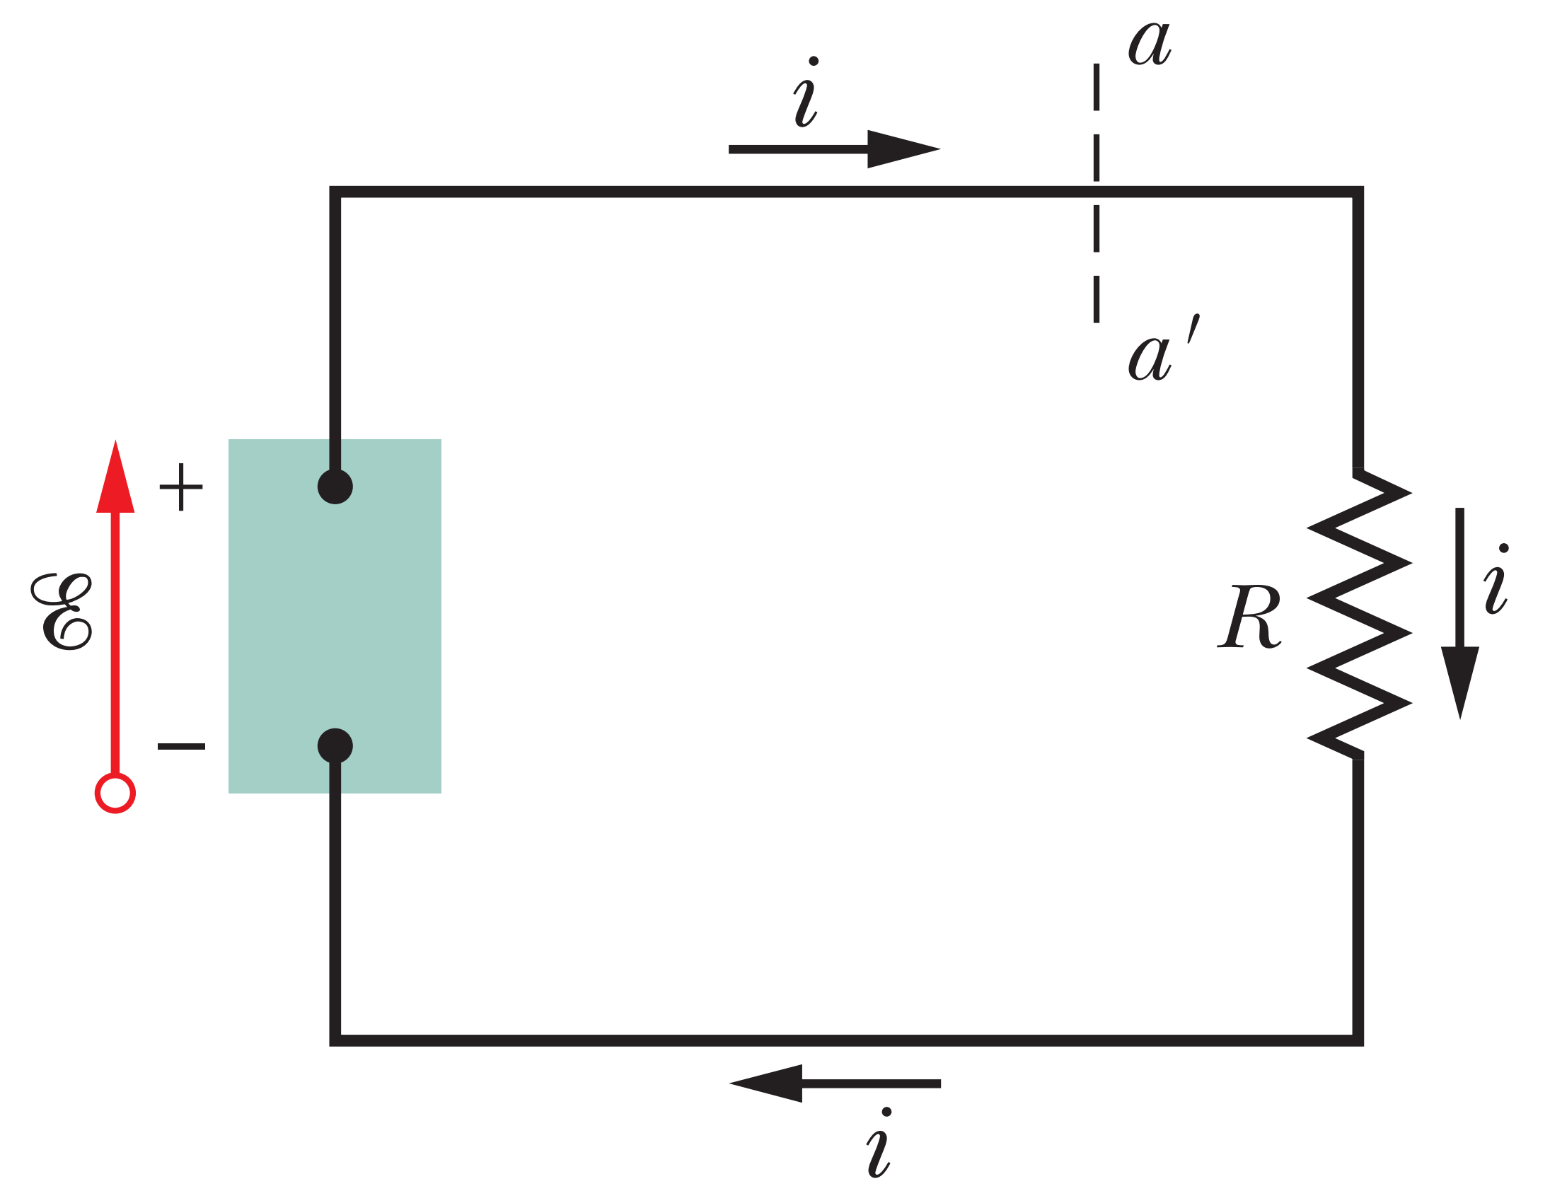
Work, Energy, and Emf
The electromotive (Emf) device must do an amount of work $dW$ on the charge $dq$ to force it to move from low-potential end(-) and leave at its high-potential end (+).
The SI unit for emf is the joule per coulomb, later called Voltage (V)
When an emf device is connected to a circuit, the device transfers energy to the charge carriers passing through it. This energy can then be transferred from the charge carriers to other devices in the circuit, for example, to light a bulb.

Slide 4
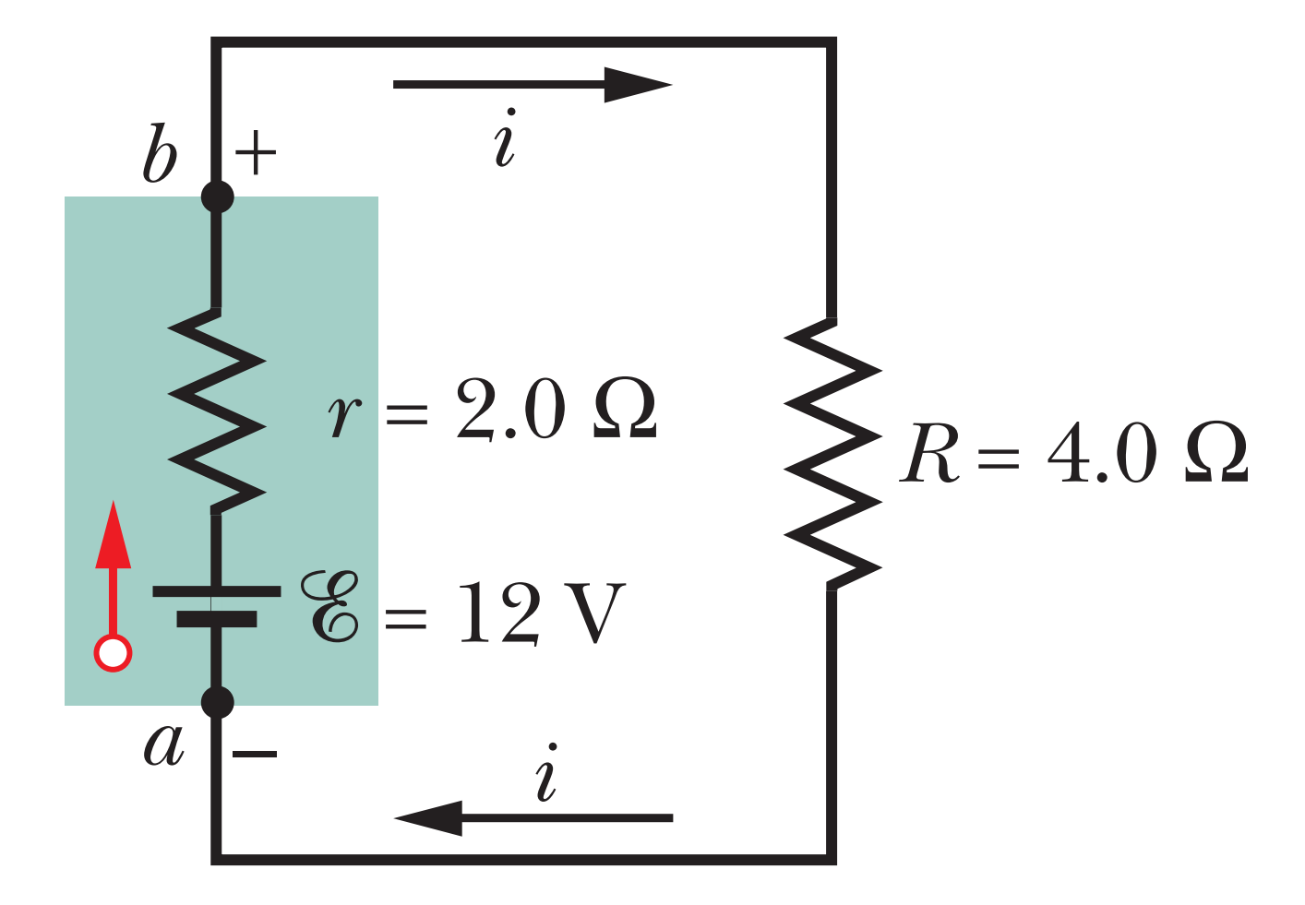
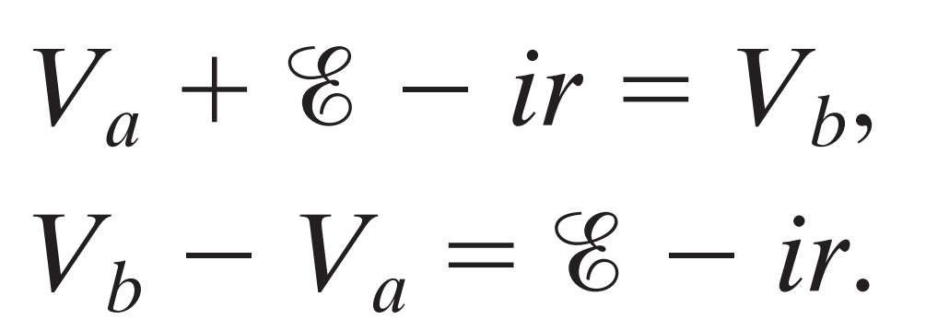
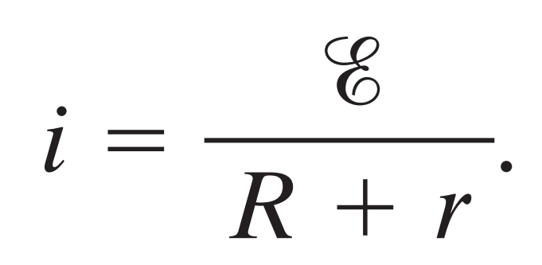
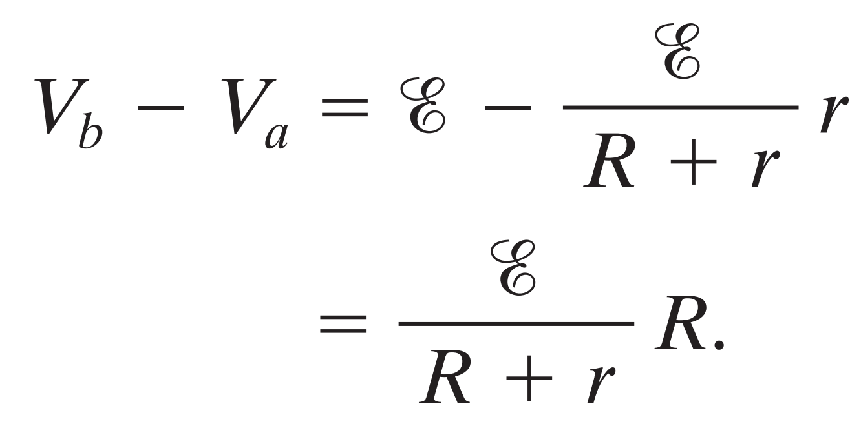
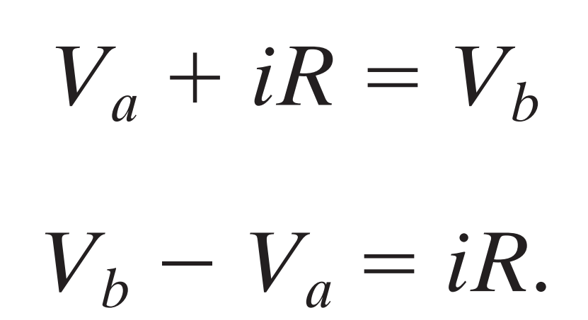
Potential Difference Between Two Points
What is the potential difference ($V_{b}−V_{a}$) between points a and b?
To find out, let’s start at point a (at potential $V_{a}$) and move through the battery to point b (at potential $V_{b}$).
emf
Internal resistance
where
clockwise
anticlockwise
Because we move opposite the current, the potential increases by iR.
where

Slide 5
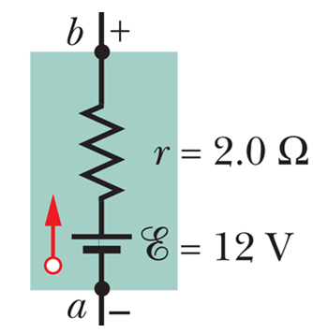
(a) less; (b) greater; (c) equal
walking with current voltage drop $–ir$
walking against current voltage increase $+ir$
no current and so ir=0

Slide 6
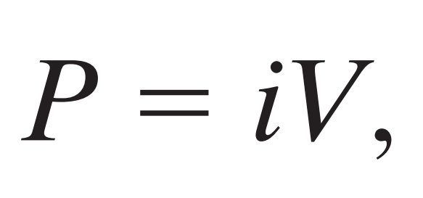
Power, Potential, and Emf
The net rate P of energy transfer from the emf device to the charge carriers is given by
Where $V=ξ−ir$
$i^{2}r$ is the rate $P_{r}$ of energy transfer to thermal energy within the emf device:
$iξ$ is the rate $P_{emf}$ at which the emf device transfers energy both to the charge carriers and to internal thermal energy.

Slide 7
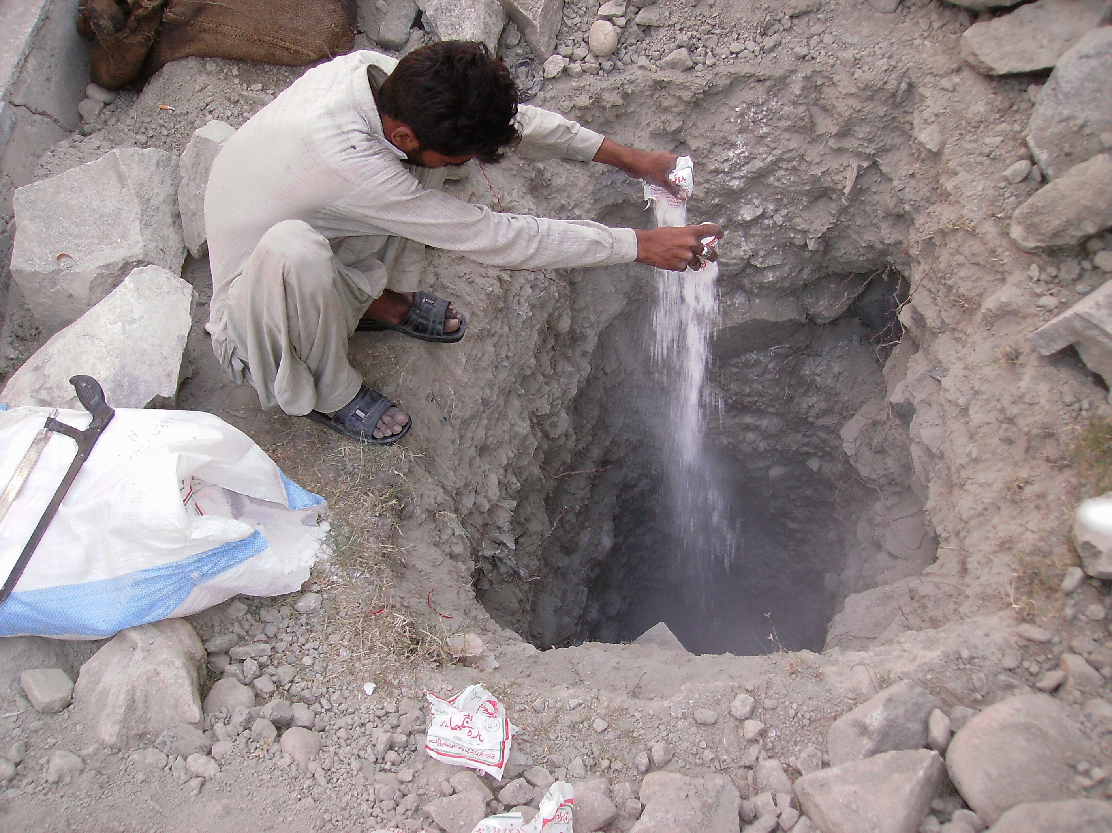
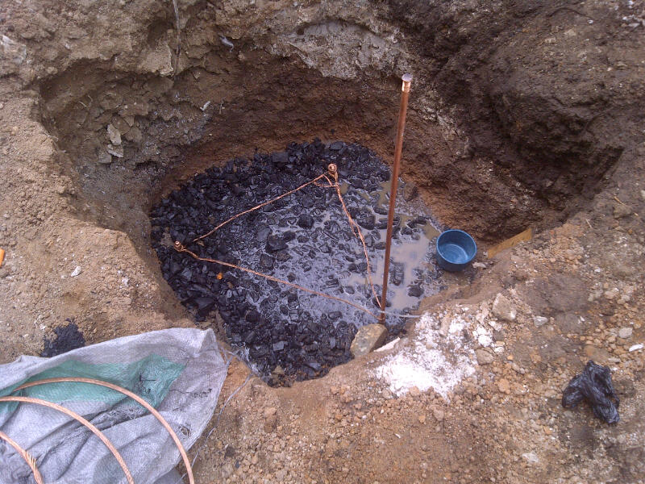
Grounding a Circuit
Ground is indicated by the common symbol .
Grounding a circuit usually means connecting the circuit to a conducting path to Earth’s surface.
Salt and coal

Slide 8
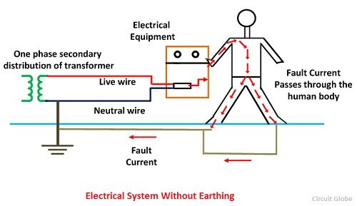
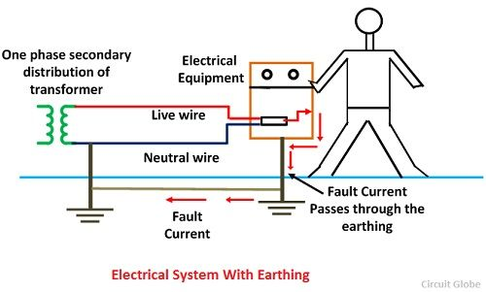
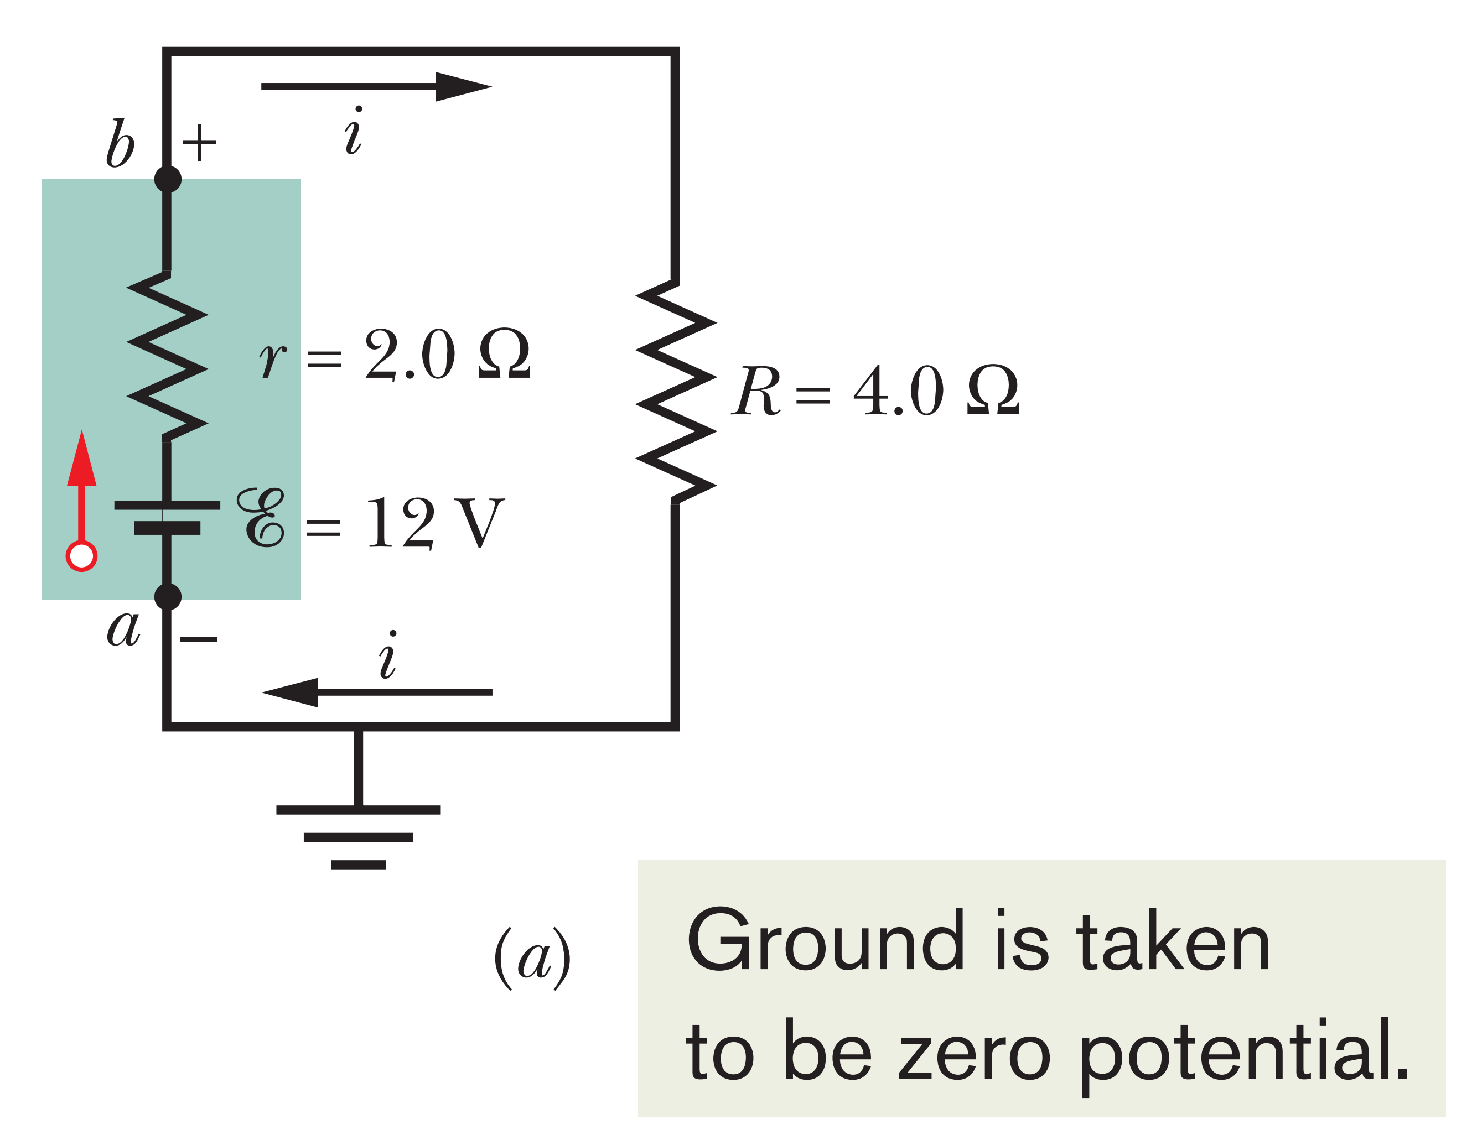
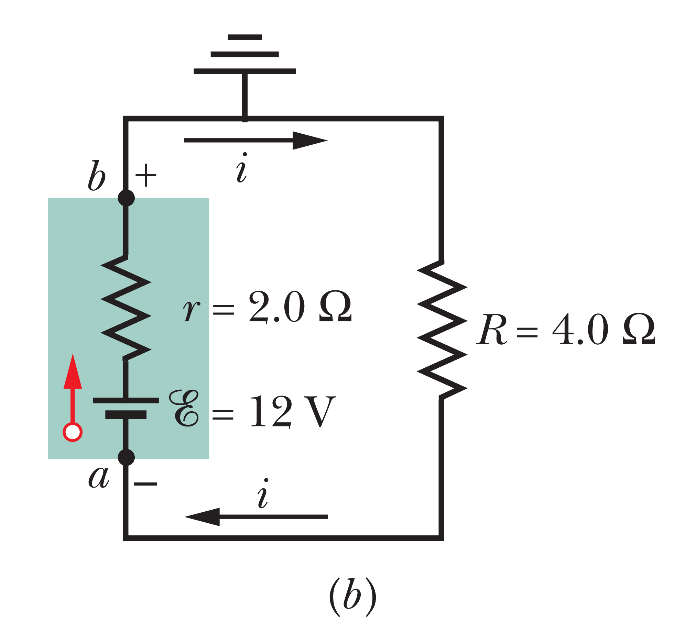
Not 100%
Here, such a connection means only that the potential is defined to be zero at the grounding point in the circuit.

Slide 9
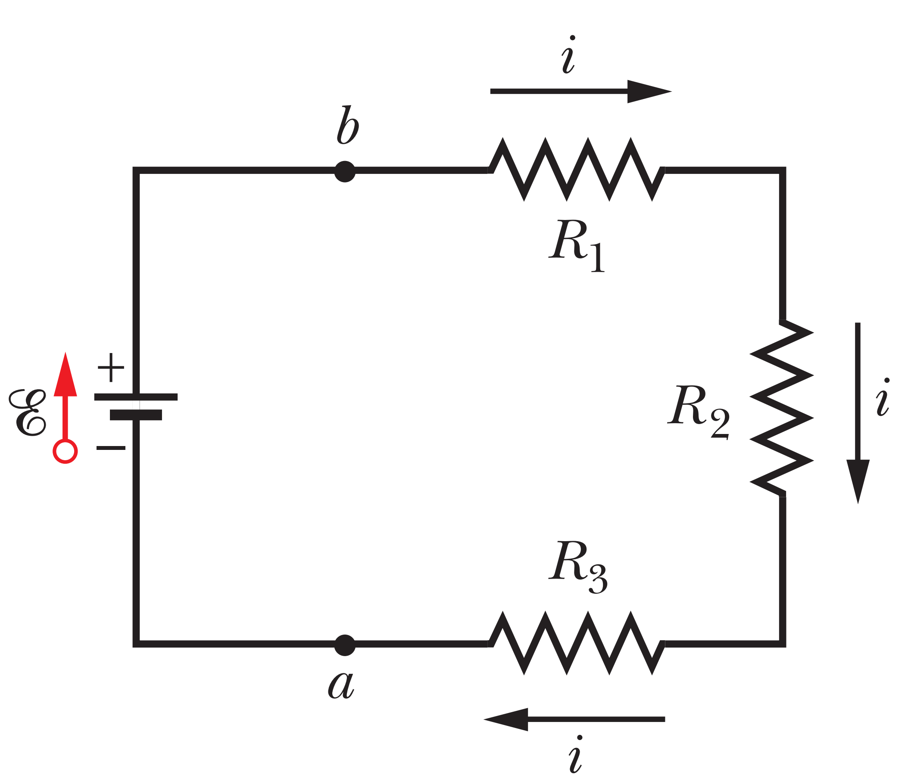
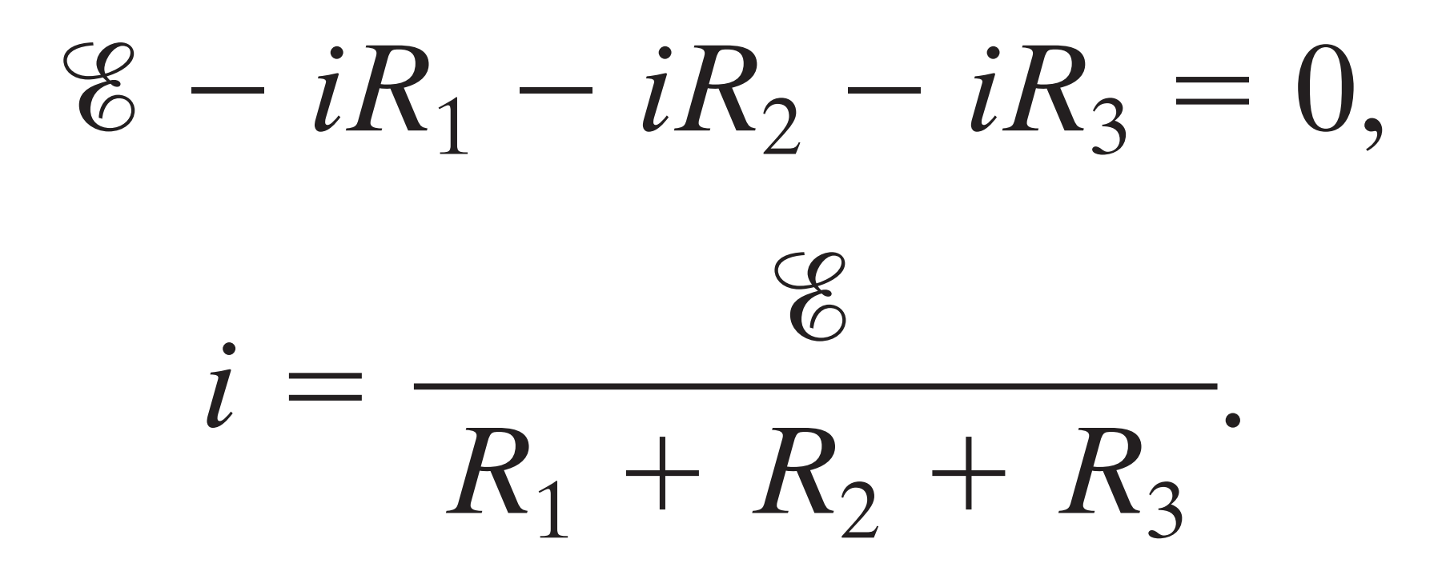
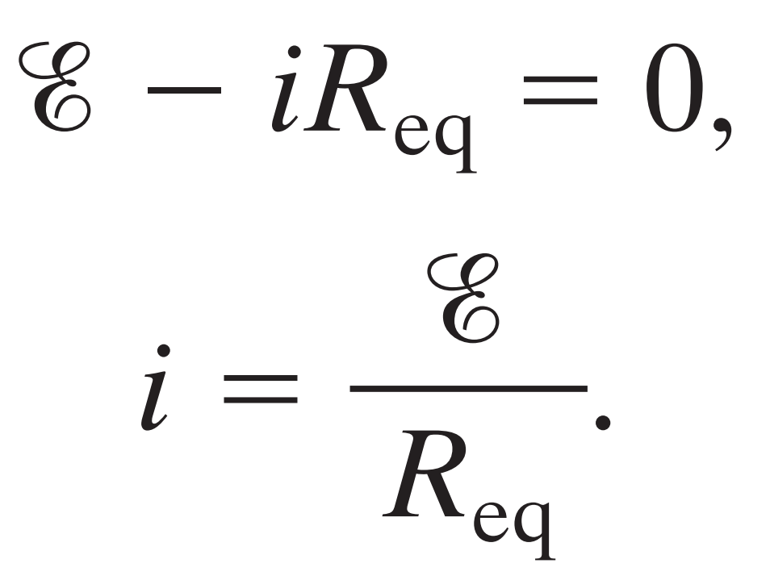
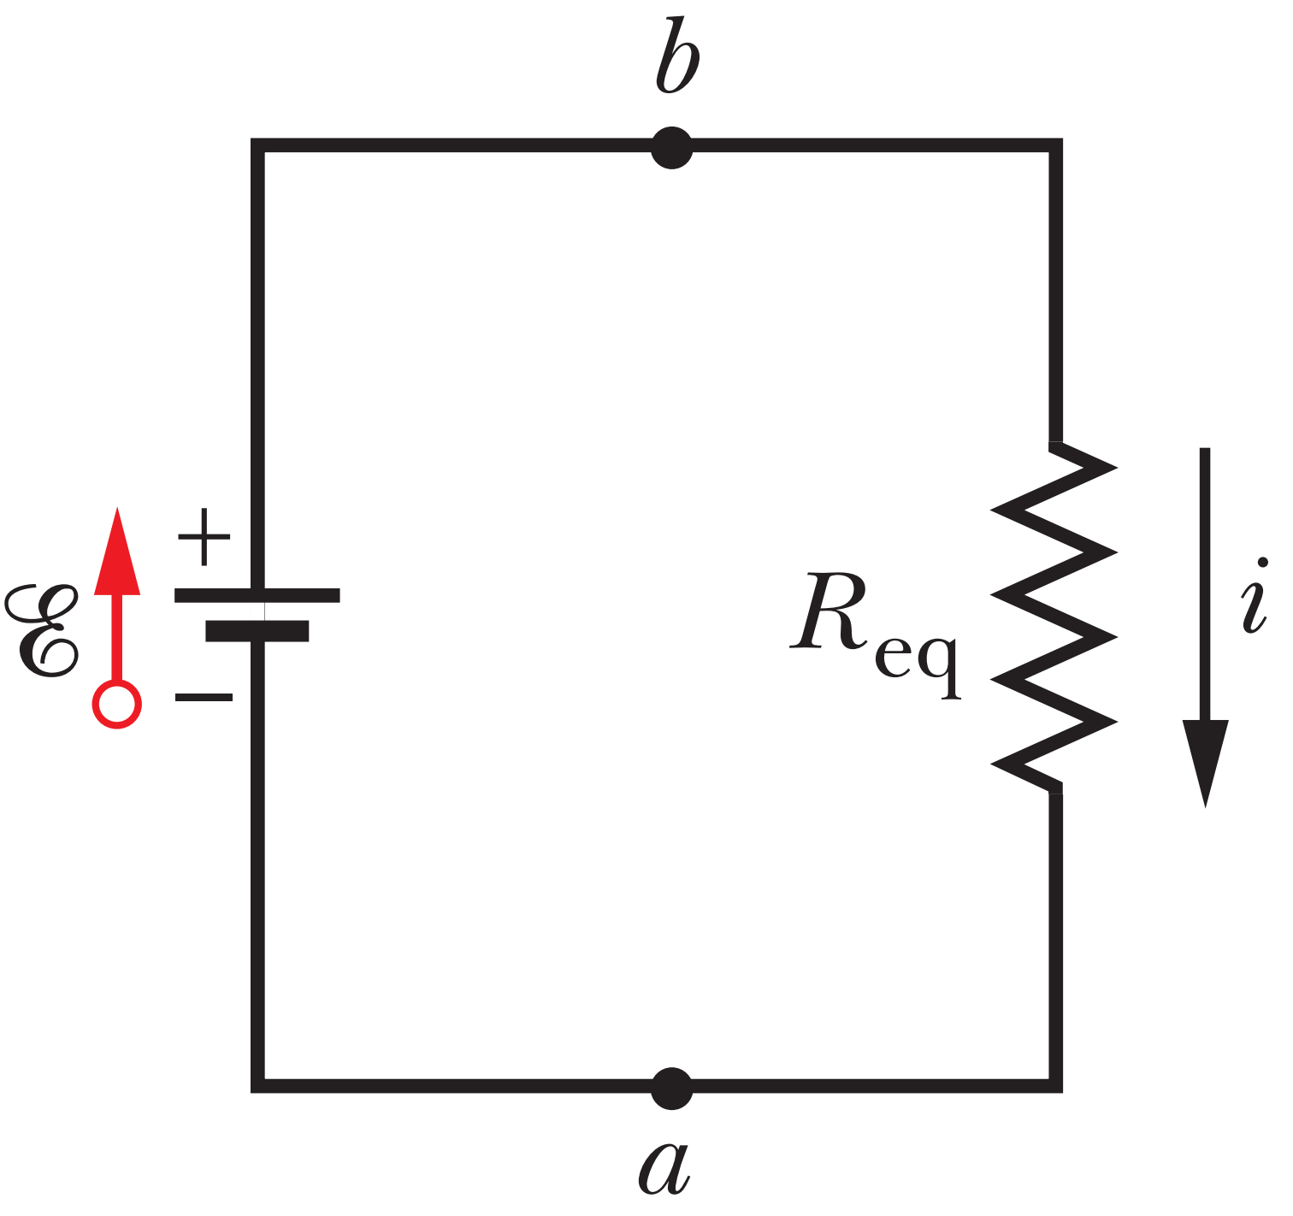
6-2 MULTILOOP CIRCUITS
The series connection is not multiloop circuit but we put it here. Also not
arranged like a book to make it easy.

Slide 10
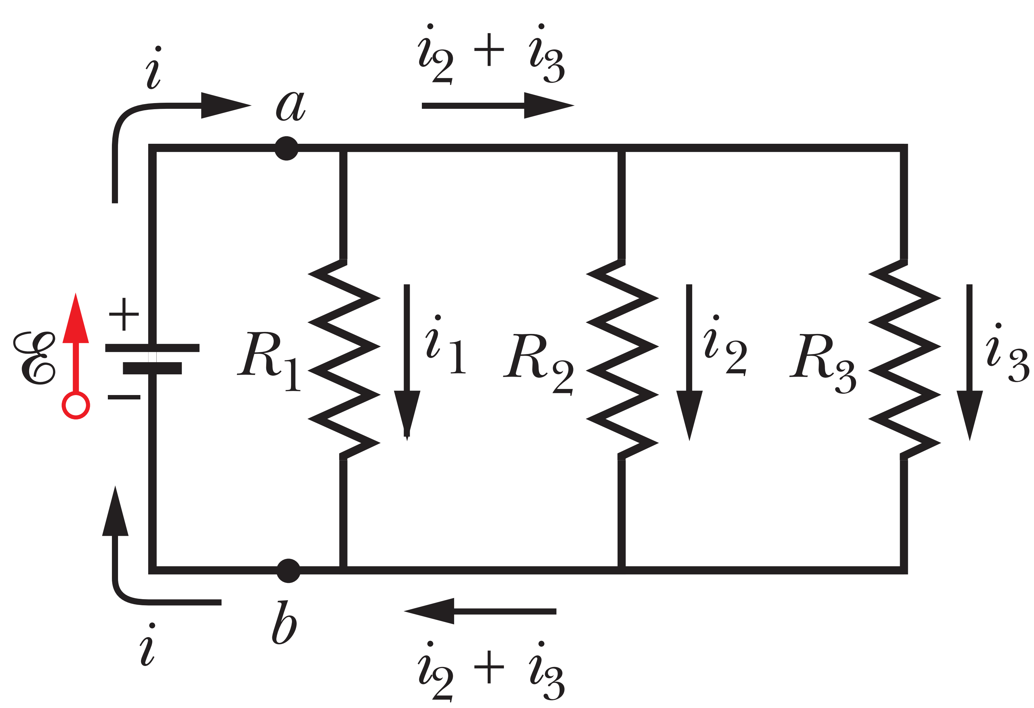
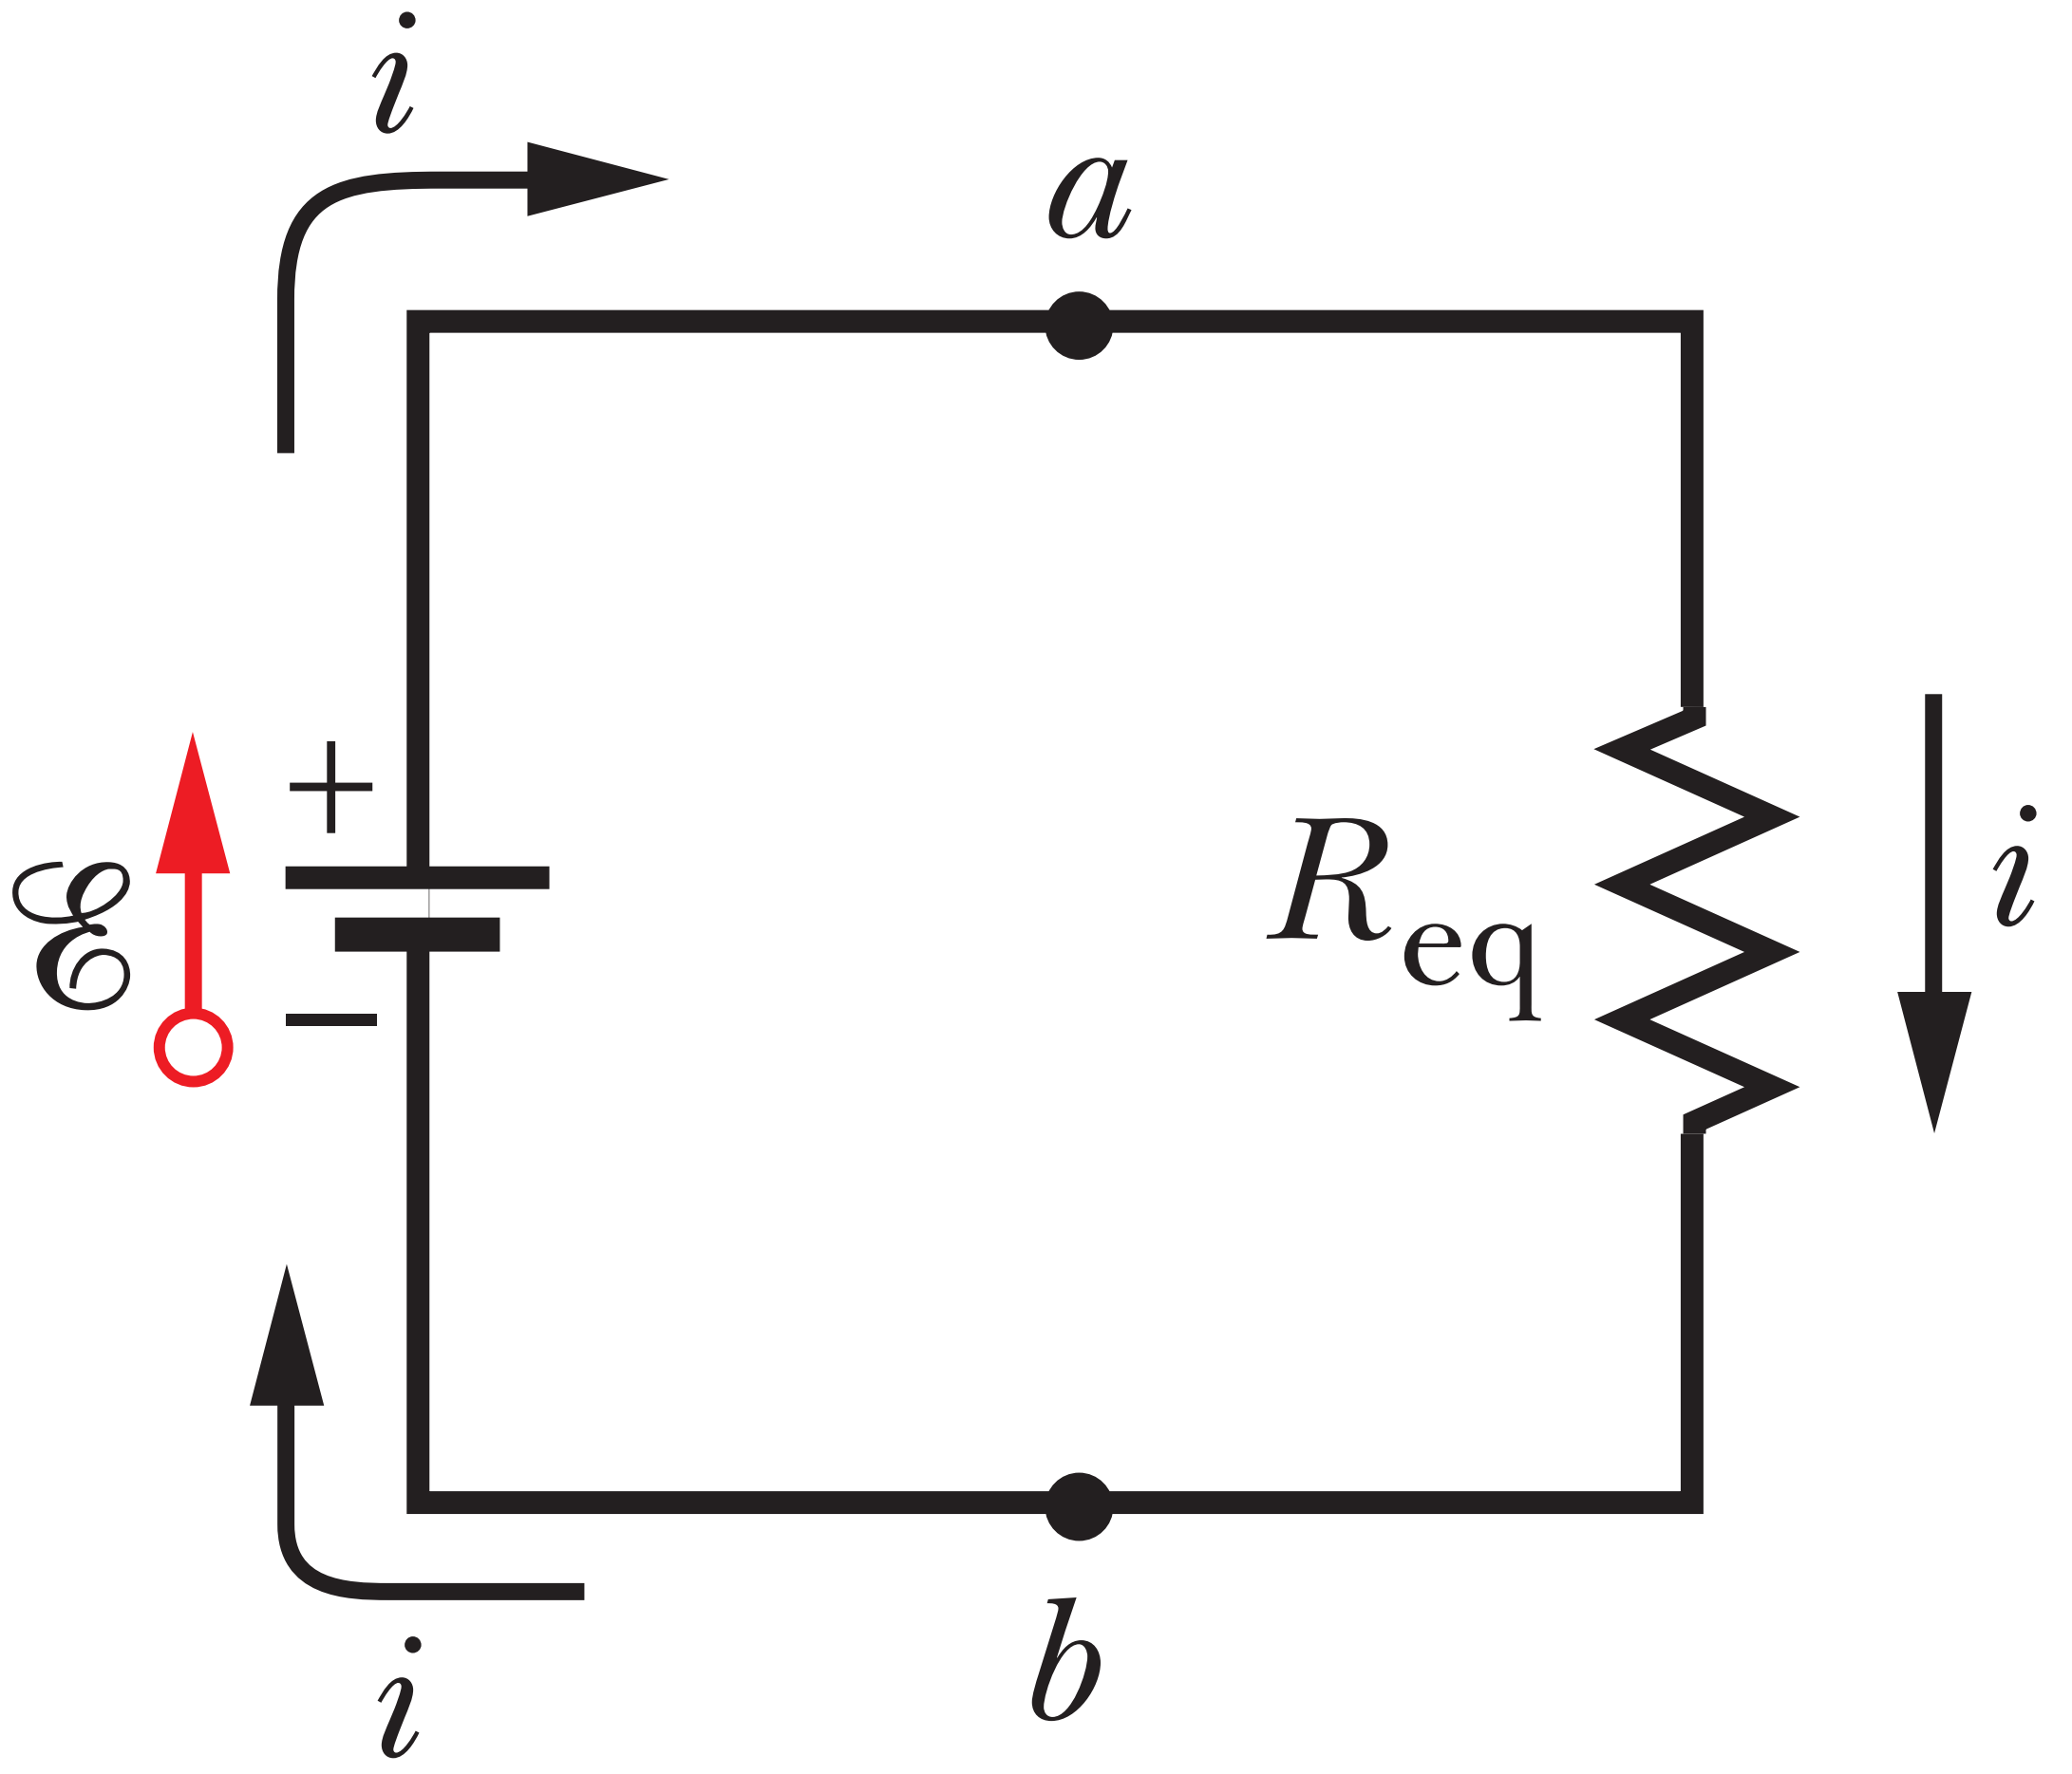
(a) all tie; (b) R1, R2, R3
Resistances in Parallel

Slide 11
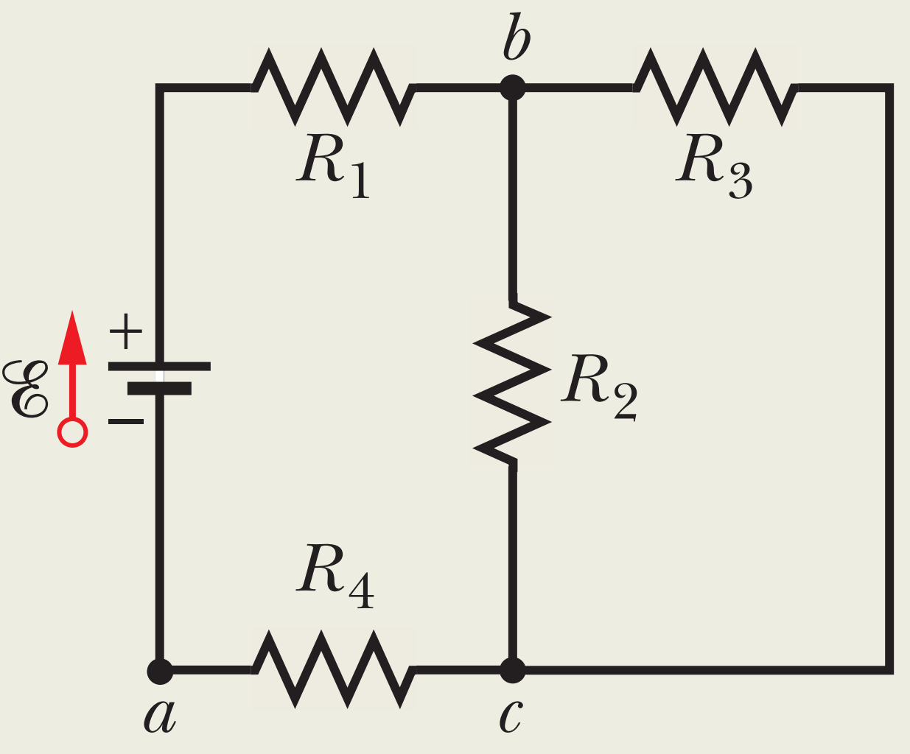
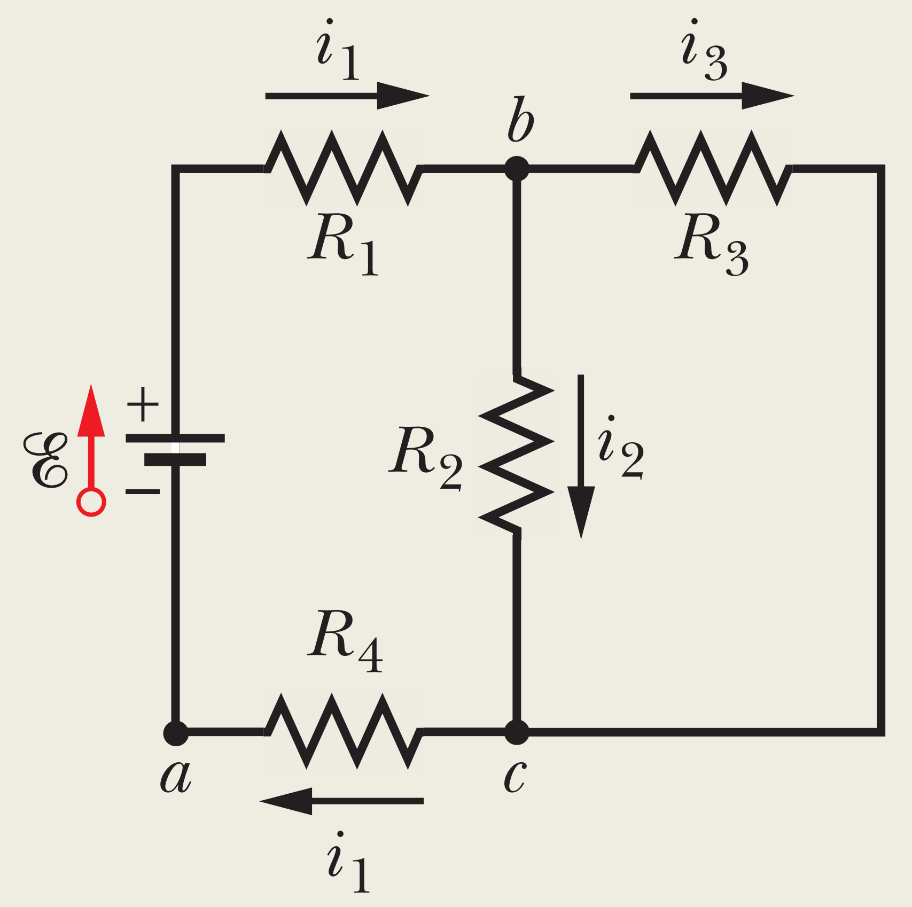
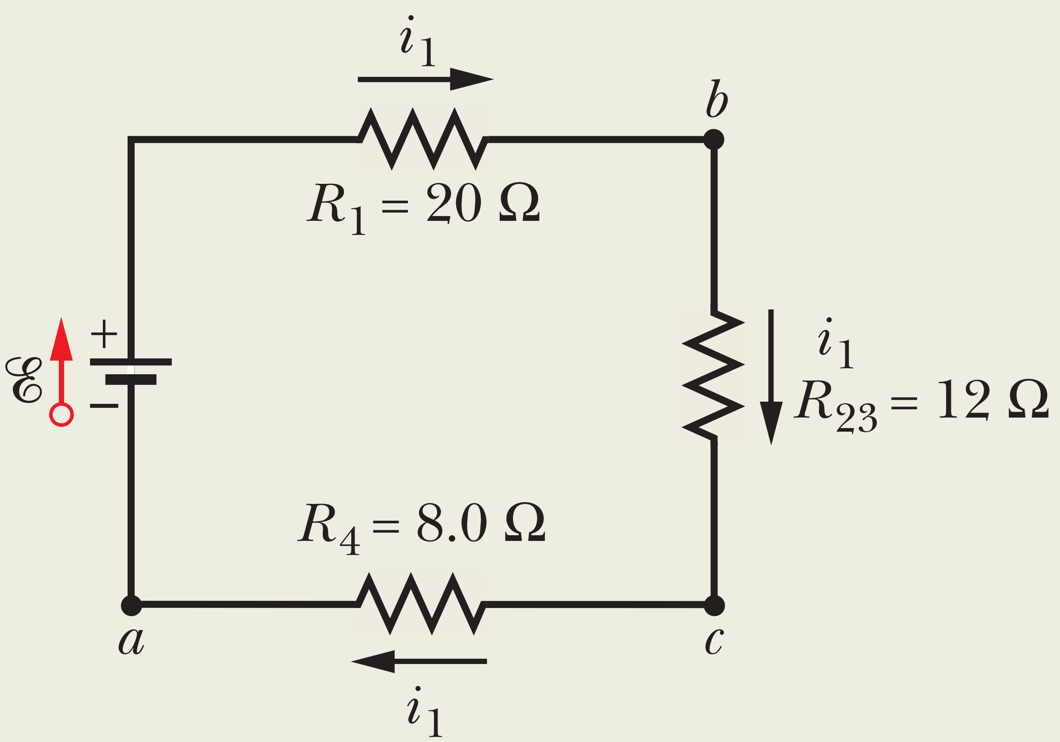
Sample Problem 27.02
$$20 Ω$$
$$30 Ω$$
(a) What is the current through the battery?
$$R_{2} and R_{3} are parrallel, why ?$$
$12$V
$$i_{1} divide to i_{2} and i_{3}$$
$$i=???$$
$$20 Ω$$
Which resistances are parallel ?
$$i_{1}=i_{2}+i_{3}$$
$$R_{2} and R_{3} are series with R_{4}, why ?$$
$$8 Ω$$
$$i_{4}=i_{2}+i_{3}$$
$$\frac{1}{R_{23}}=\frac{1}{R_{2}}+\frac{1}{R_{3}} −→ R_{23}=12Ω$$

Slide 12
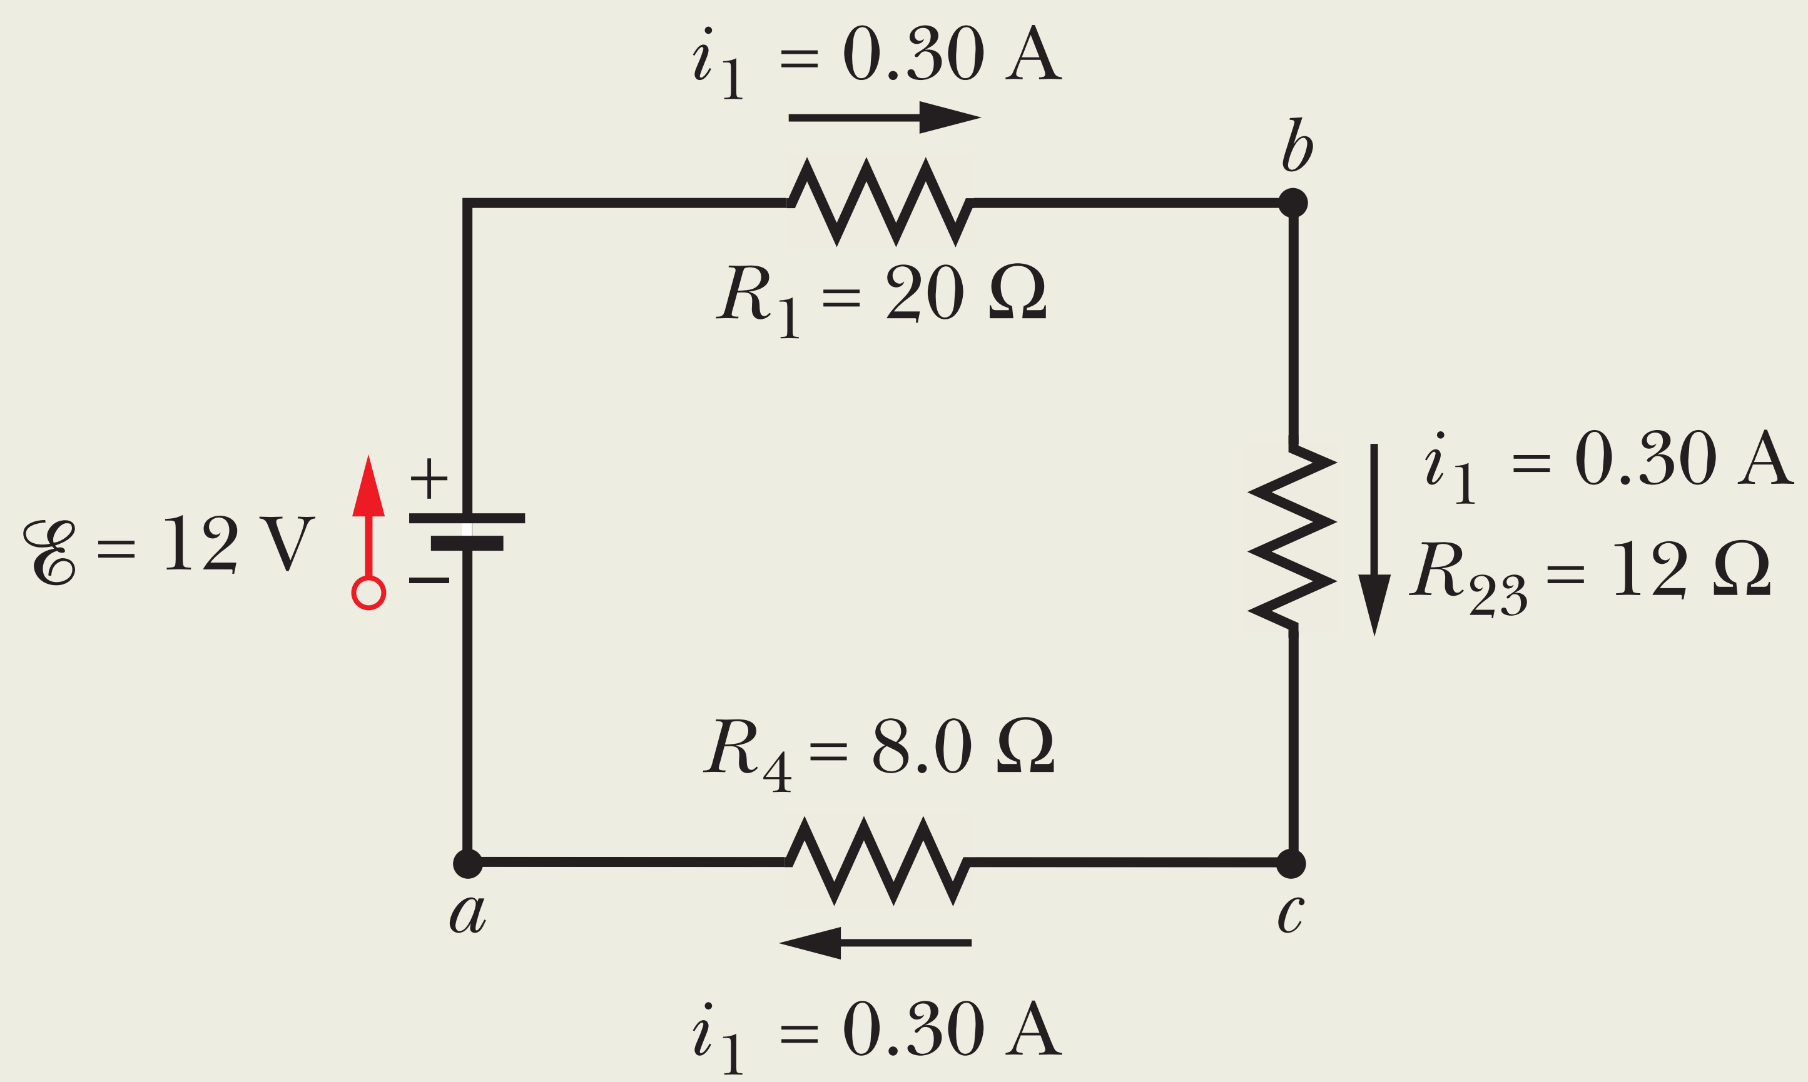
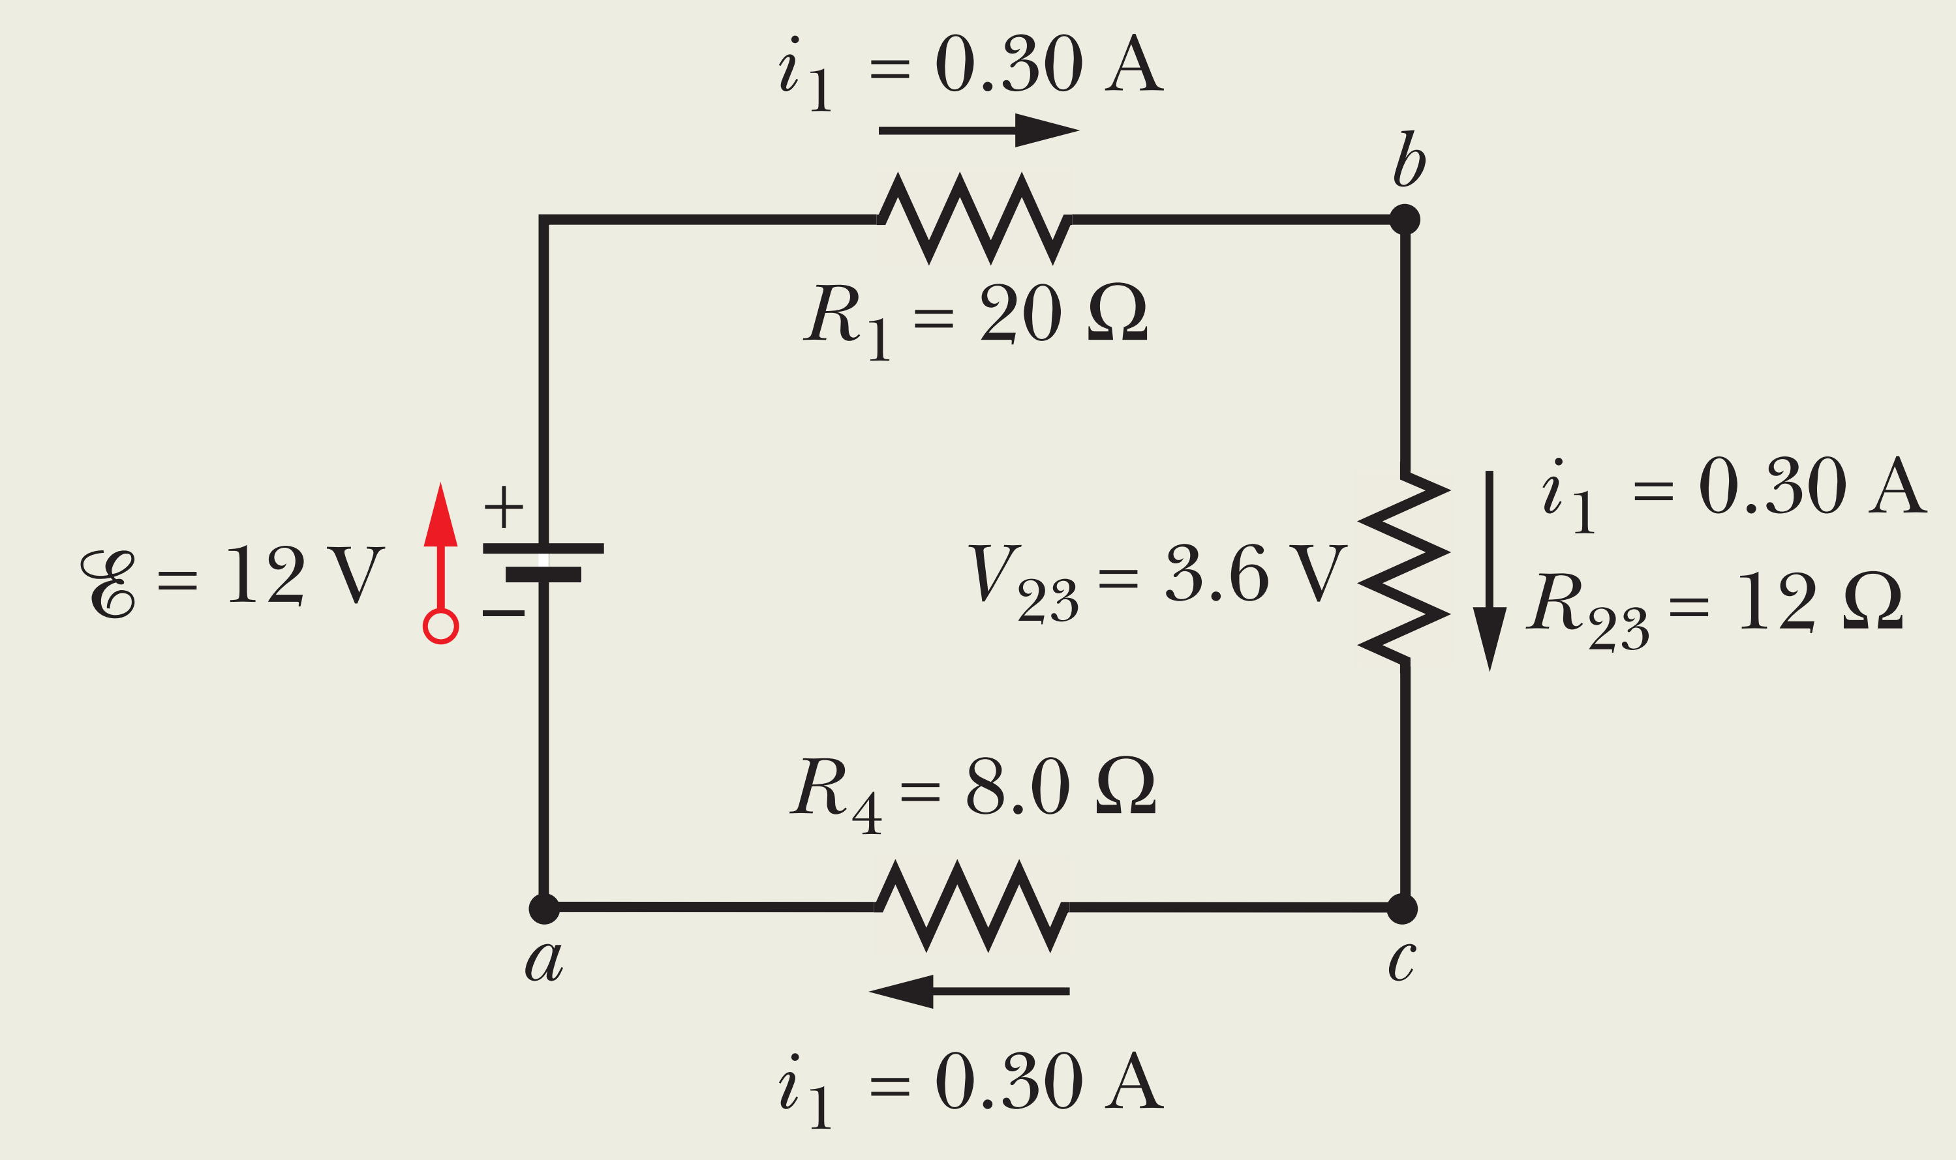
(b) What is the current $i_{2}$ through $R_{2}$?

Slide 13
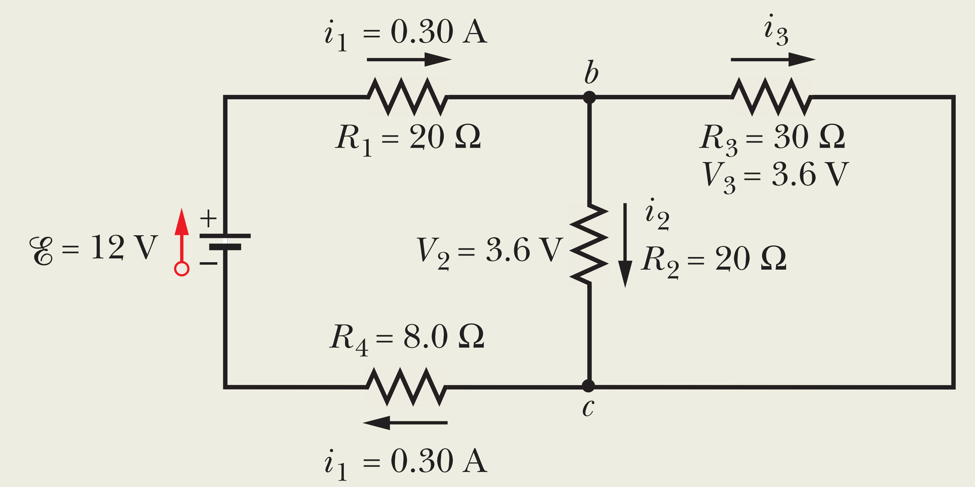
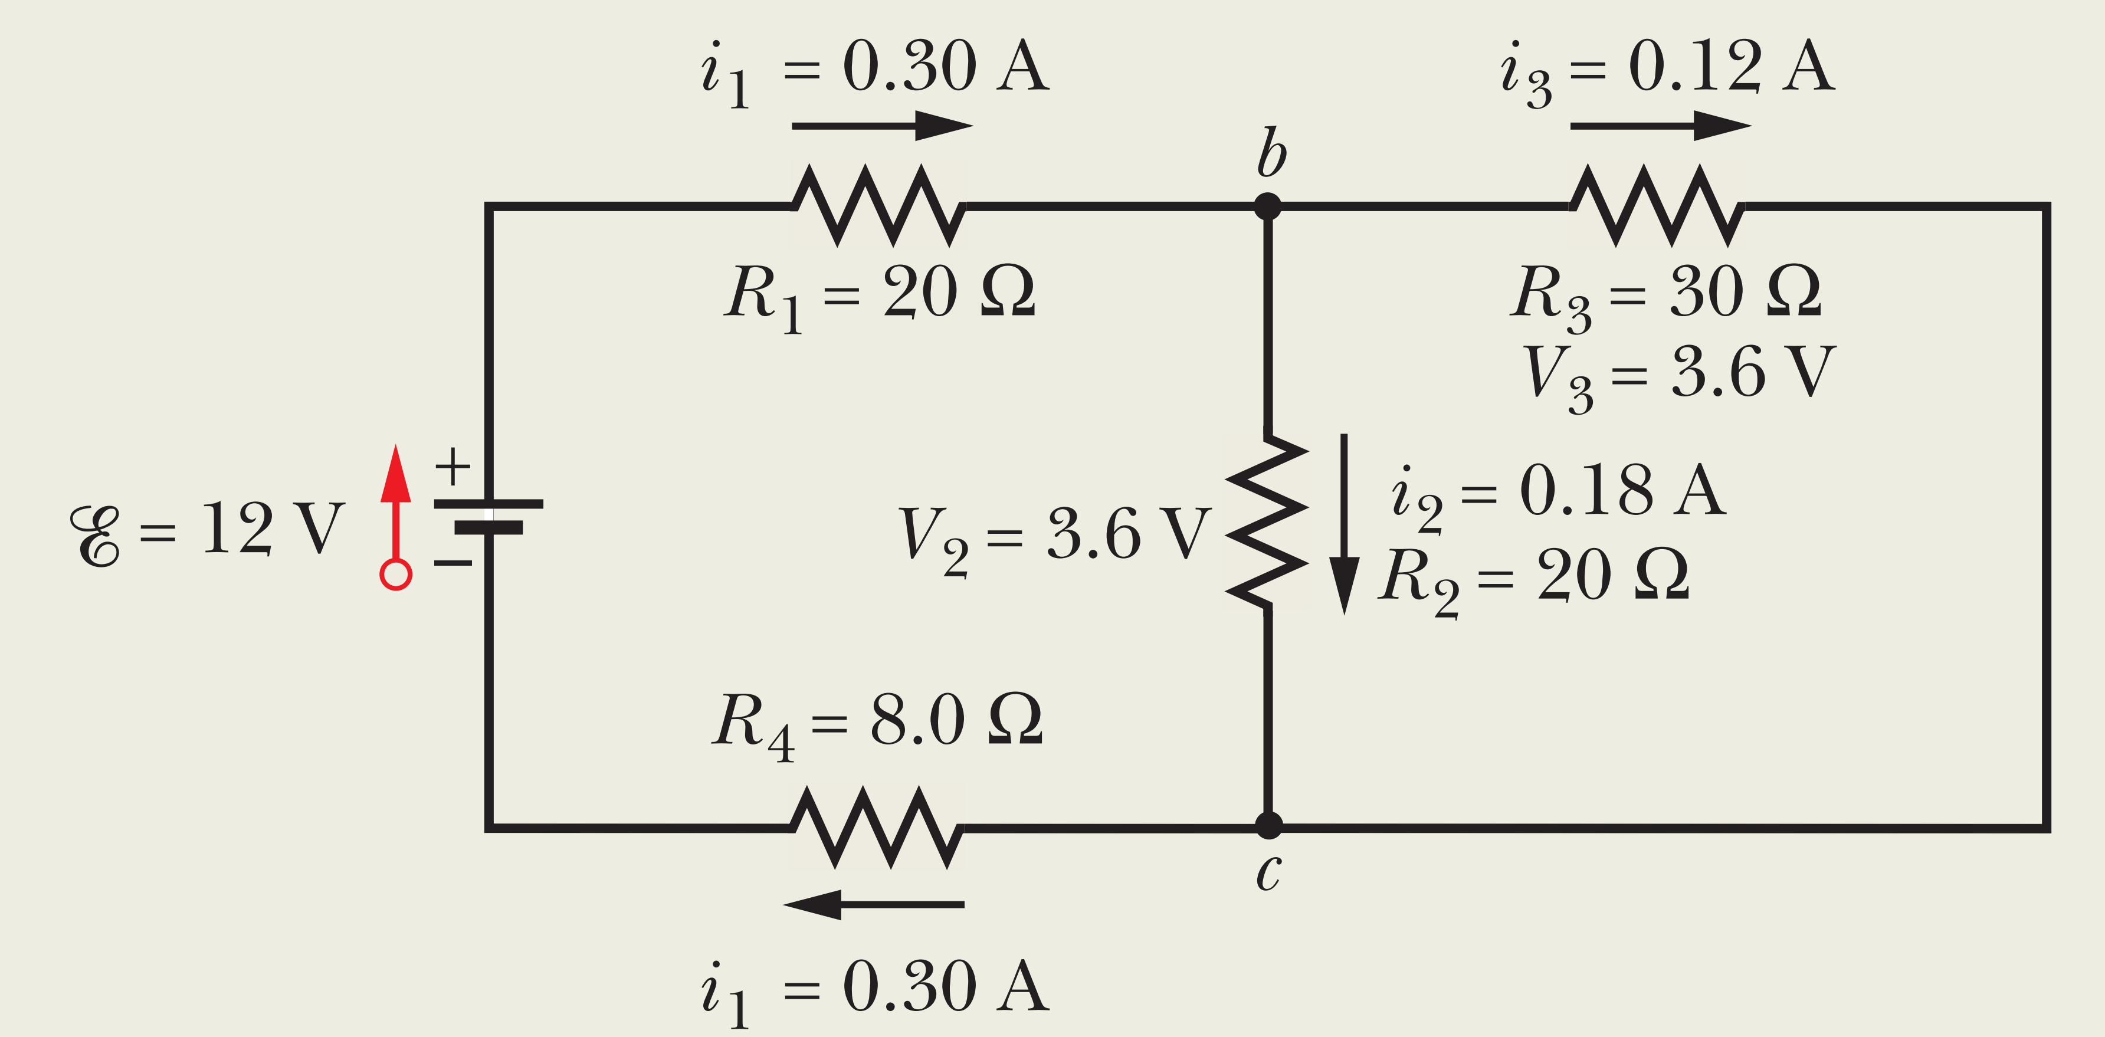
(c) What is the current $i_{3}$ through $R_{3}$?

Slide 14
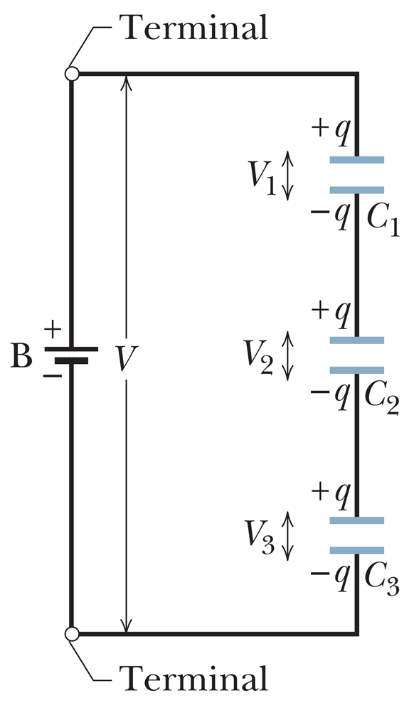
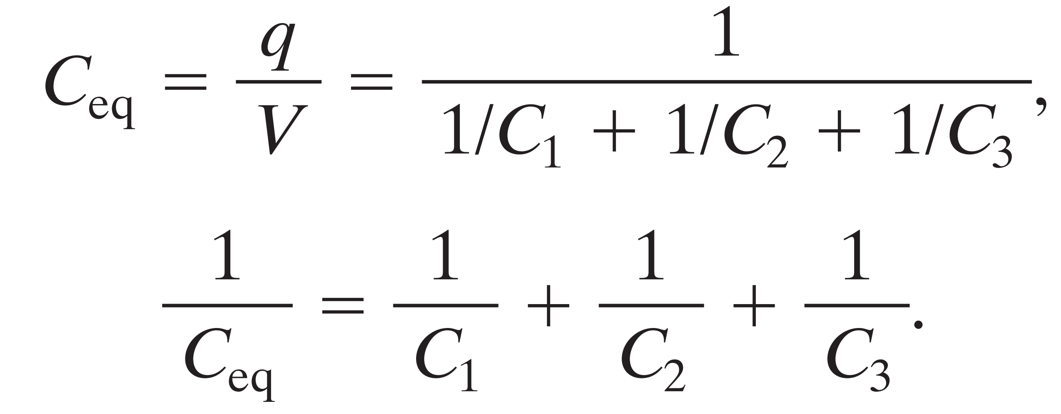
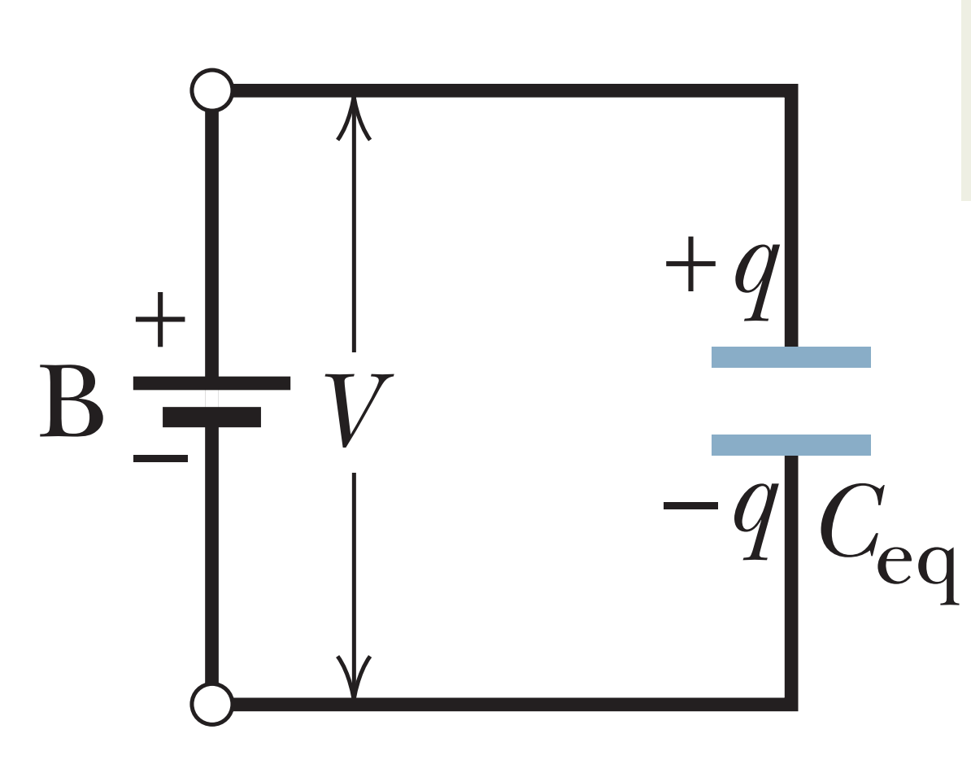
Capacitor in Series
Explain ?

Slide 15
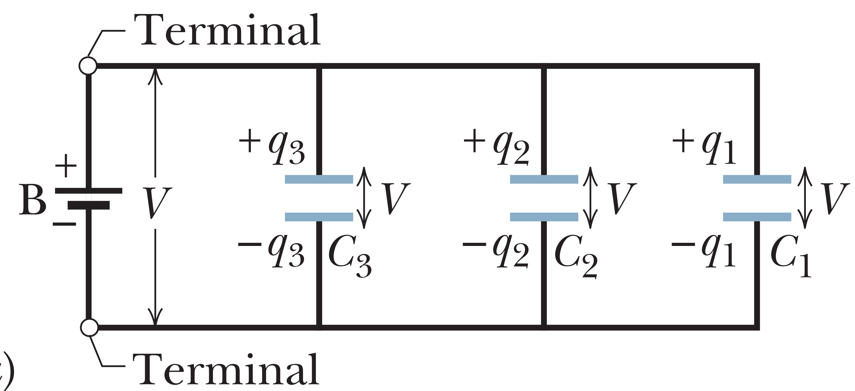
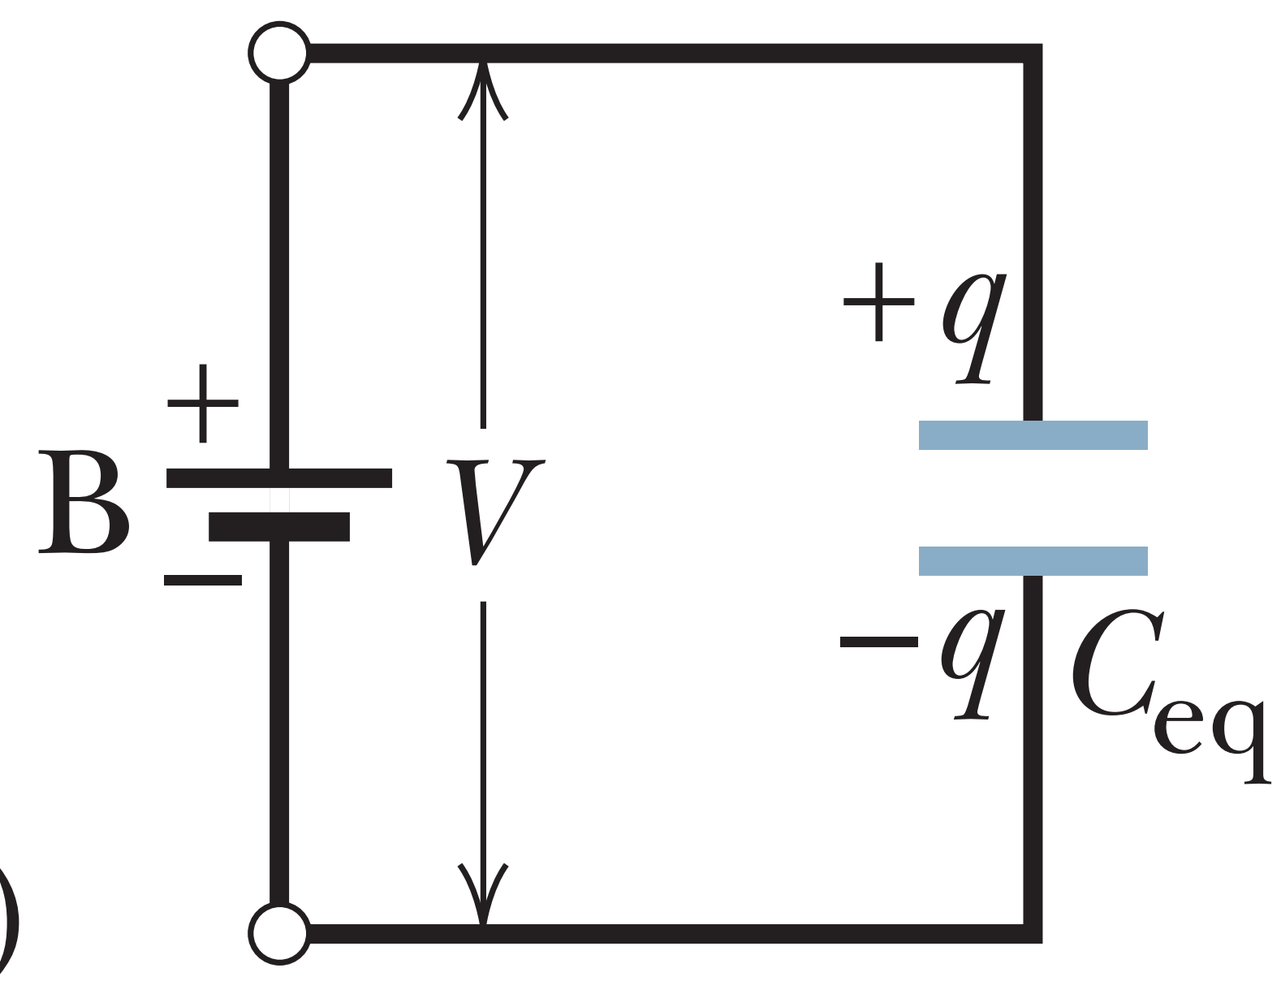
Capacitors in Parallel

Slide 16
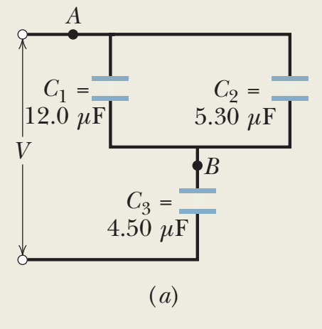

Slide 17
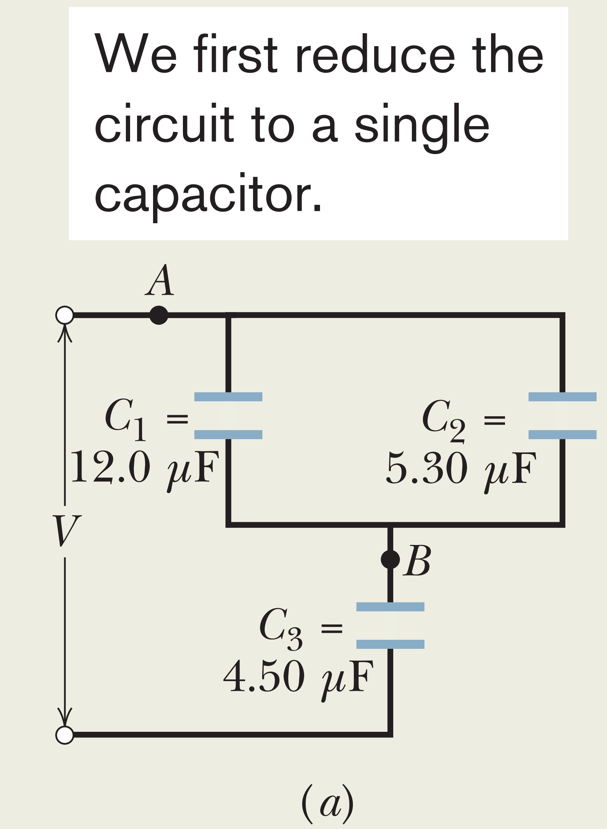
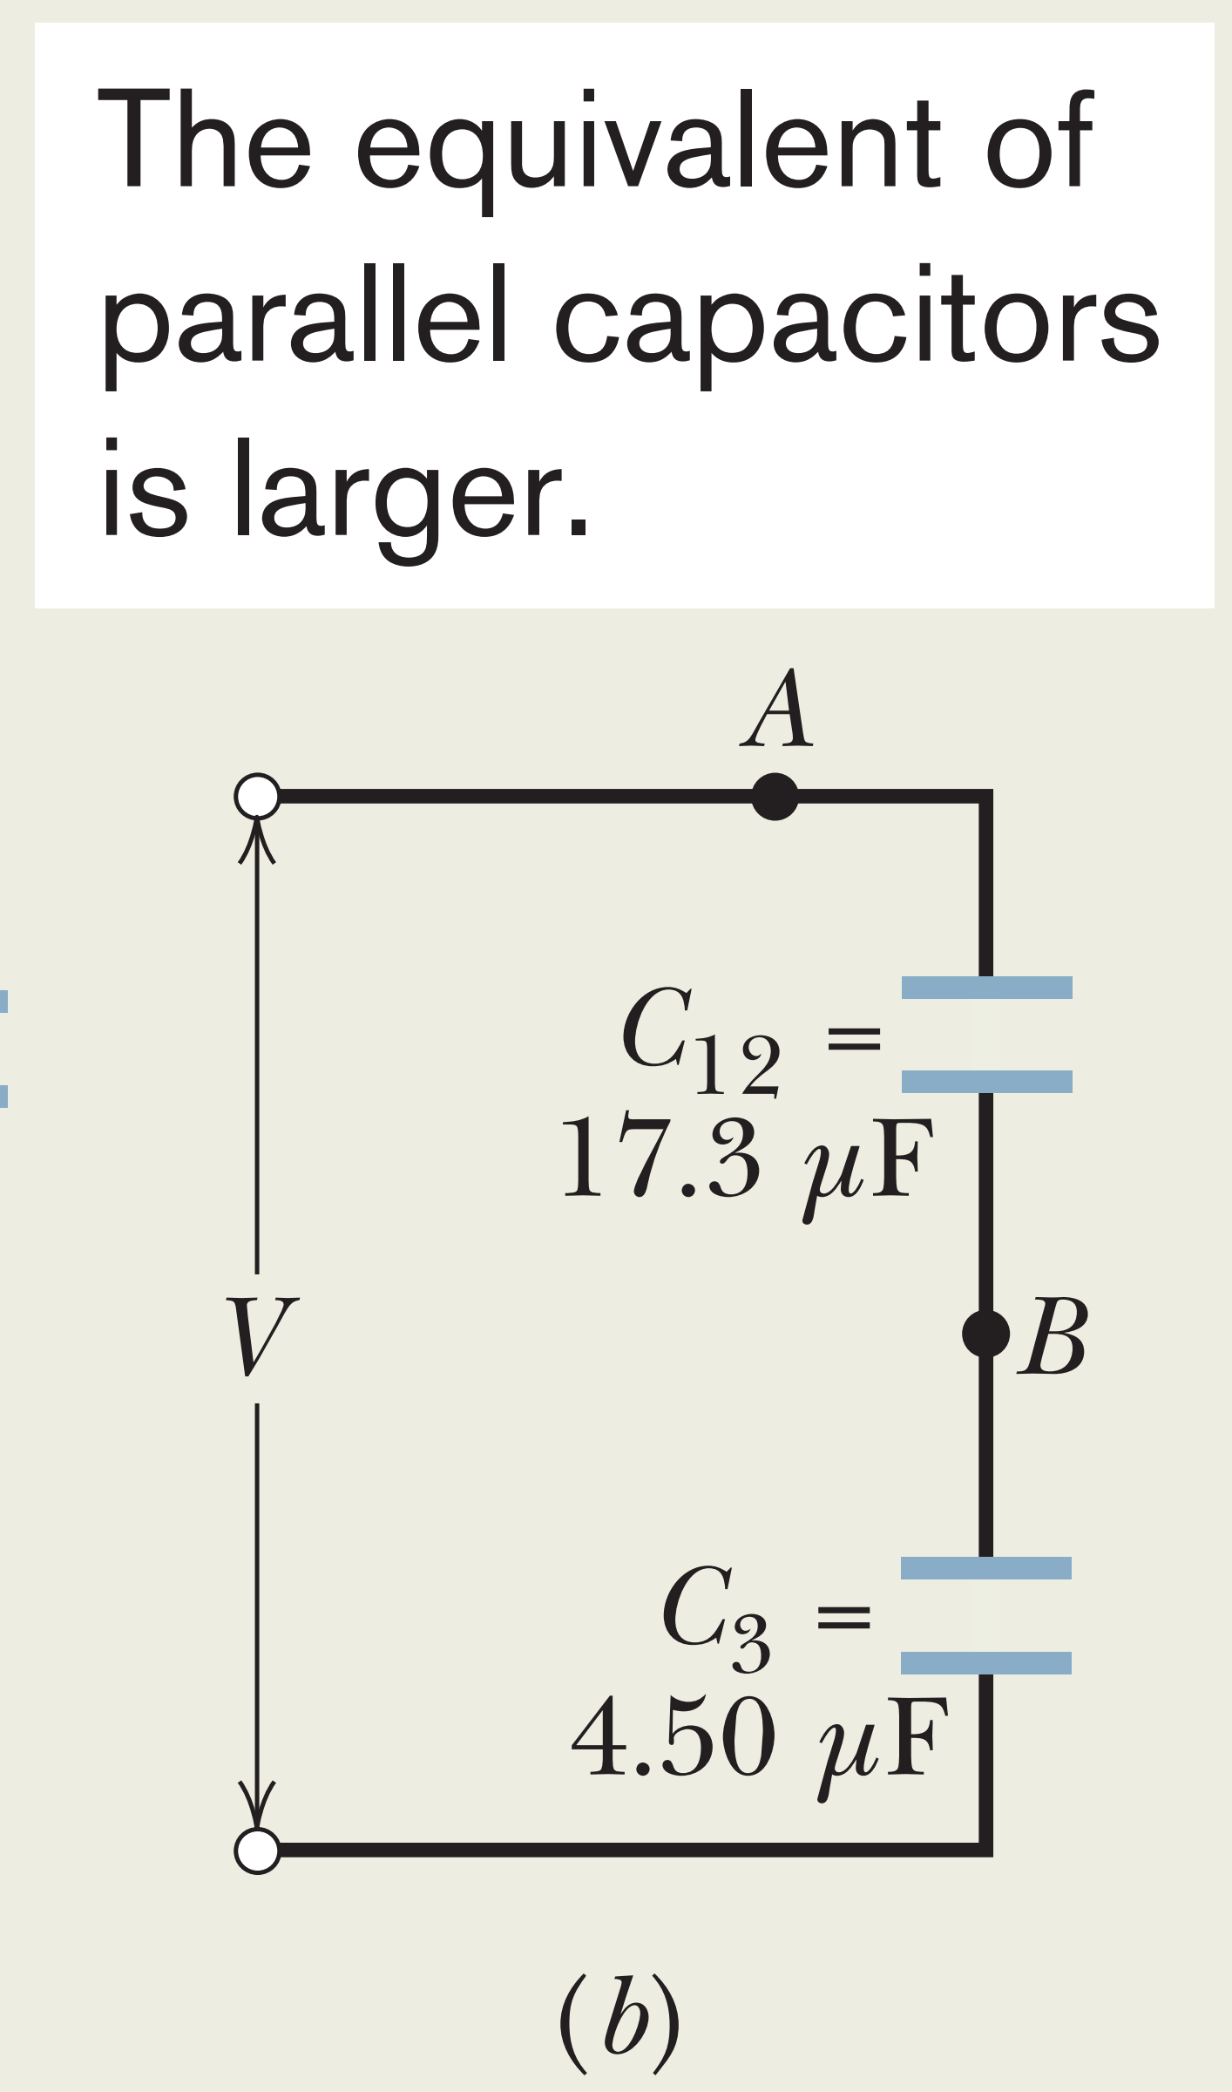
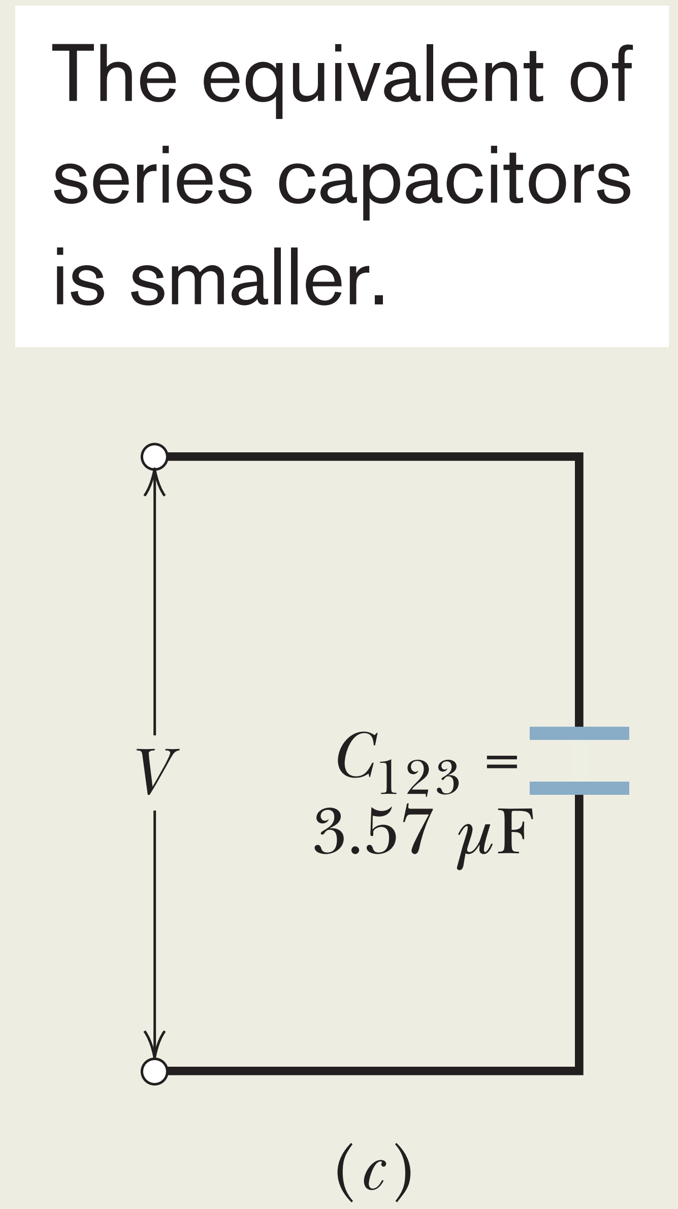
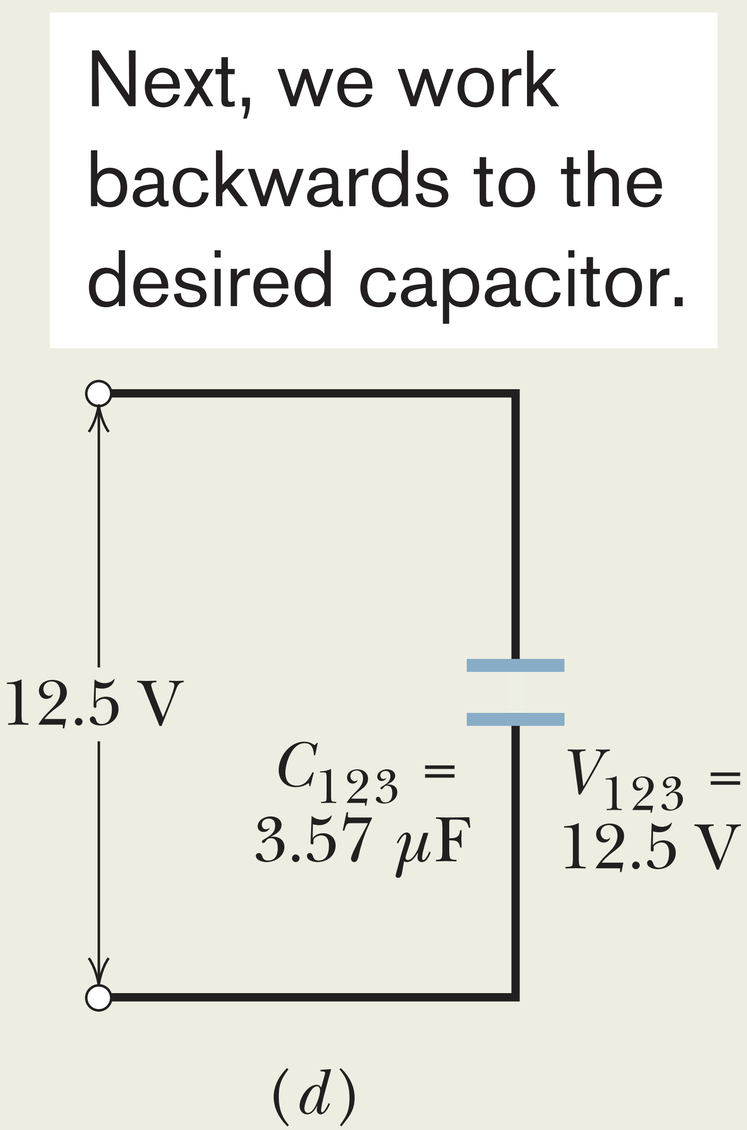
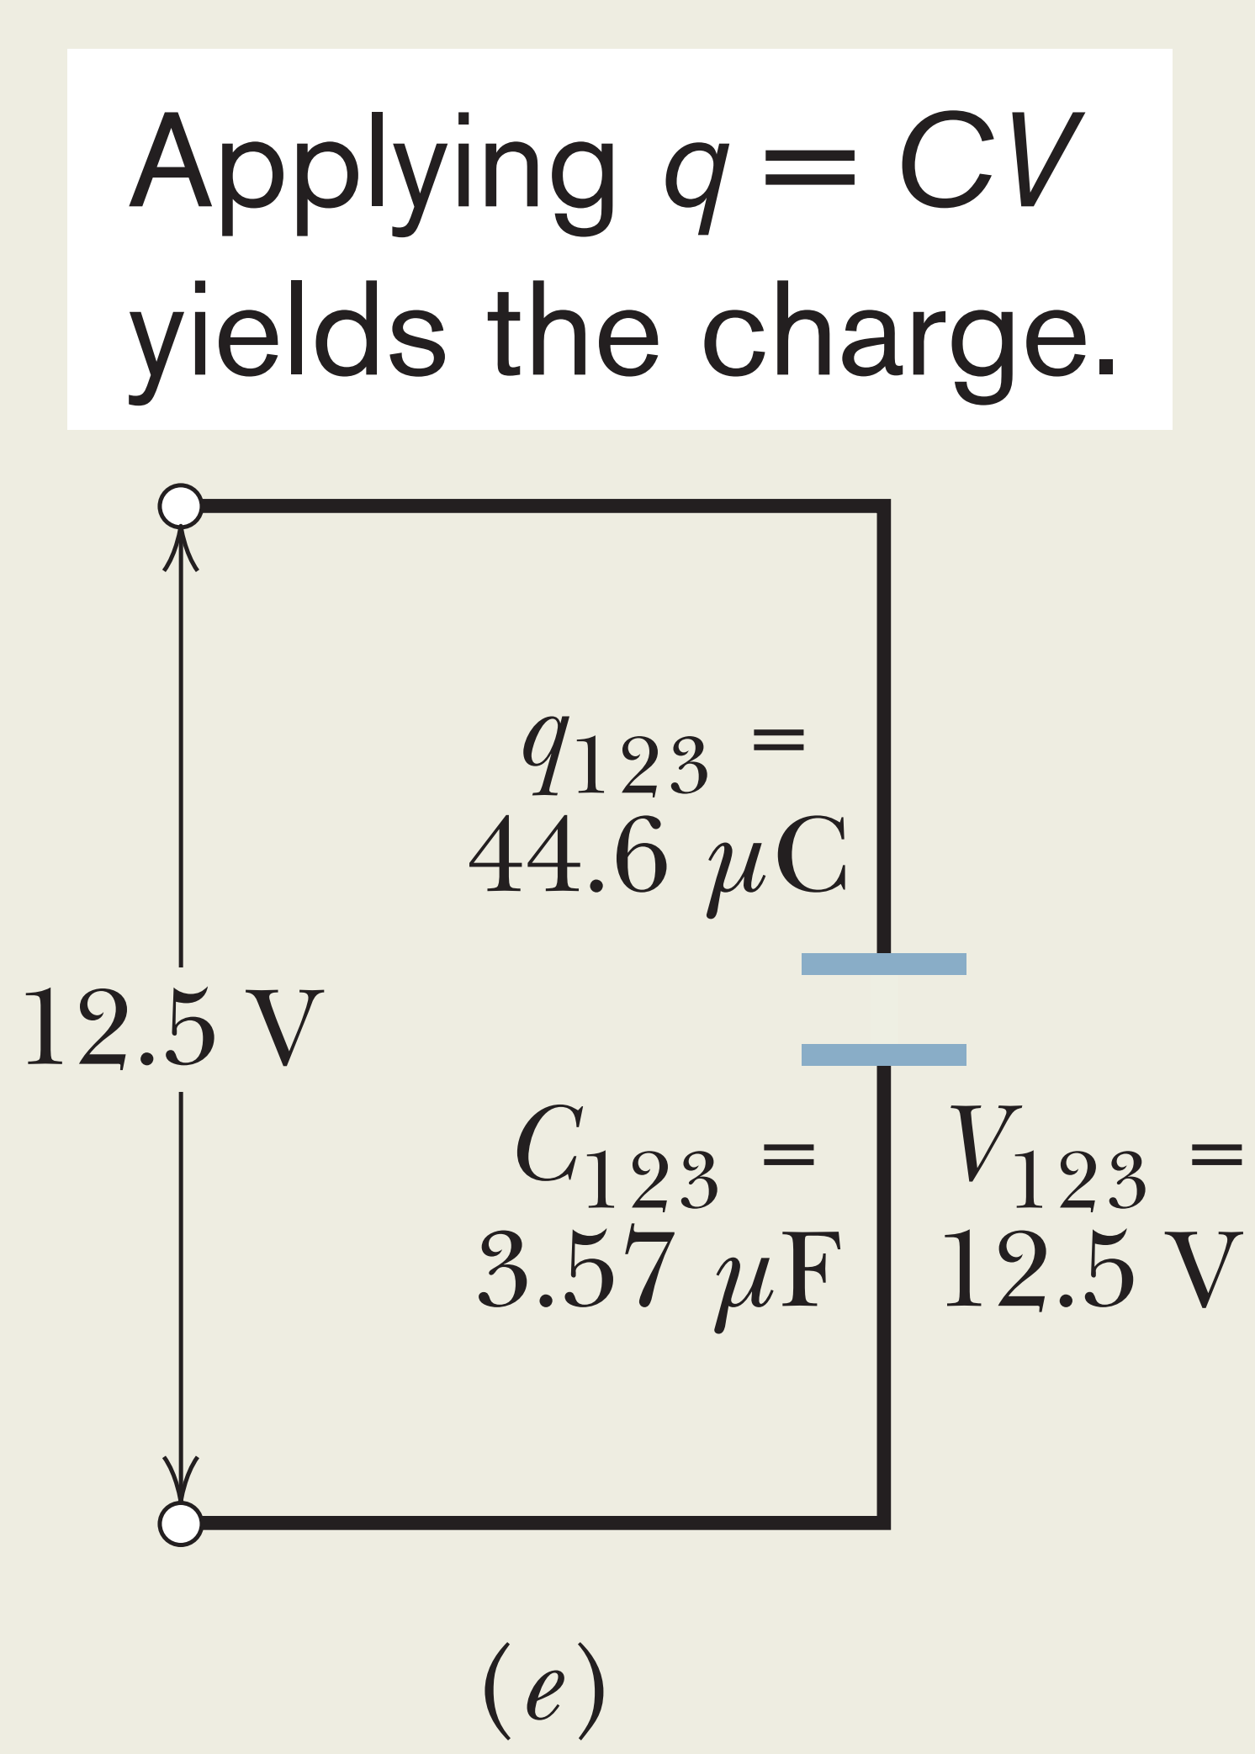
Sample Problem 25.02
$$\frac{1}{C_{123}}=\frac{1}{C_{12}}+\frac{1}{C_{3}}$$
$$C_{123}=3.57 μF$$
$$q_{123}=44.6 μC$$
$$V=12.5 V$$
$$V=V_{123}$$
$$C_{12}=C_{1}+C_{2}$$
$$C_{12}=12μF+5.3μC$$
$$\frac{1}{C_{123}}=\frac{1}{17.3 μF}+\frac{1}{4.5 μF}$$
$$C_{12}=17.3 μF$$

Slide 18
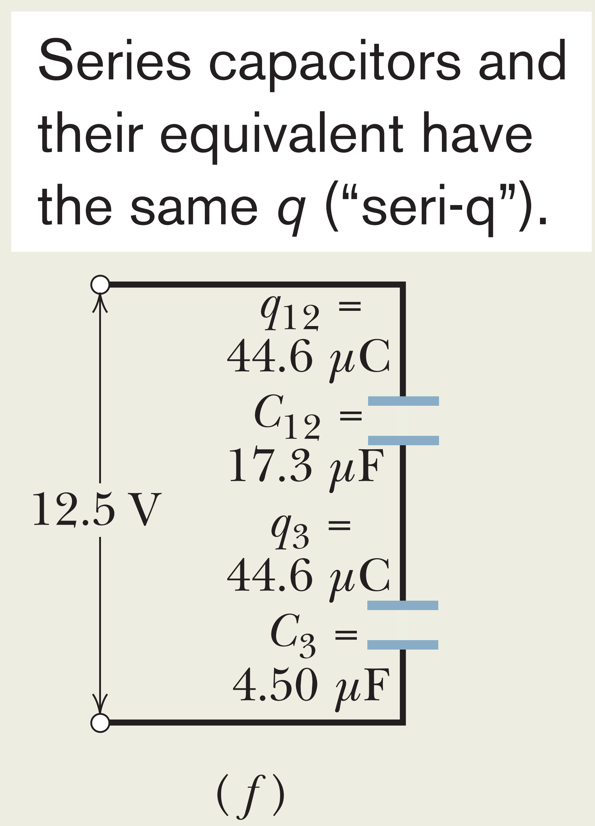
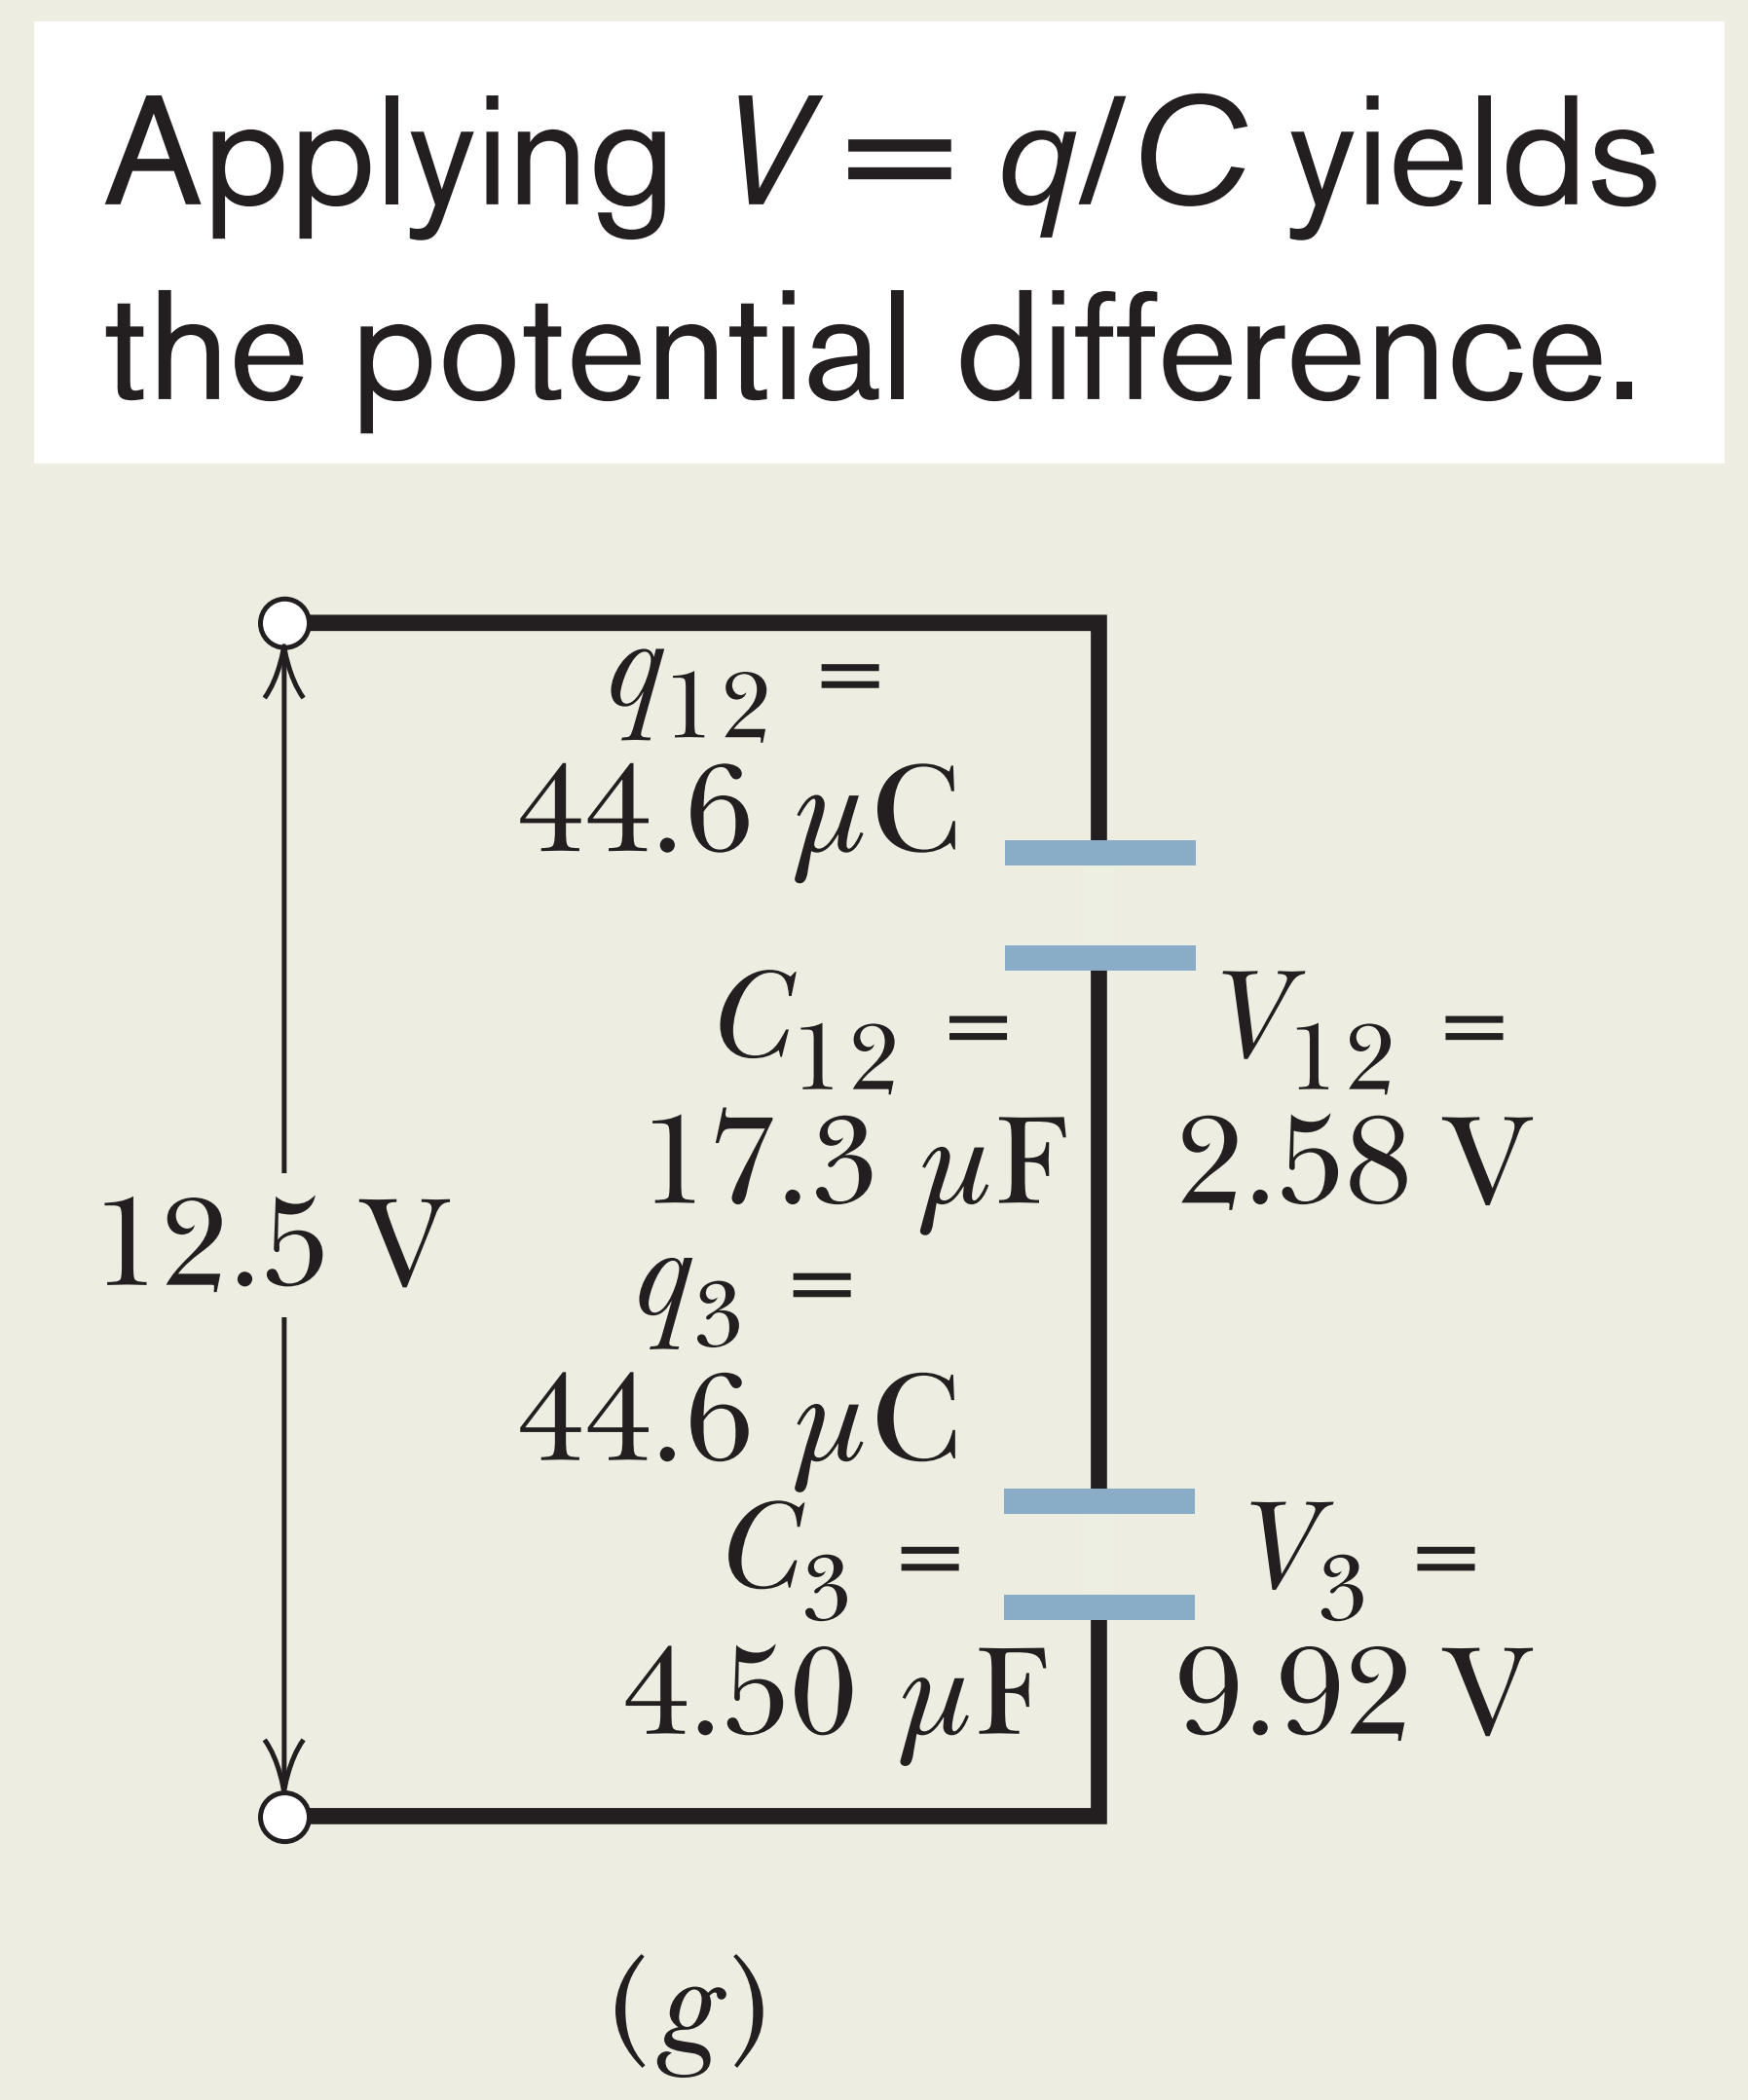
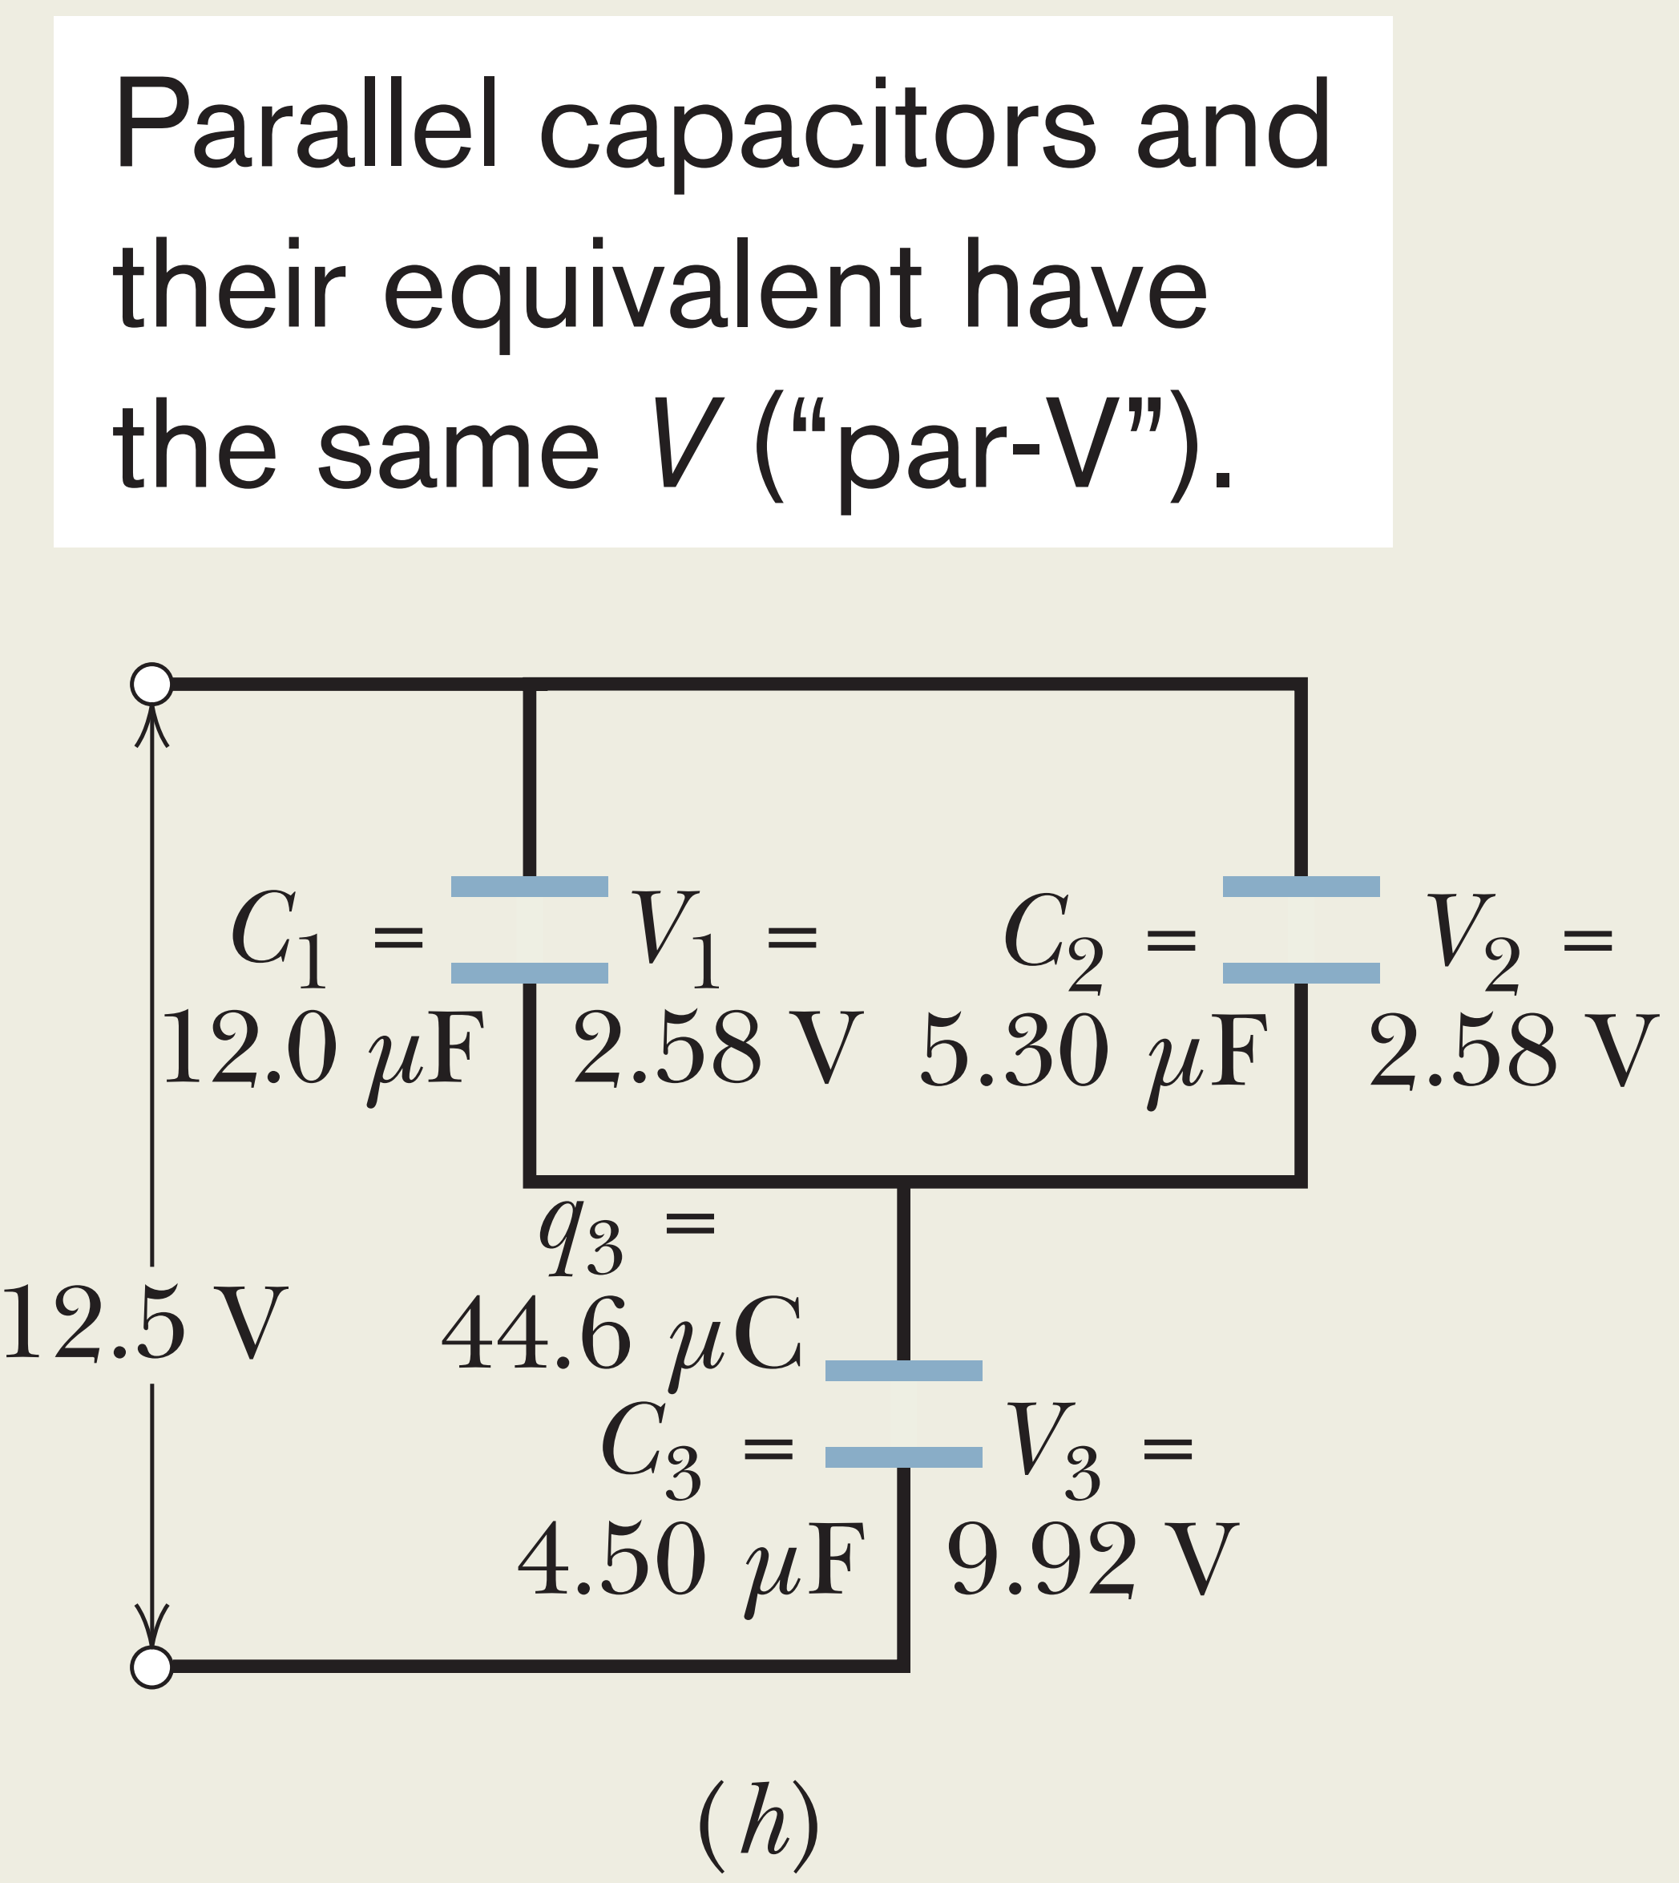
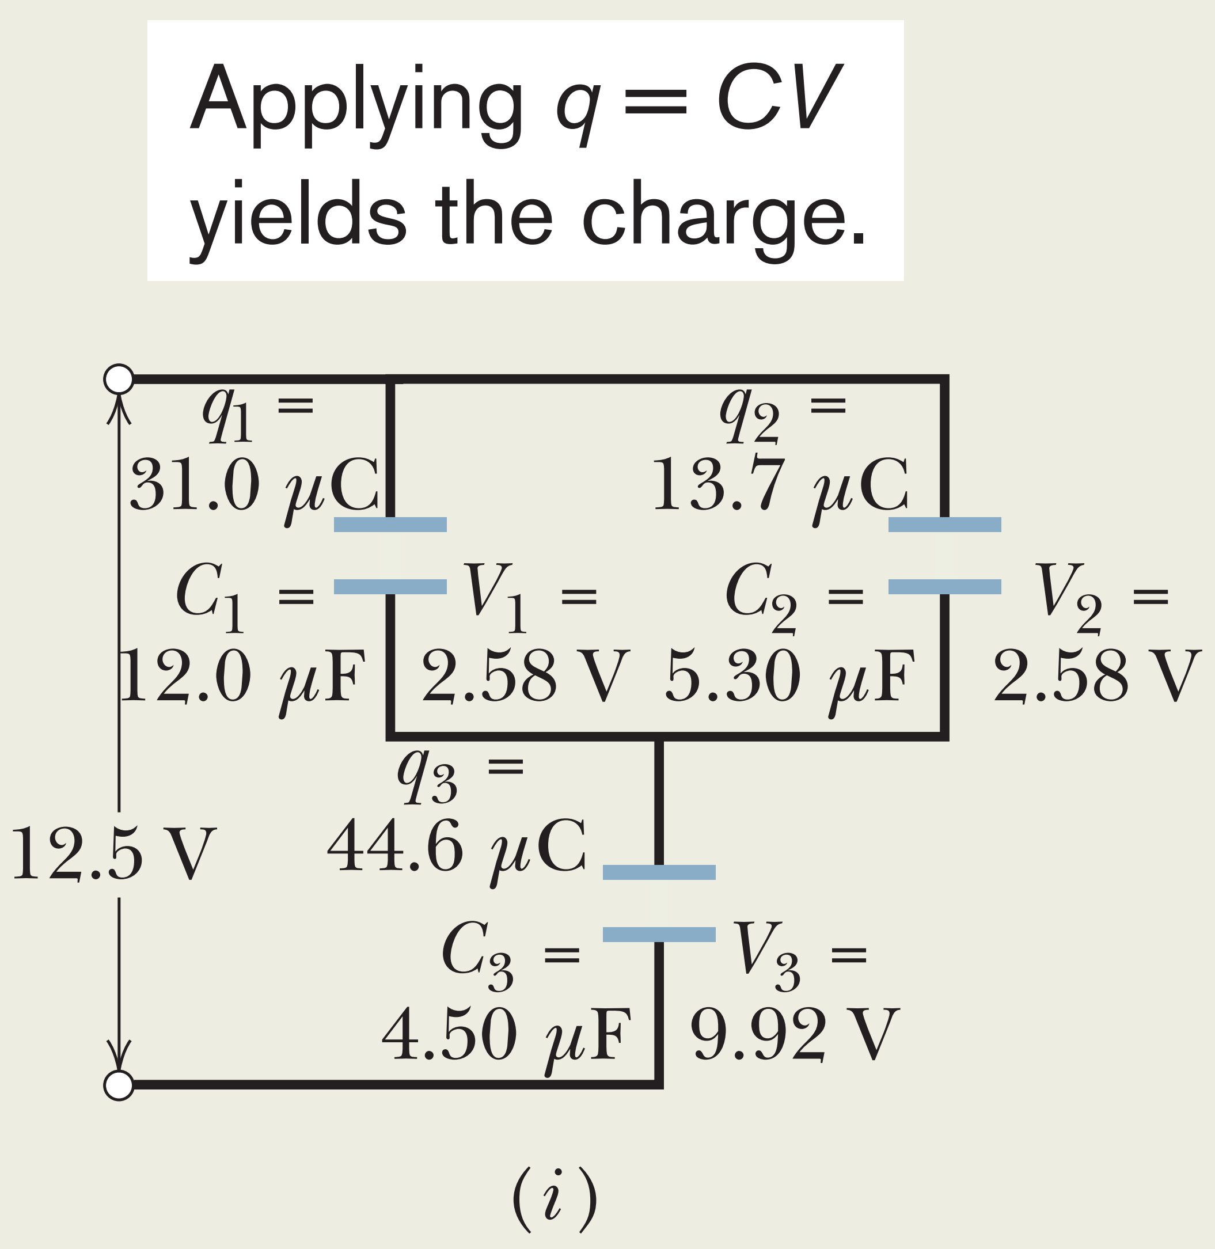
$$q_{123}=q_{12}=q_{3}$$
$$V_{12}=V_{1}=V_{2}$$
$$q_{1}=2.58 V×12 μF$$
$$V_{12}=\frac{44.6 μC}{17.3 μF}=2.58 V$$
$$q_{1}=V_{1}×C_{1}$$
$$q_{2}=2.58 V×5.30 μF$$
$$V_{12}=\frac{q_{12}}{C_{12}}$$
$$V_{3}=\frac{44.6 μC}{4.5 μF}=9.92 V$$
$$q_{2}=V_{2}×C_{2}$$
$$q_{3}=9.92 V×4.50 μF$$
$$V_{3}=\frac{q_{3}}{C_{3}}$$
$$q_{3}=V_{3}×C_{3}$$

Slide 19
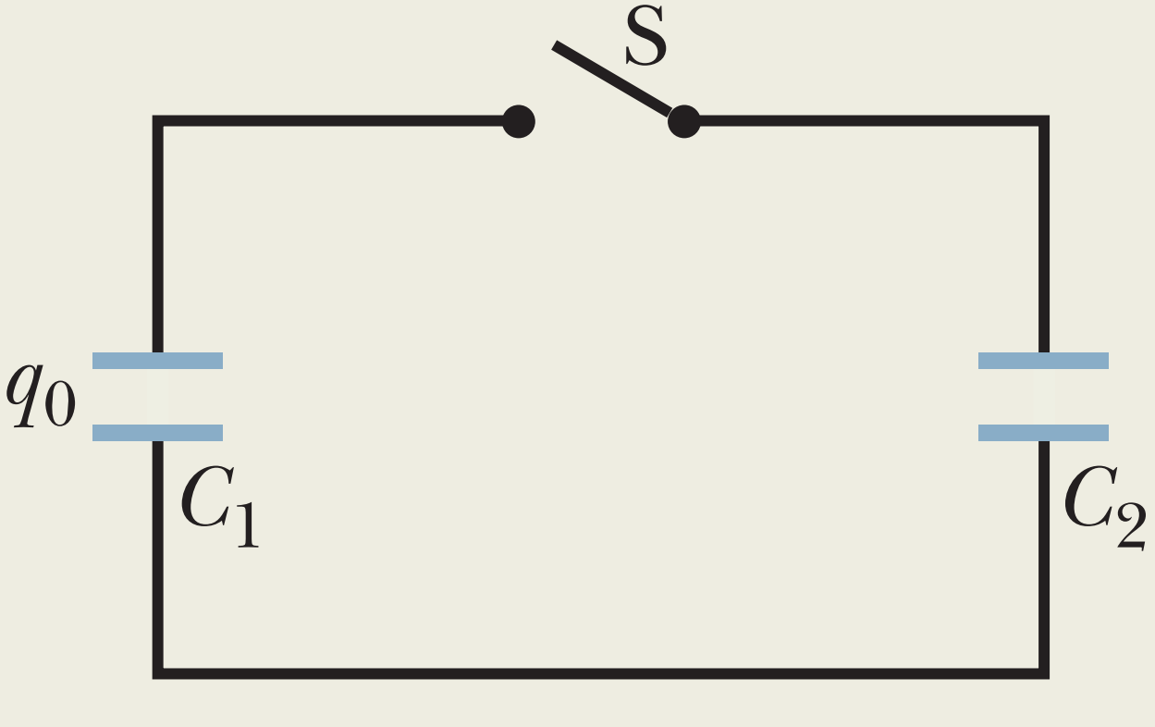
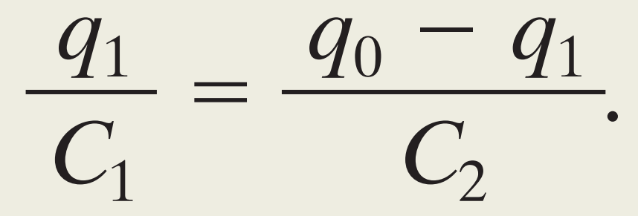
Sample Problem 25.03

Slide 20
6-3 THE AMMETER AND THE VOLTMETER
To measure the current in a wire, you usually have to break or cut the wire and insert the ammeter so that the current to be measured passes through the meter.
Ammeter,
Voltmeter,
To find the potential difference between any two points in the circuit, the voltmeter terminals are connected between those points without breaking or cutting the wire.
$R_{A}$ of the ammeter most be very much smaller than other resistances in the circuit.
$R_{V}$ of a voltmeter most be very much larger than the resistance of any circuit element across which the voltmeter is connected.

Slide 21
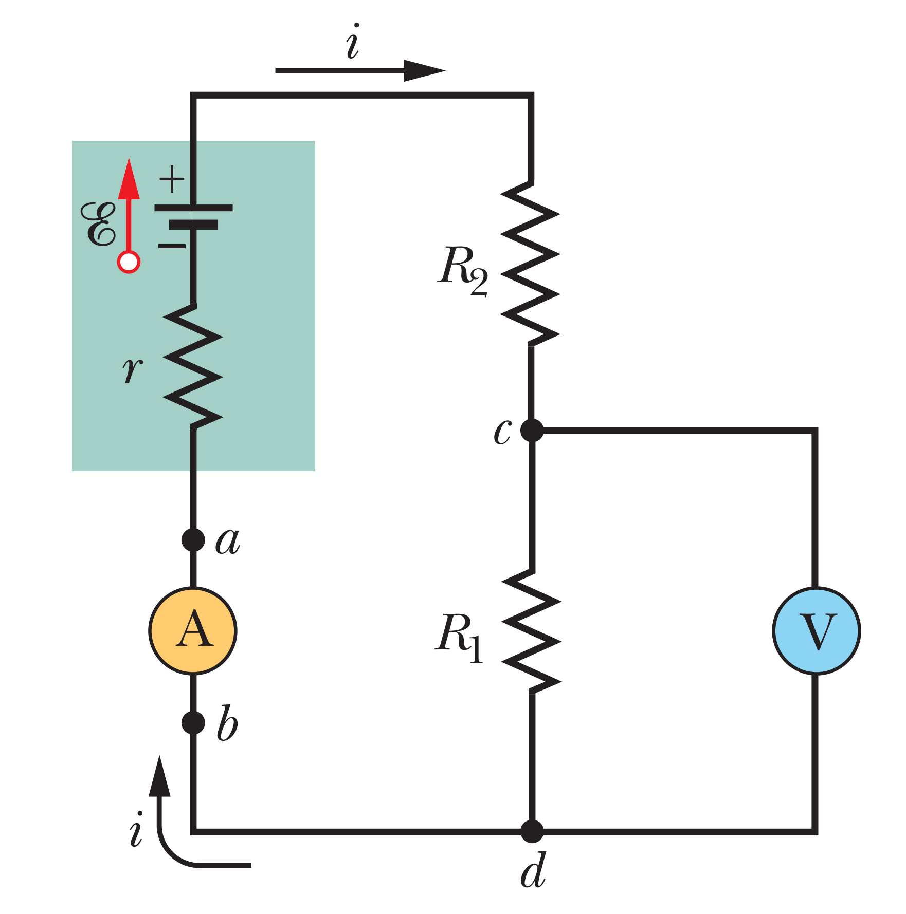

Slide 22
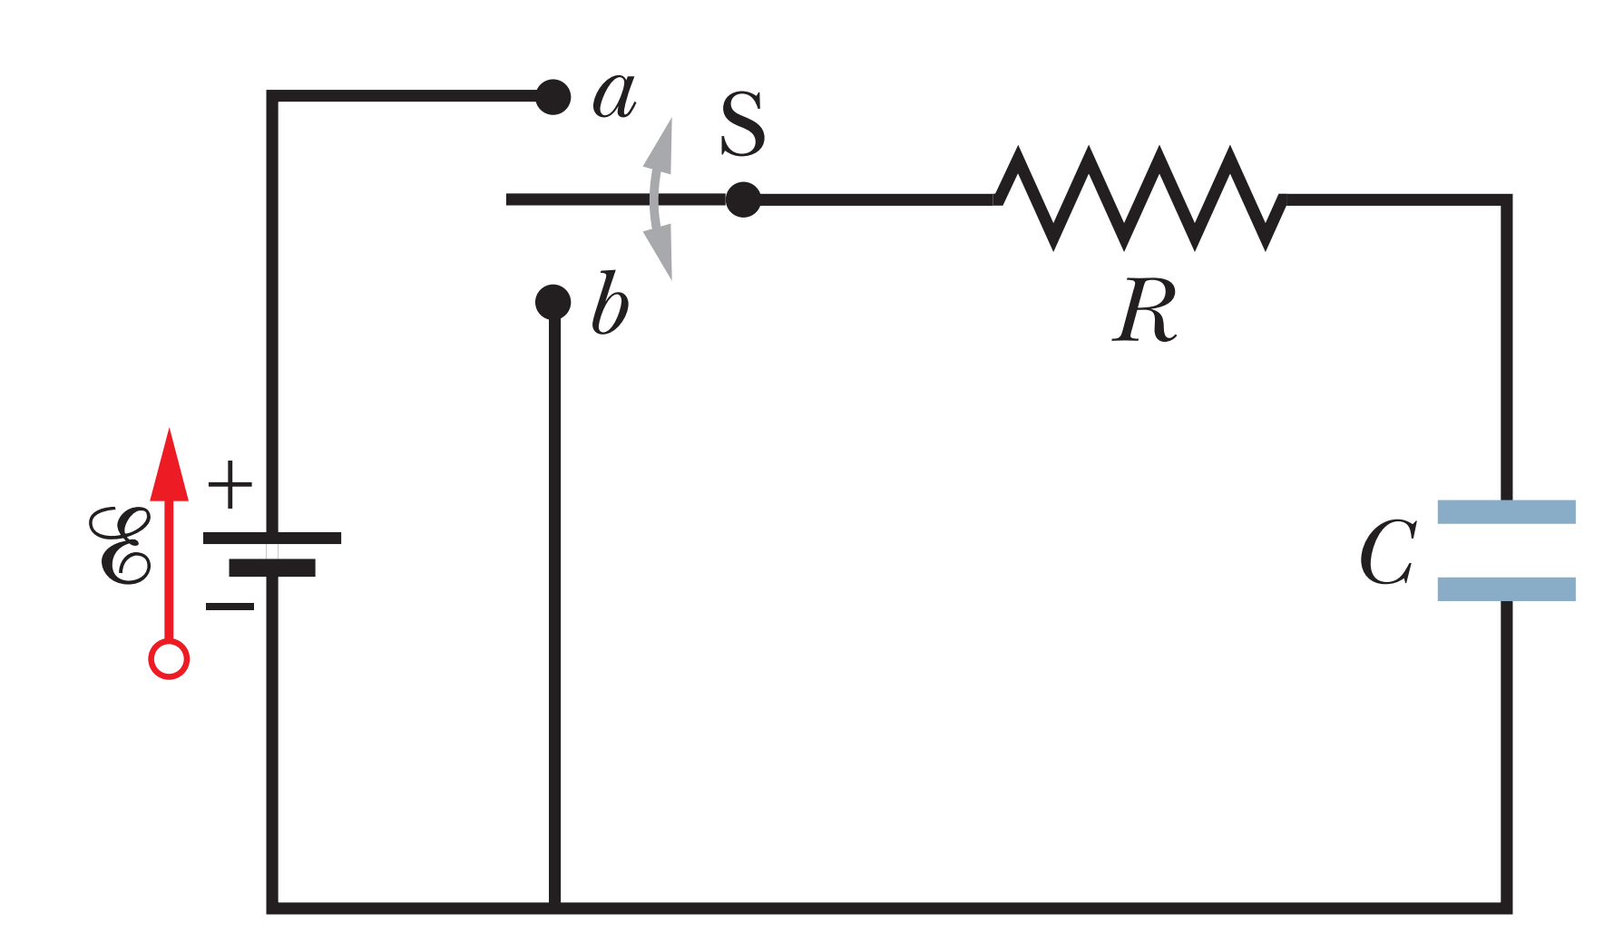
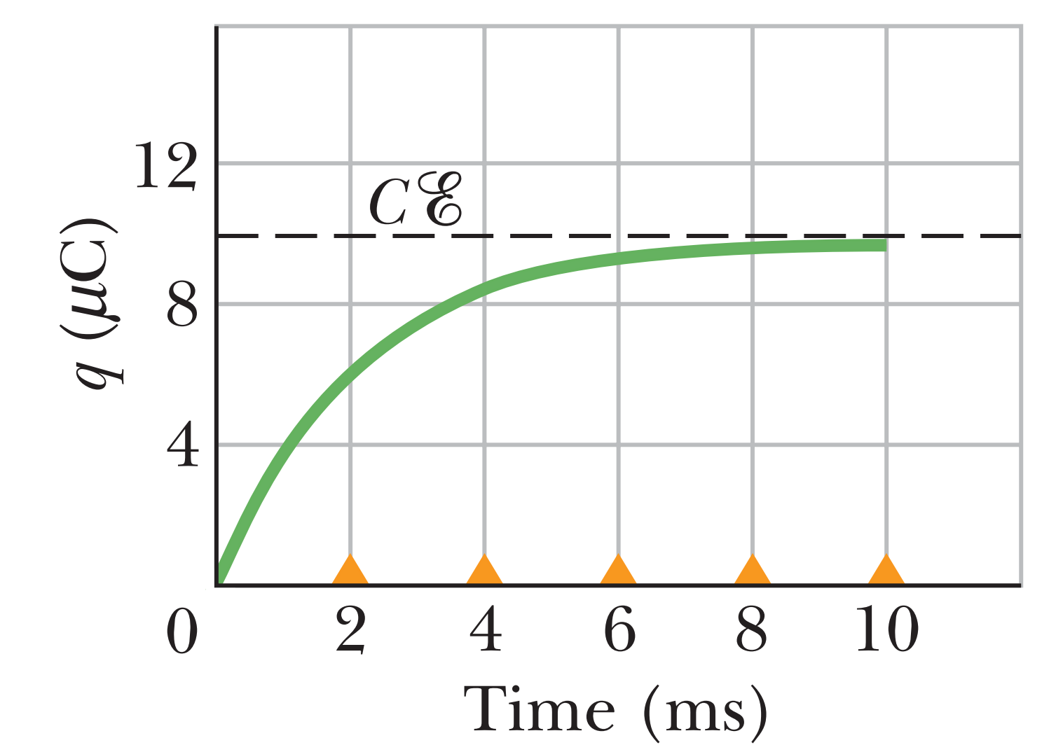
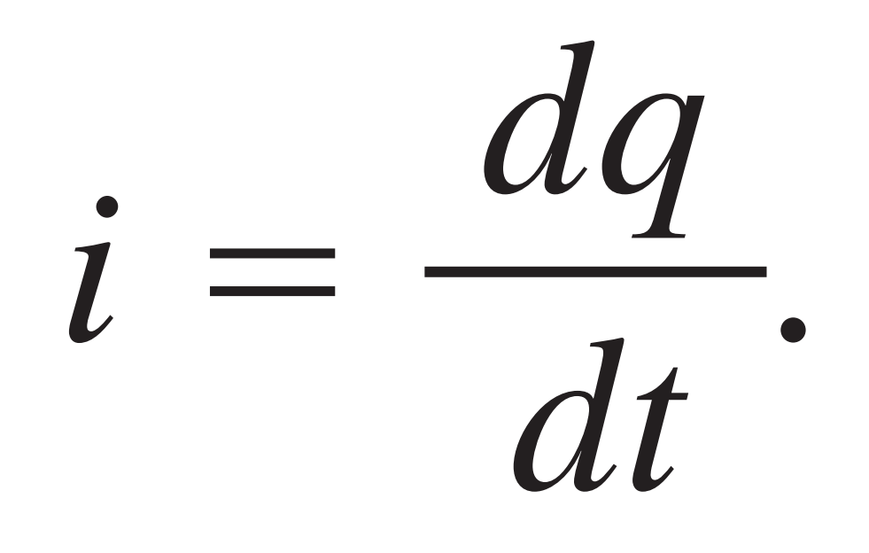
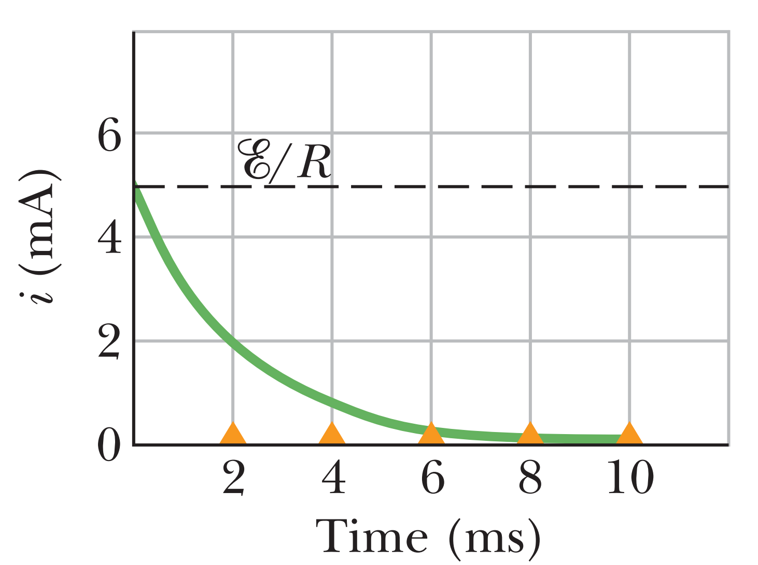
RC Circuits
Charging a Capacitor
Here we want to examine the charging process. In particular we want to know how the charge q(t) on the capacitor plates, the potential difference VC(t) across the capacitor, and the current i(t) in the circuit vary with time during the charging process. We begin by applying the loop rule to the circuit,
$q$=
Substitute
When $t$ goes infinite
$$i=$$
When $t=0$ initial ($i=ξ/R)$

Slide 24
The Time Constant
The product RC that appears in above equations has the dimensions of time (both because the argument of an exponential must be dimensionless and because, in fact,$1Ω×1 F=1s$). The product RC is called ‘the capacitive time constant(τ)’ of the circuit and is represented with the symbol $τ$:
at time $t=τ=RC$ the charge on the initially uncharged capacitor

Slide 25
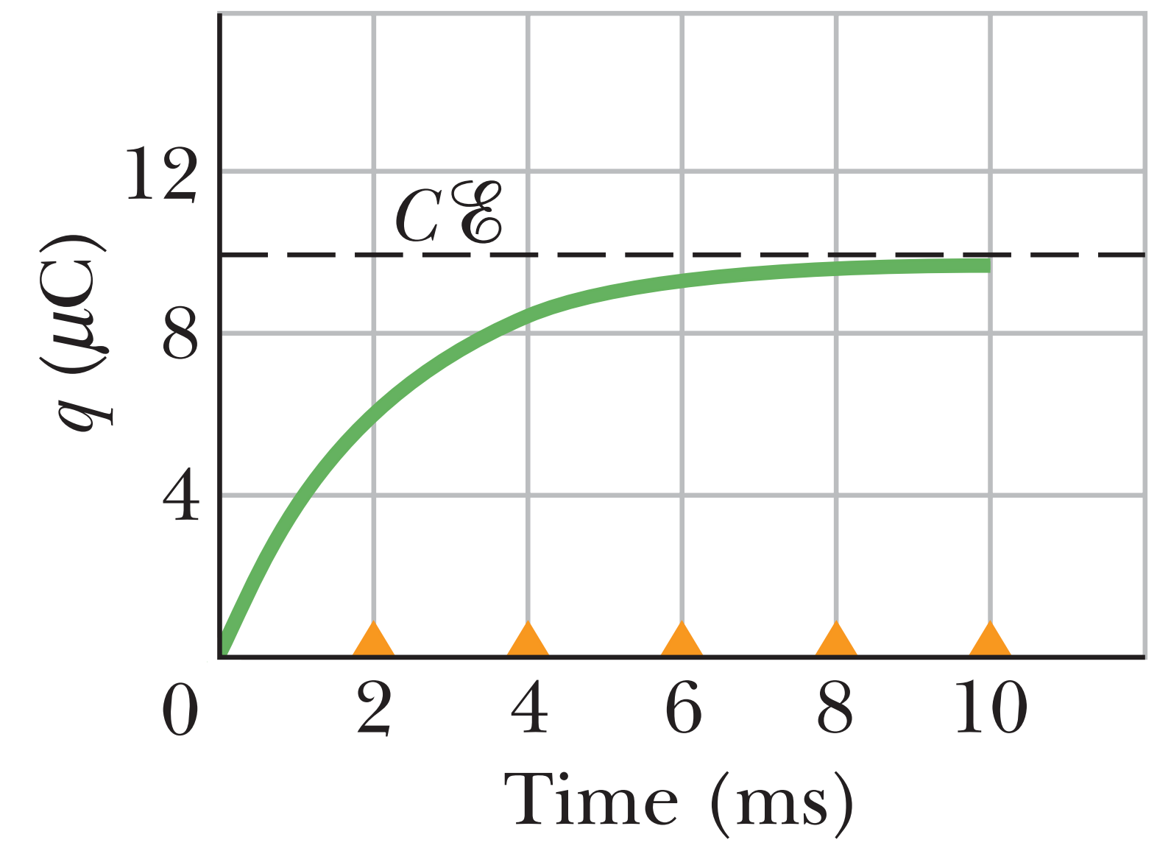
In words, during the first time constant $τ$ the charge has increased from zero to 63% of its final value (full) $Cξ$.
The small triangles in figure along the time axes mark successive intervals of one time constant ($τ=RC)$ during the charging of the capacitor. In figure, the circuit with $τ=2 ms$ charges quickly while one with $τ=10 ms$ charges much more slowly
How the plot will be for $τ=10 ms$ ?

Slide 26
Discharging a Capacitor
The differential equation describing q(t) is like previous equation except that now, with no battery in the discharge loop, $ξ=0$.
tells us that q decreases exponentially with time, at a rate that is set by the capacitive time constant $τ=RC$. At time $t=τ$, the capacitor’s charge has been reduced to $q_{o}e^{−1}$, or about 37% of the initial value. Note that a greater t means a greater discharge time.

Slide 27
This tells us that the current also decreases exponentially with time, at a rate set by $τ$. The initial current $i_{o}$ is equal to $q_{o}/RC$.

Slide 28
The end of Ch.5

Slide 29
C1
C2

Slide 30
1
2
$$3μF$$
$$1μF$$
$$6μF$$
3
$$2μF$$
$$4μF$$
4
5
$$5 V$$

