Slide 1
Finding Area by integration:

Slide 3
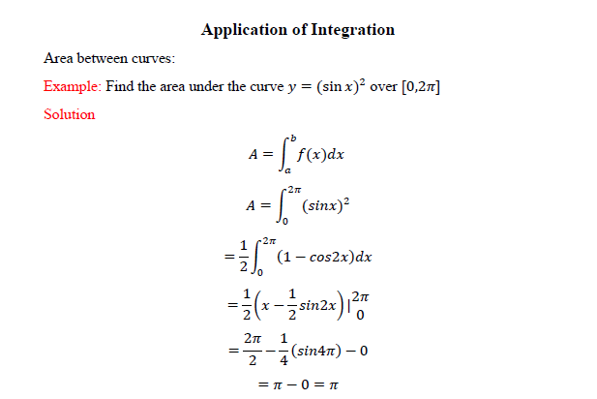

Slide 6
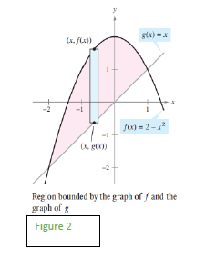

Slide 7
