Slide 1
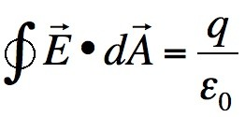
Chapter Three
Gauss’ Law
Gauss’ law relates the electric field at points on a closed surface (real or imaginary, said to be a Gaussian surface) to the net charge enclosed by that surface.

Slide 2
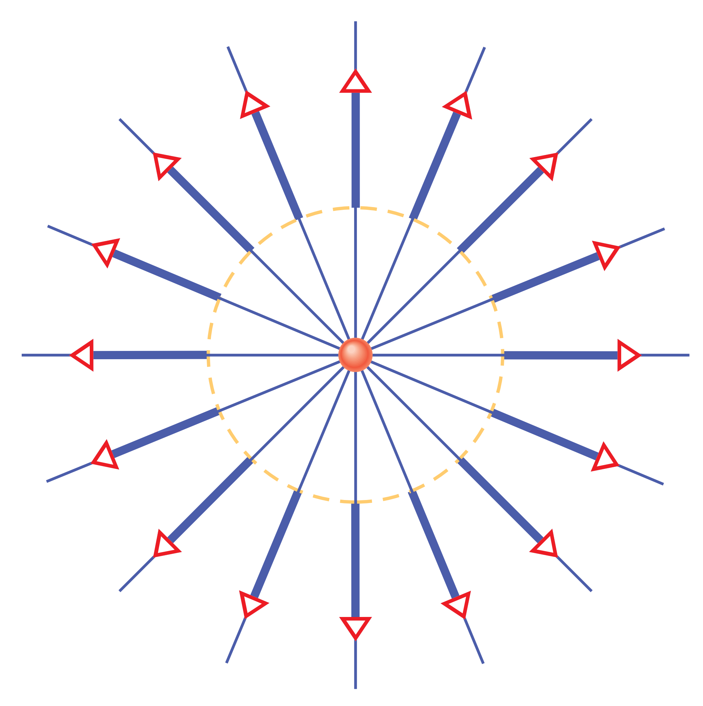
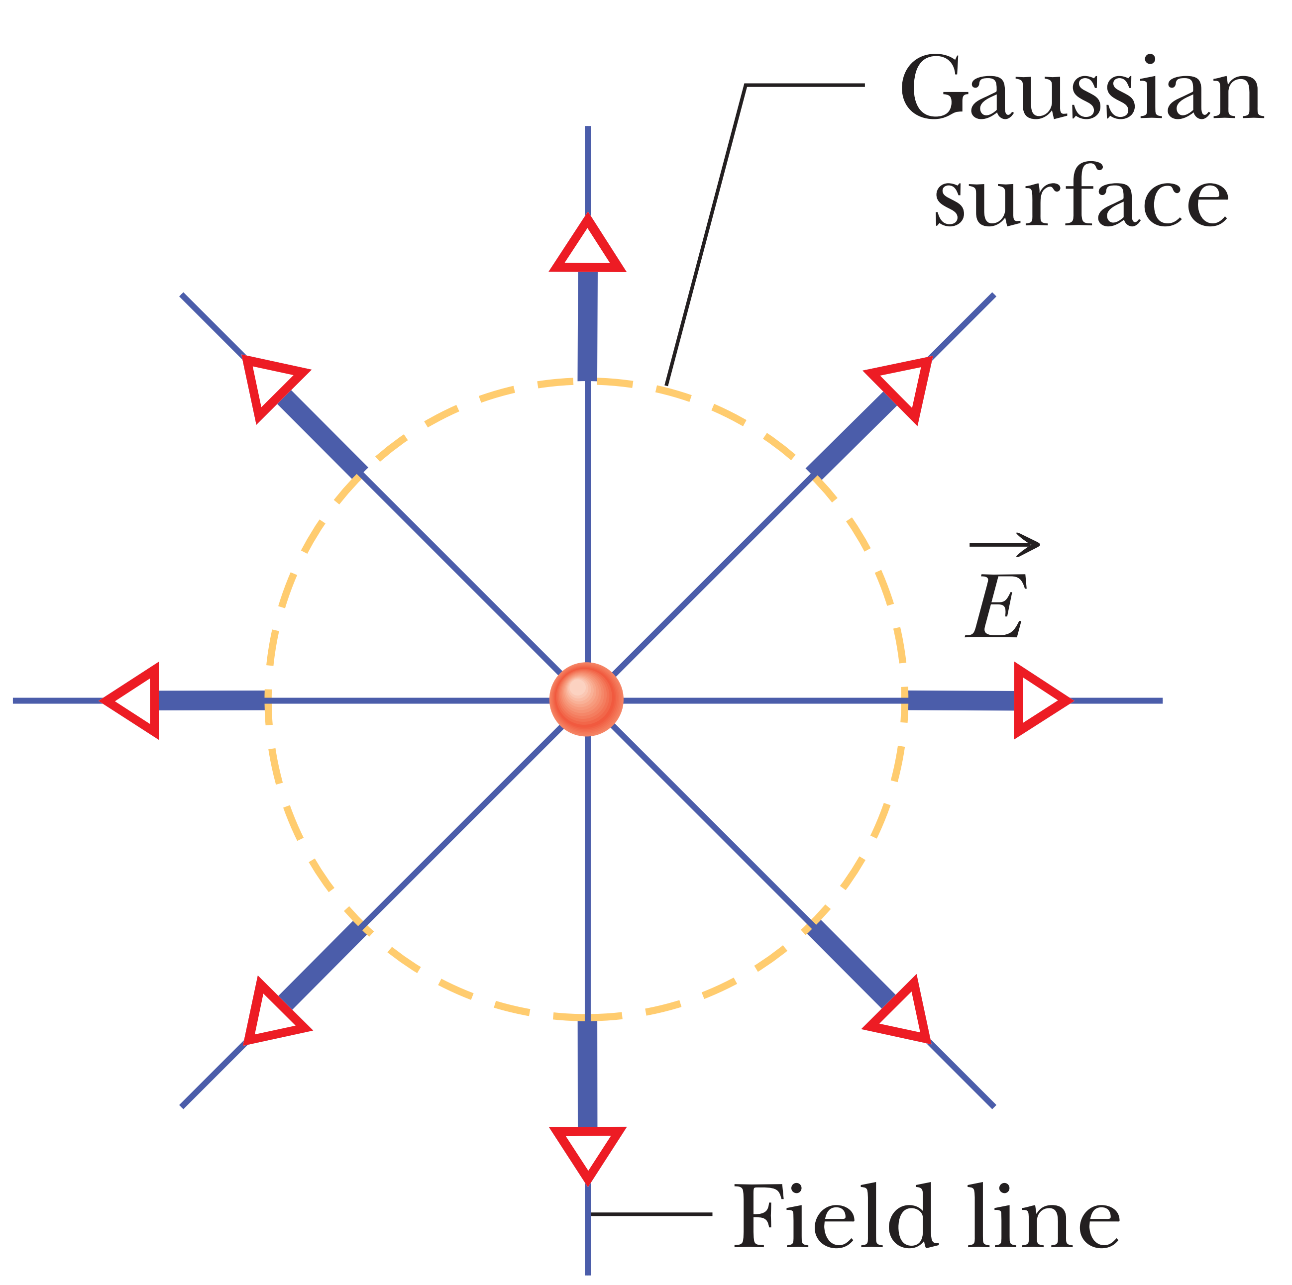
A particle with charge +Q that is surrounded by an imaginary concentric sphere. At points on the sphere (said to be a Gaussian surface), the electric field vectors have a moderate magnitude (given by E = kQ/r2 ) and point radially away from the particle. The electric field lines are also outward and have a moderate density. We say that the field vectors and the field lines pierce the surface.
+2Q
+Q
The magnitude of the field vectors piercing outward through the (same) Gaussian surface is twice as much as
However, we need a quantitative way of determining how much electric field pierces a surface. That measure is called the electric flux.

Slide 3
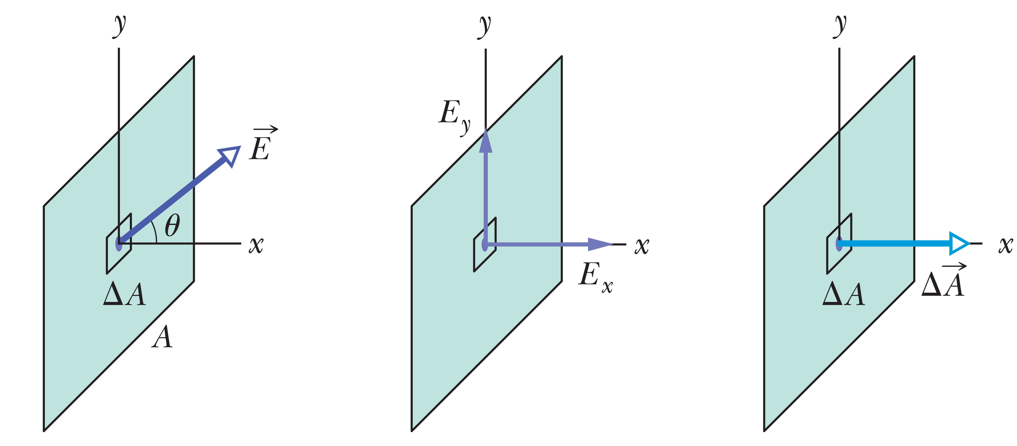
Electric Flux
We begin with a flat surface with area A in a uniform electric field .
$$\vec{E}$$
$$E_{x}=E cosθ$$
$$E_{x}=E cosθ$$
$$E_{y}=E sinθ$$
$$E_{y}=E sin0=0$$
The amount of electric field piercing the patch is defined to be the electric flux $(ΔΦ)$ through it :
$$ΔΦ=\left(Ecosθ\right) ∆A$$
uniform field, flat surface

Slide 4
We can rewrite this statement in another way which will have the only piercing component. Define an area vector that is perpendicular to the patch and that has a magnitude equal to the area A of the patch . Then we can write
$$∆Φ=\vec{E}.∆\vec{A}$$
The dot product automatically gives us the component of $\vec{E}$ that is parallel to $∆\vec{A}$and thus piercing the patch
To find the total flux through the surface, we sum the flux through every patch on the surface:
$$\vec{E}$$
$$Φ=\sum{\vec{E}}.∆\vec{A}$$
we transform the summation into an integral
$Φ=\int{\vec{E}.d\vec{A}}$ (total flux)
$$\frac{N}{C}.m^{2}$$
dot product= $A.B$
cross product= $A×B$

Slide 5
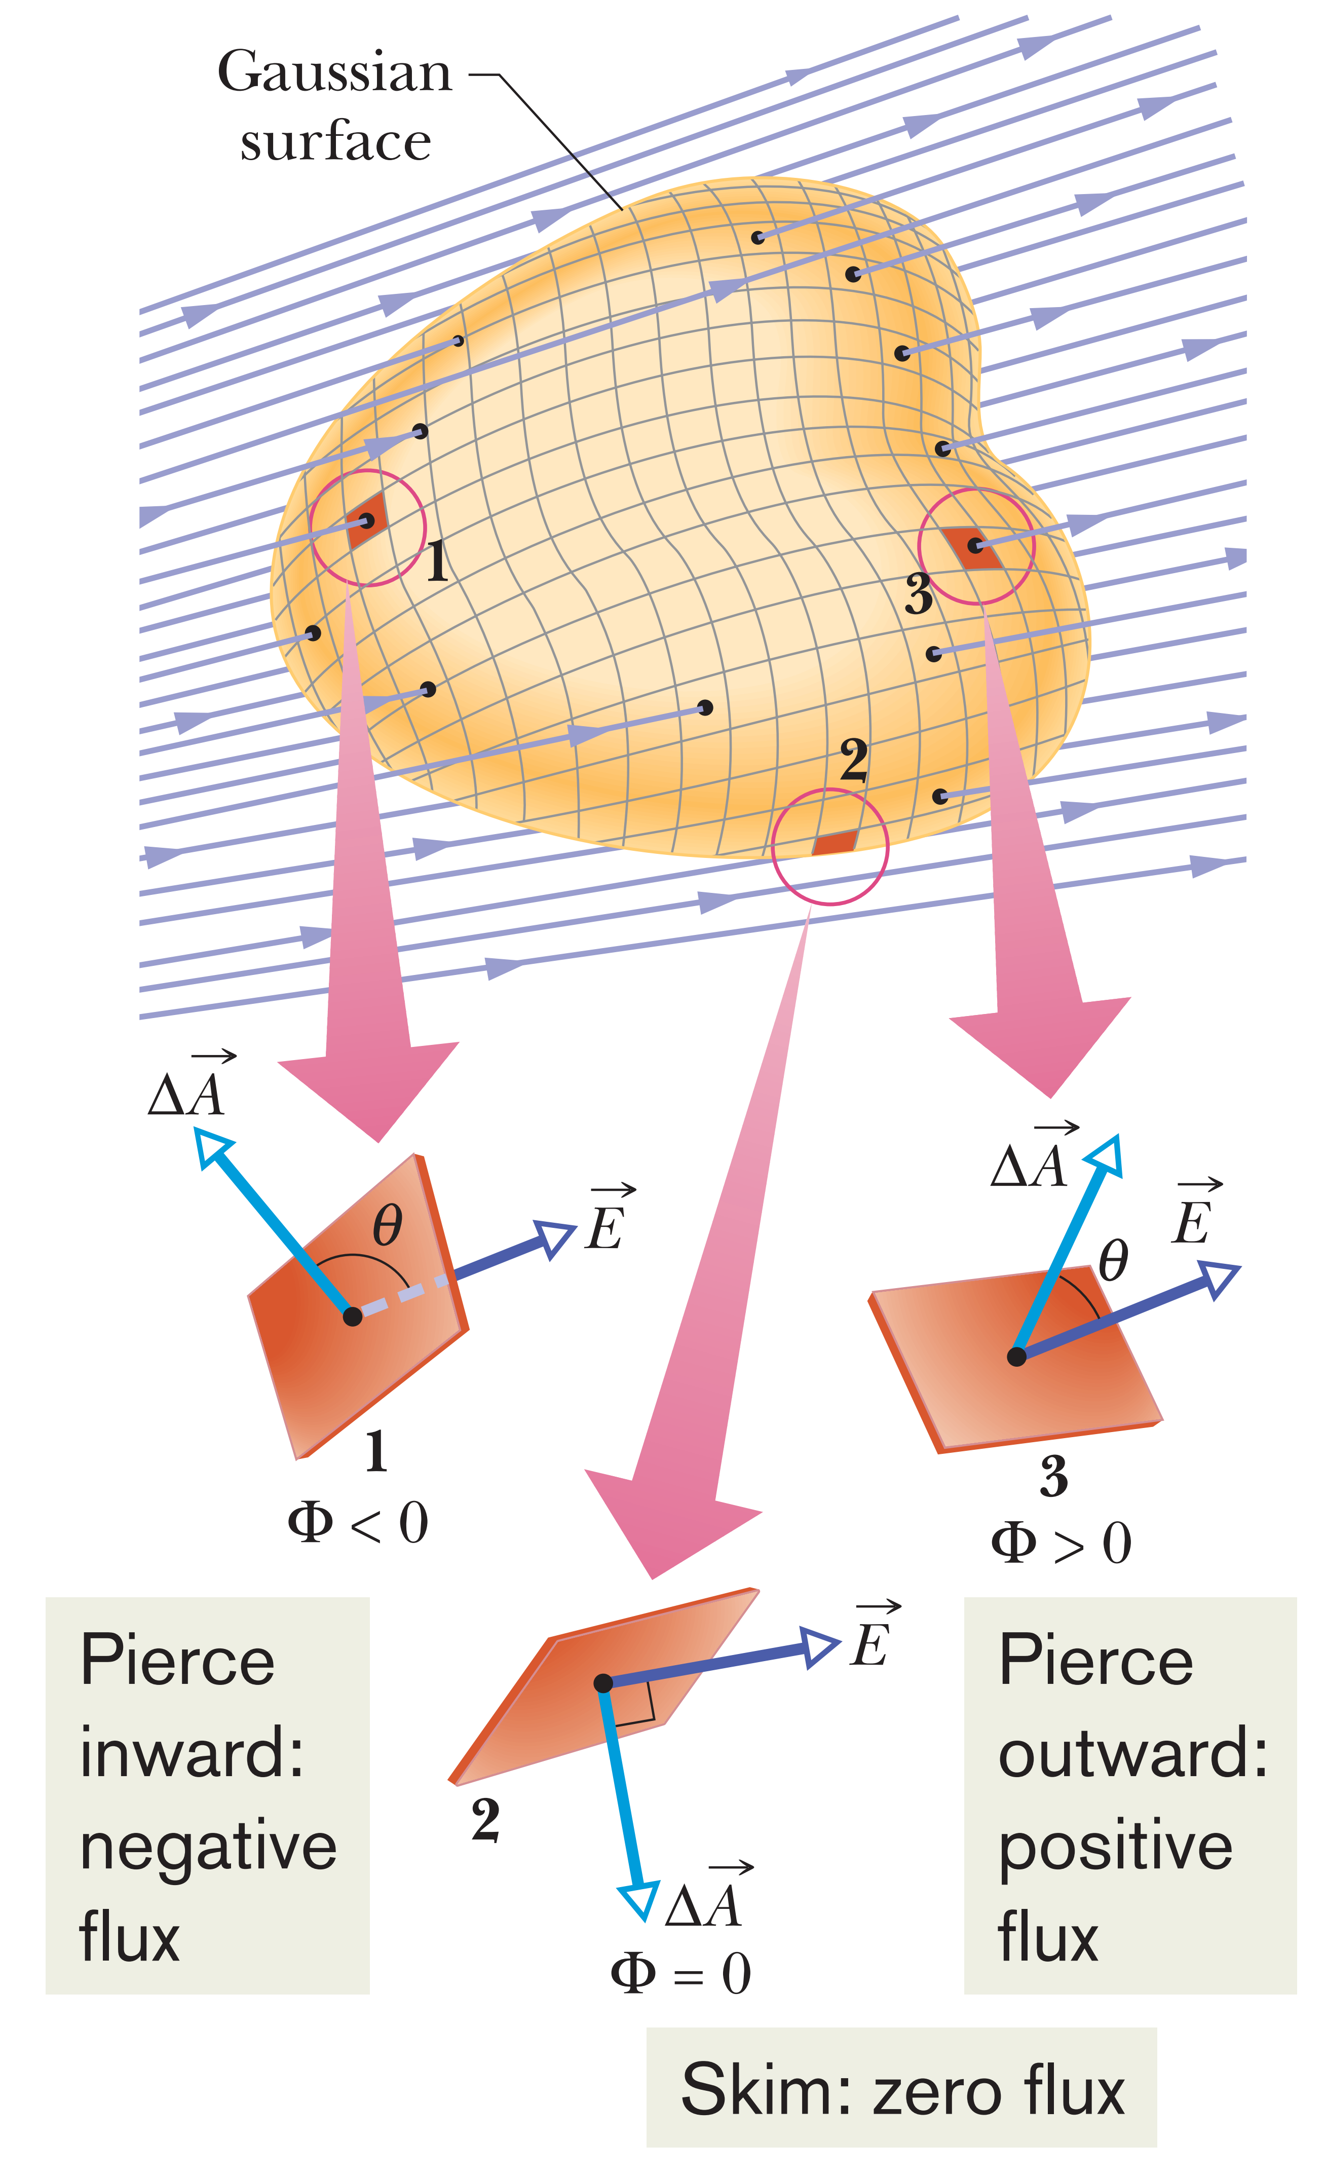
Closed Surface and directions
The closed surface in figure that sits in a nonuniform electric field.
Now we are interested in not only the piercing components of the field but also on whether the piercing is inward or outward
If $∆\vec{A} ⇉\vec{E}(θ=0^{o})$, flux is positive ($ΔΦ=\left(Ecosθ\right) ∆A$) and outward field vector.
The angle between $∆\vec{A}⇆\vec{E} (θ={180}^{o})$, flux is negative and inward field vector.
The angle between $∆\vec{A}→↑\vec{E} (θ={90}^{o})$, flux is zero and field vector skims the surface (no piercing).

Slide 6
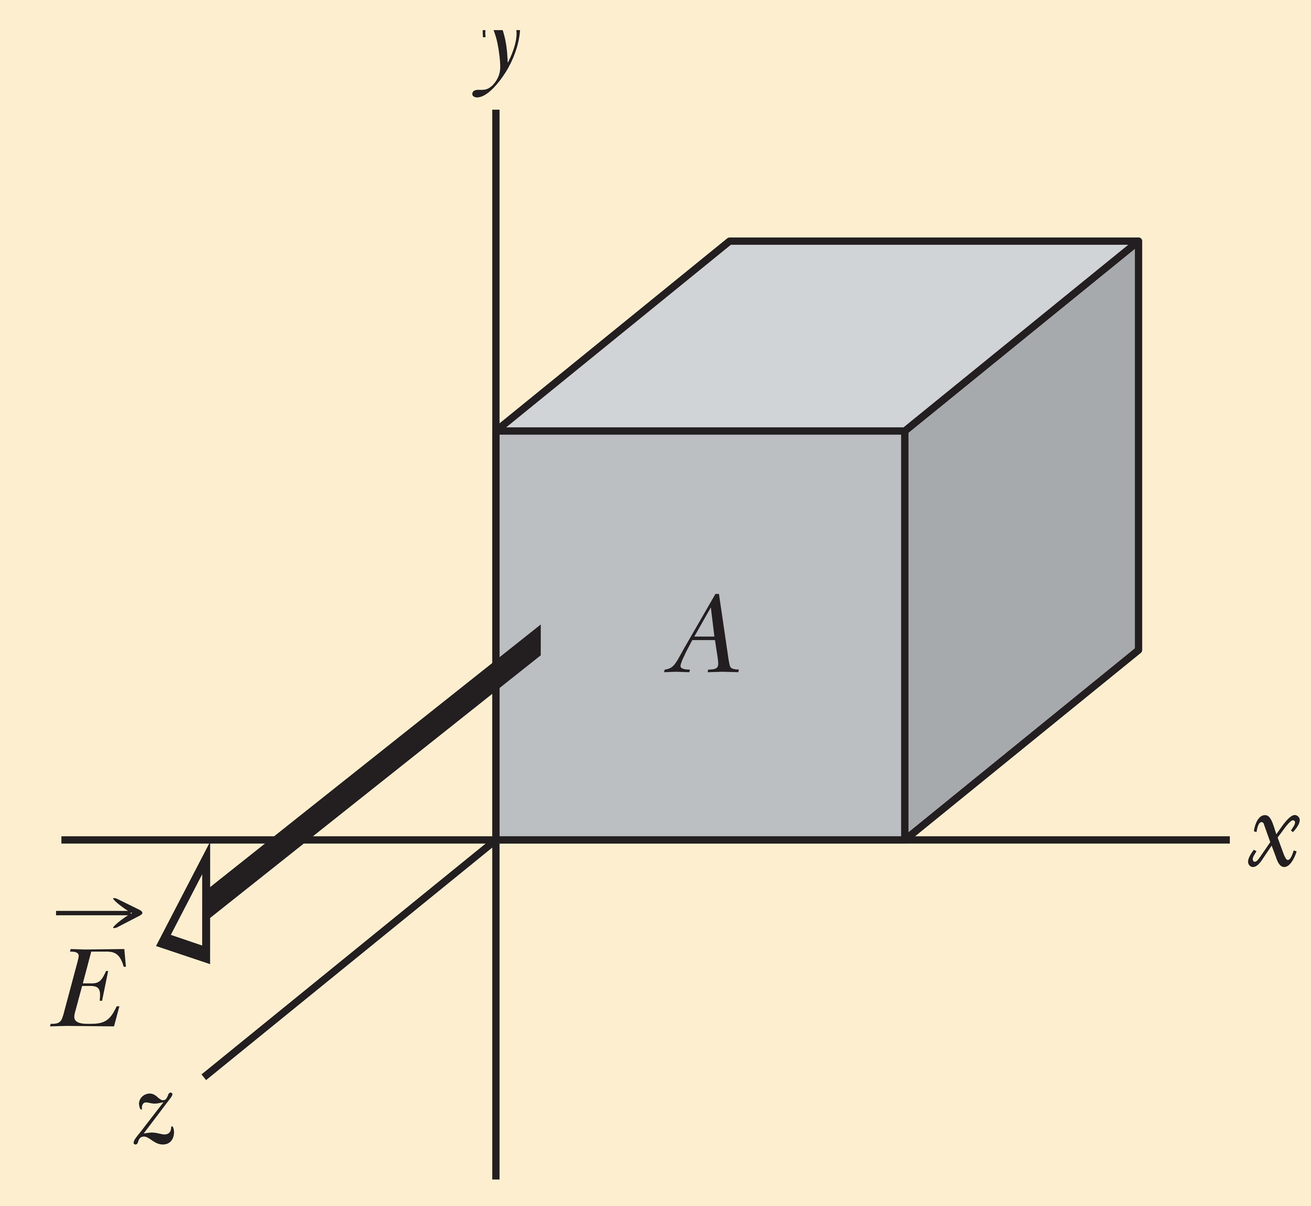
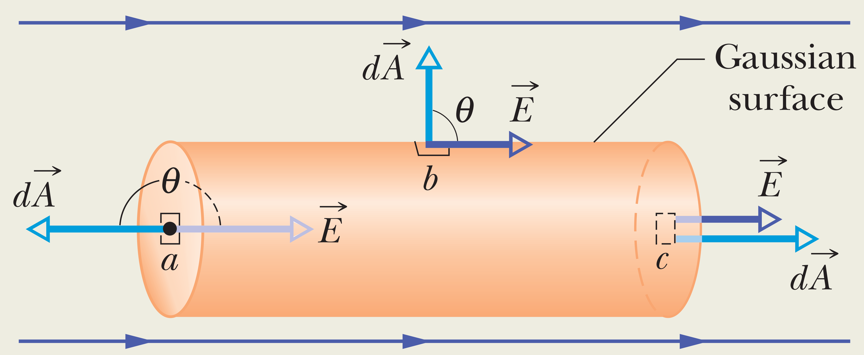
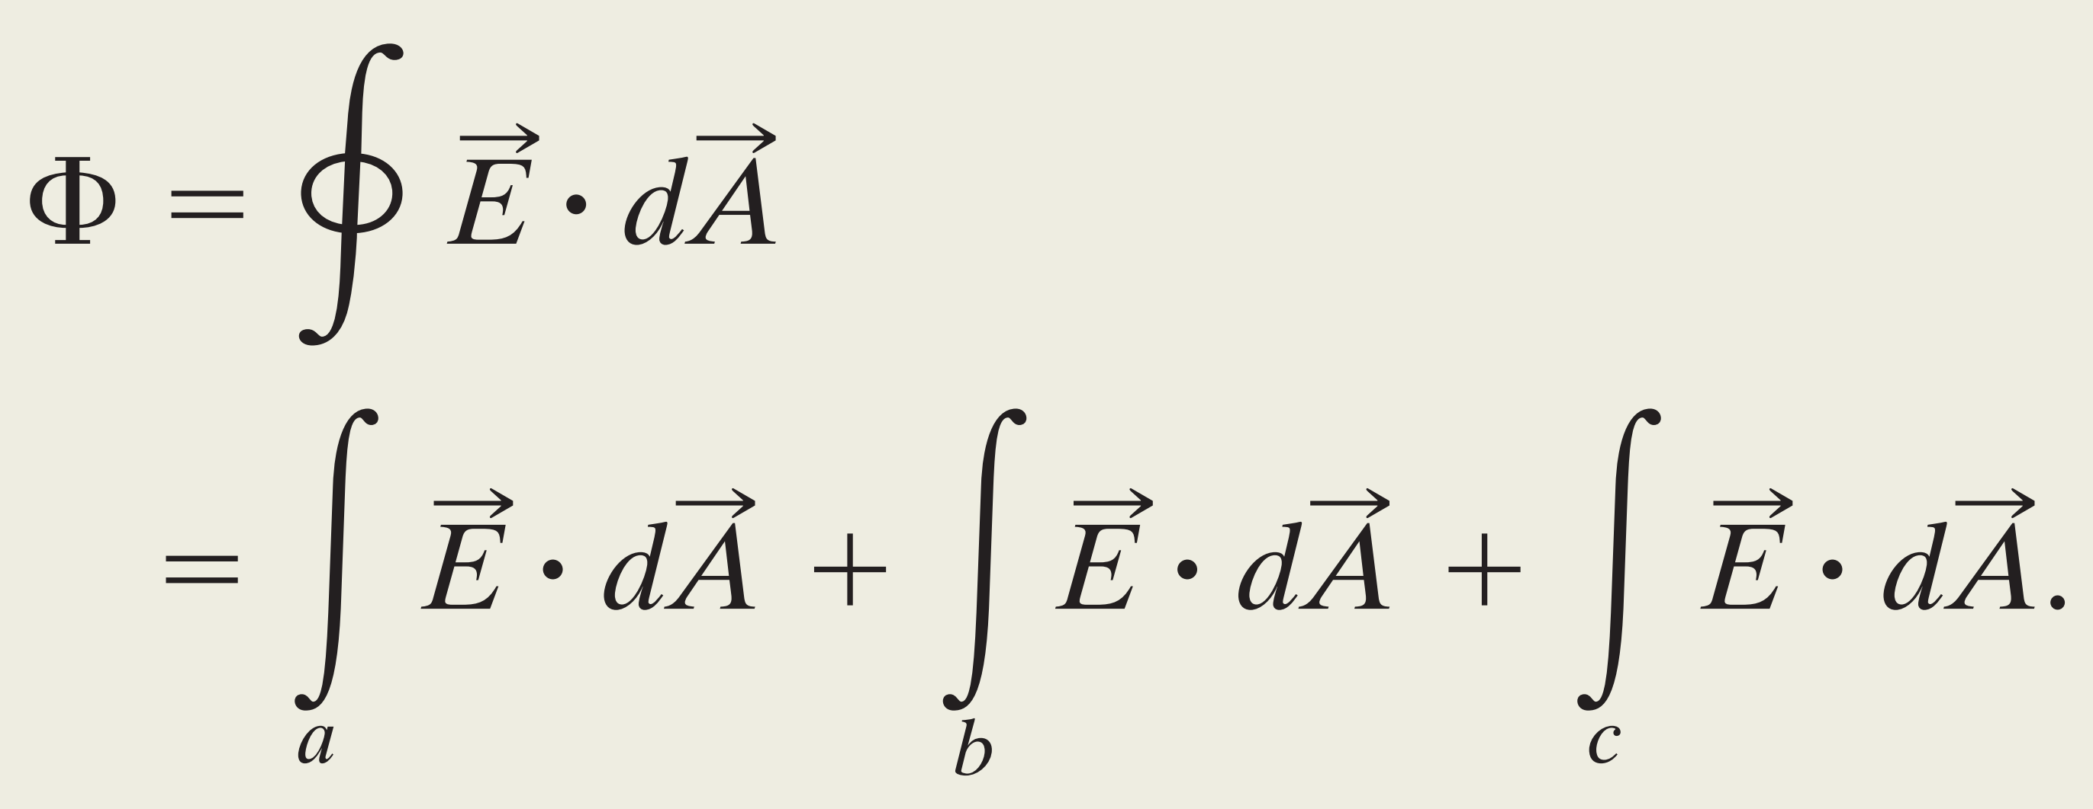
Checkpoint:
what is the flux through (a) the front face (which is in the xy plane), (b) the rear face, (c) the top face, and (d) the whole cube?
a) Positive b) Negative C) zero ( no piercing) C) Zero
Problem (2-1) figure below shows a Gaussian surface in the form of a
closed cylinder (a Gaussian cylinder or G-cylinder) of radius R. It lies in
a uniform electric field with the cylinder’s central axis (along the length of the cylinder) parallel to the field. What is the net flux of the electric field through the cylinder?
Solution:
Break the cylinder into three terms: integrals over the left cylinder cap a, the curved cylindrical surface b,and the right cap c:

Slide 7
Gauss’ law
Gauss’ law relates the net flux of an electric field through a closed surface (a Gaussian surface) to the net charge qenc that is enclosed by that surface.
Substitute the flux
The net charge $q_{enc}$is the algebraic sum of all the enclosed positive and negative charges, and it can be positive, negative, or zero.
If $q_{enc}$is positive, the net flux is outward; if $q_{enc}$is negative, the net flux is inward.

Slide 8
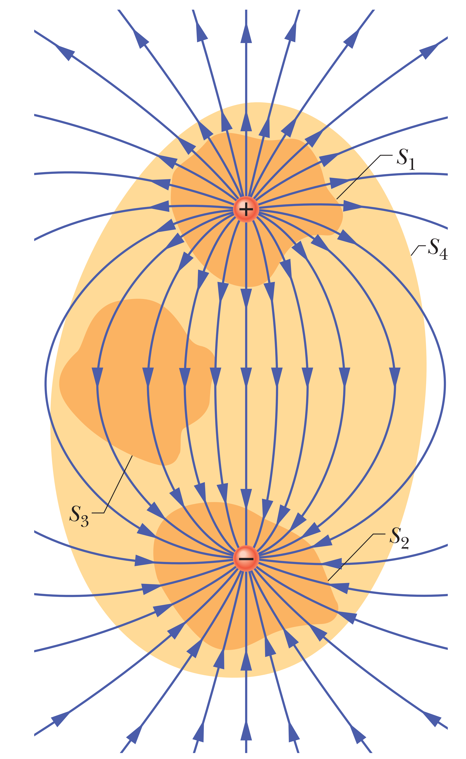
Surface S₁: The electric field is outward. Thus, the flux is positive
and $q_{enc}$ as well.
Surface S₂ : The electric field is inward. Thus, the flux is negative
and $q_{enc}$ as well.
Surface S₃ : No charge within the enclose surface thus $q_{enc}$=0.
Surface S₄: The flux is zero because …..

Slide 9
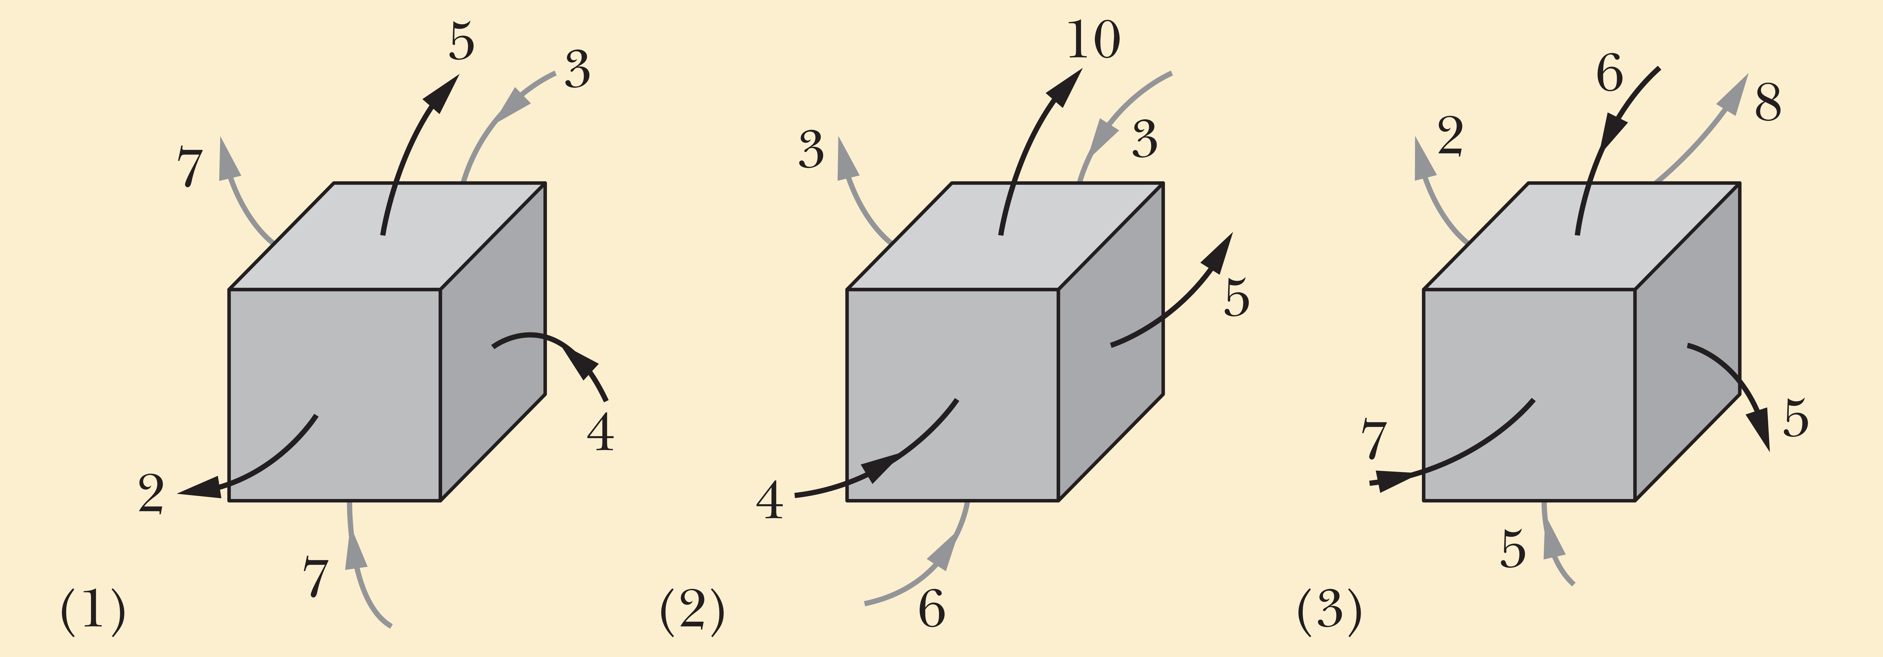
CheckPoint2: The figure shows three situations in which a Gaussian cube sits in an electric field. In which situation does the cube enclose (a) a positive net charge,(b) a negative net charge, and (c) zero net charge?
Zero
Positive
Negative

Slide 10
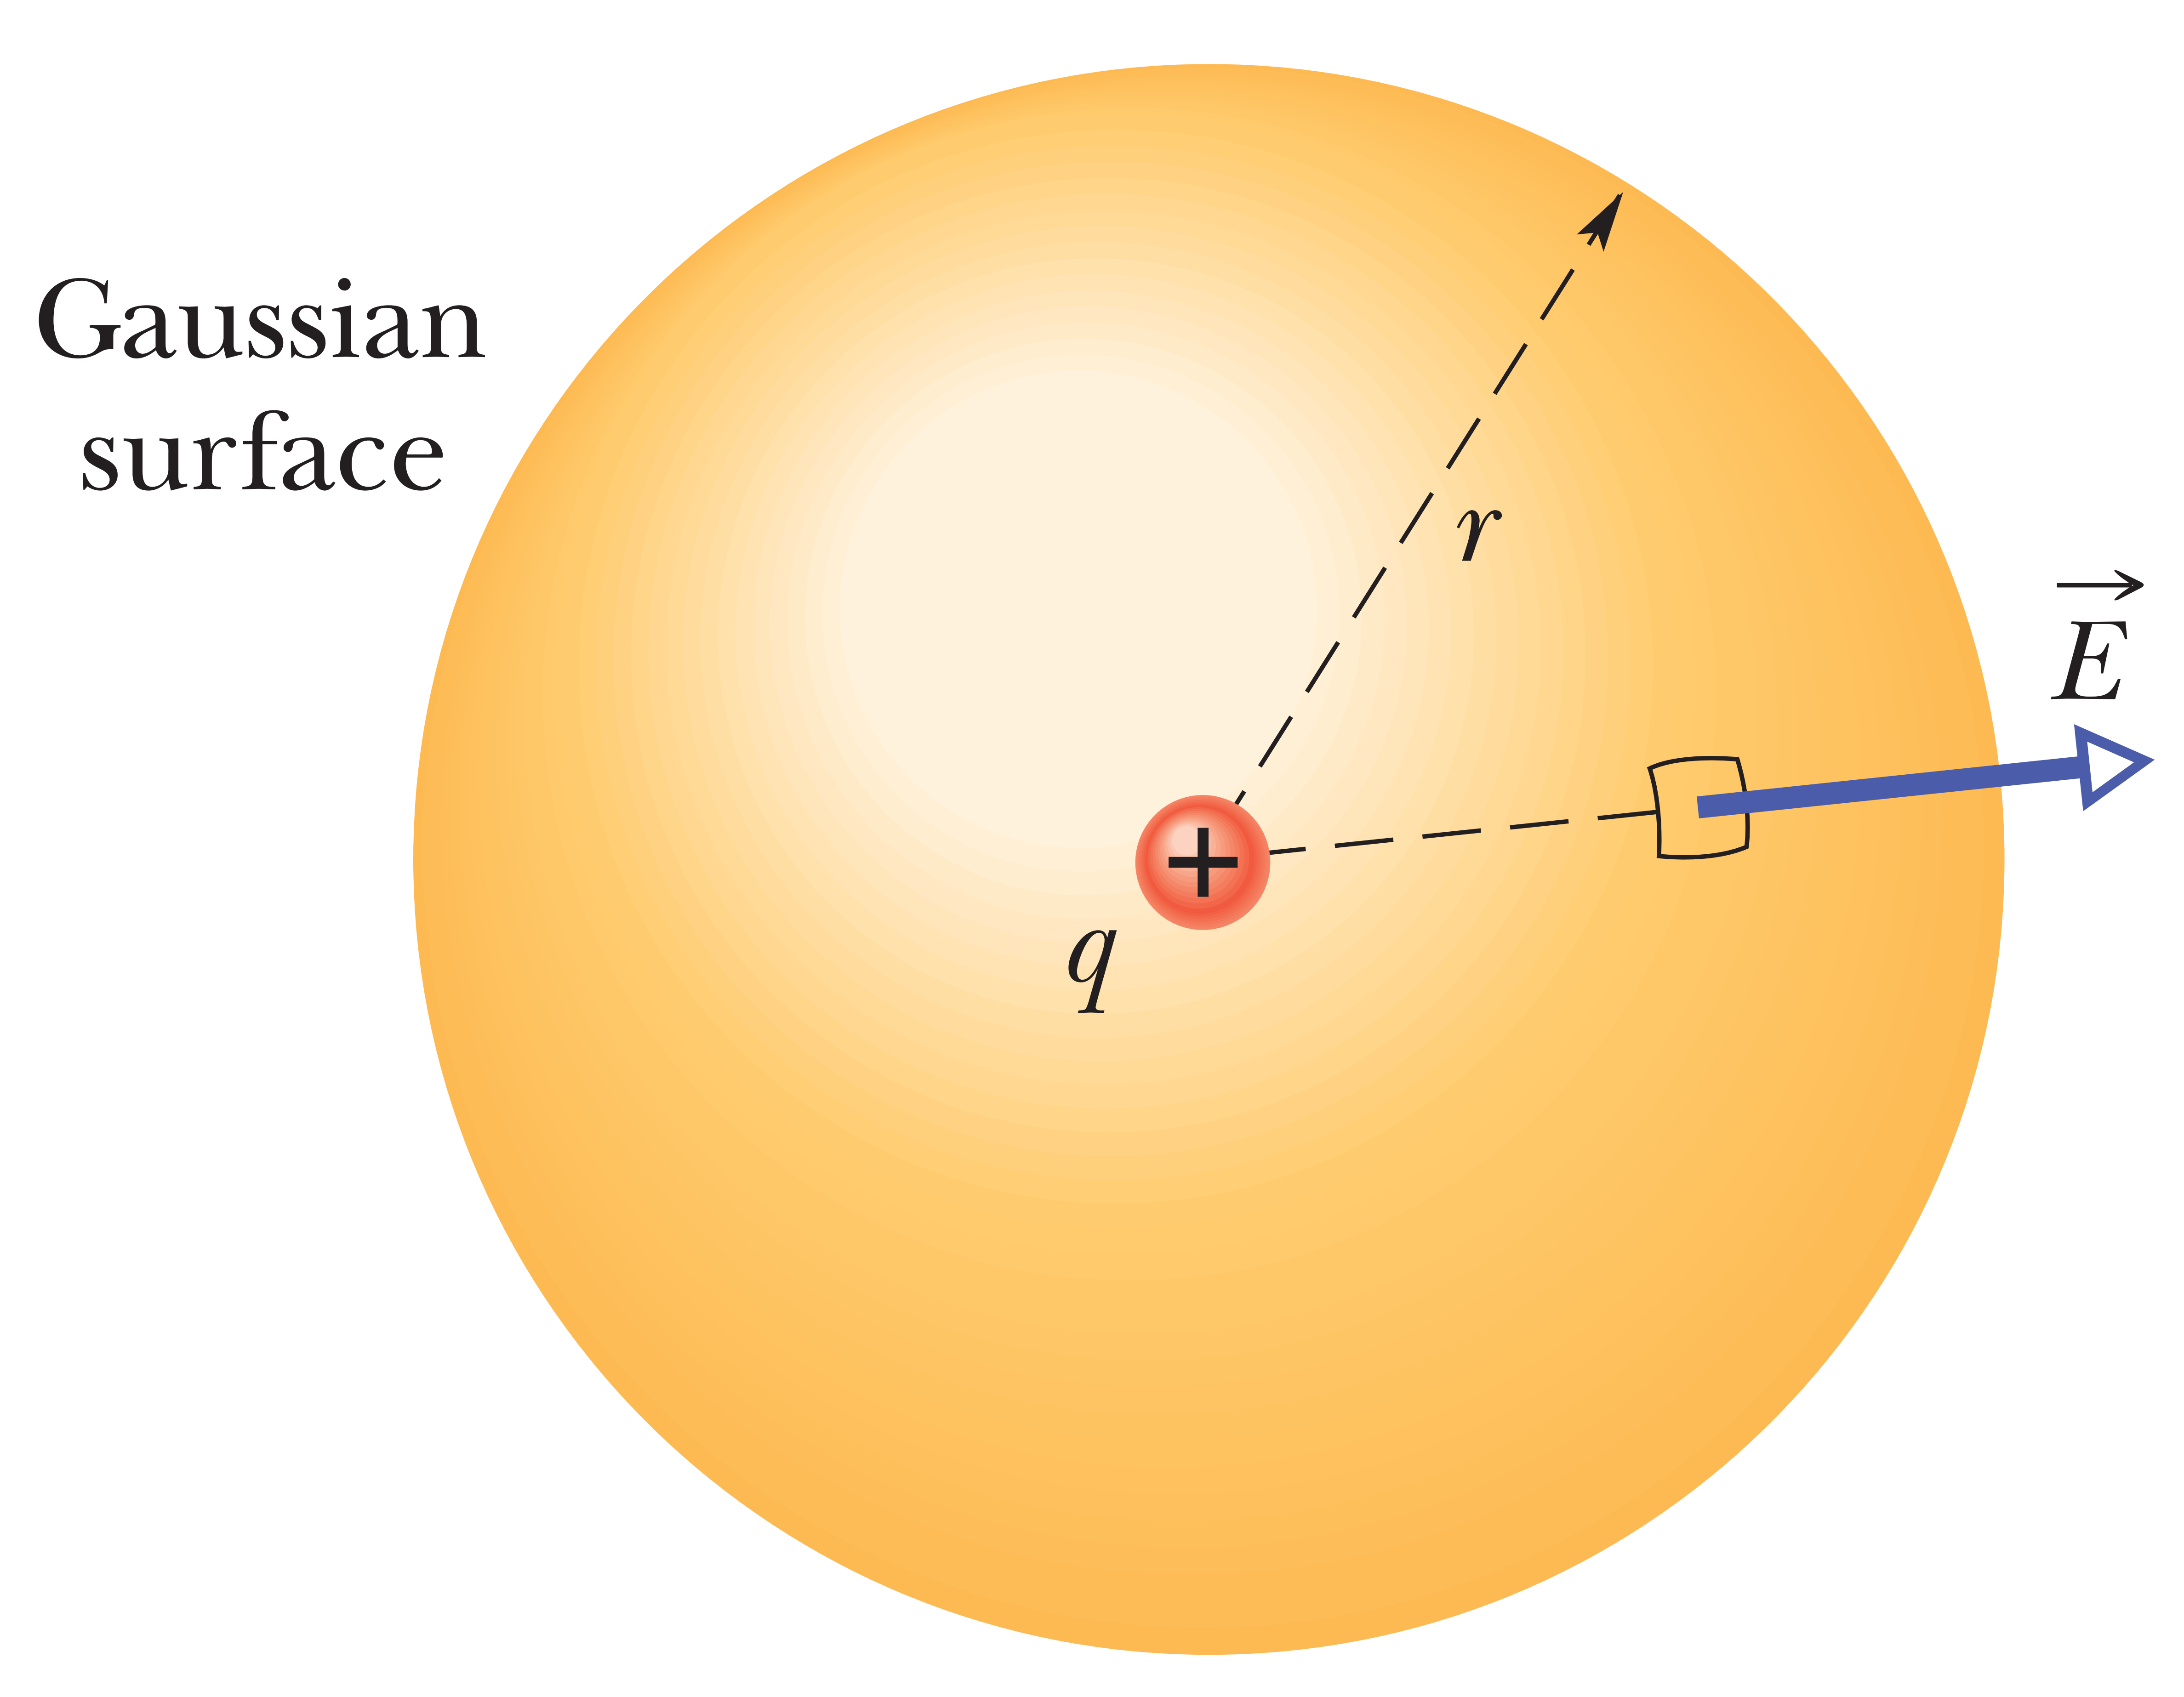
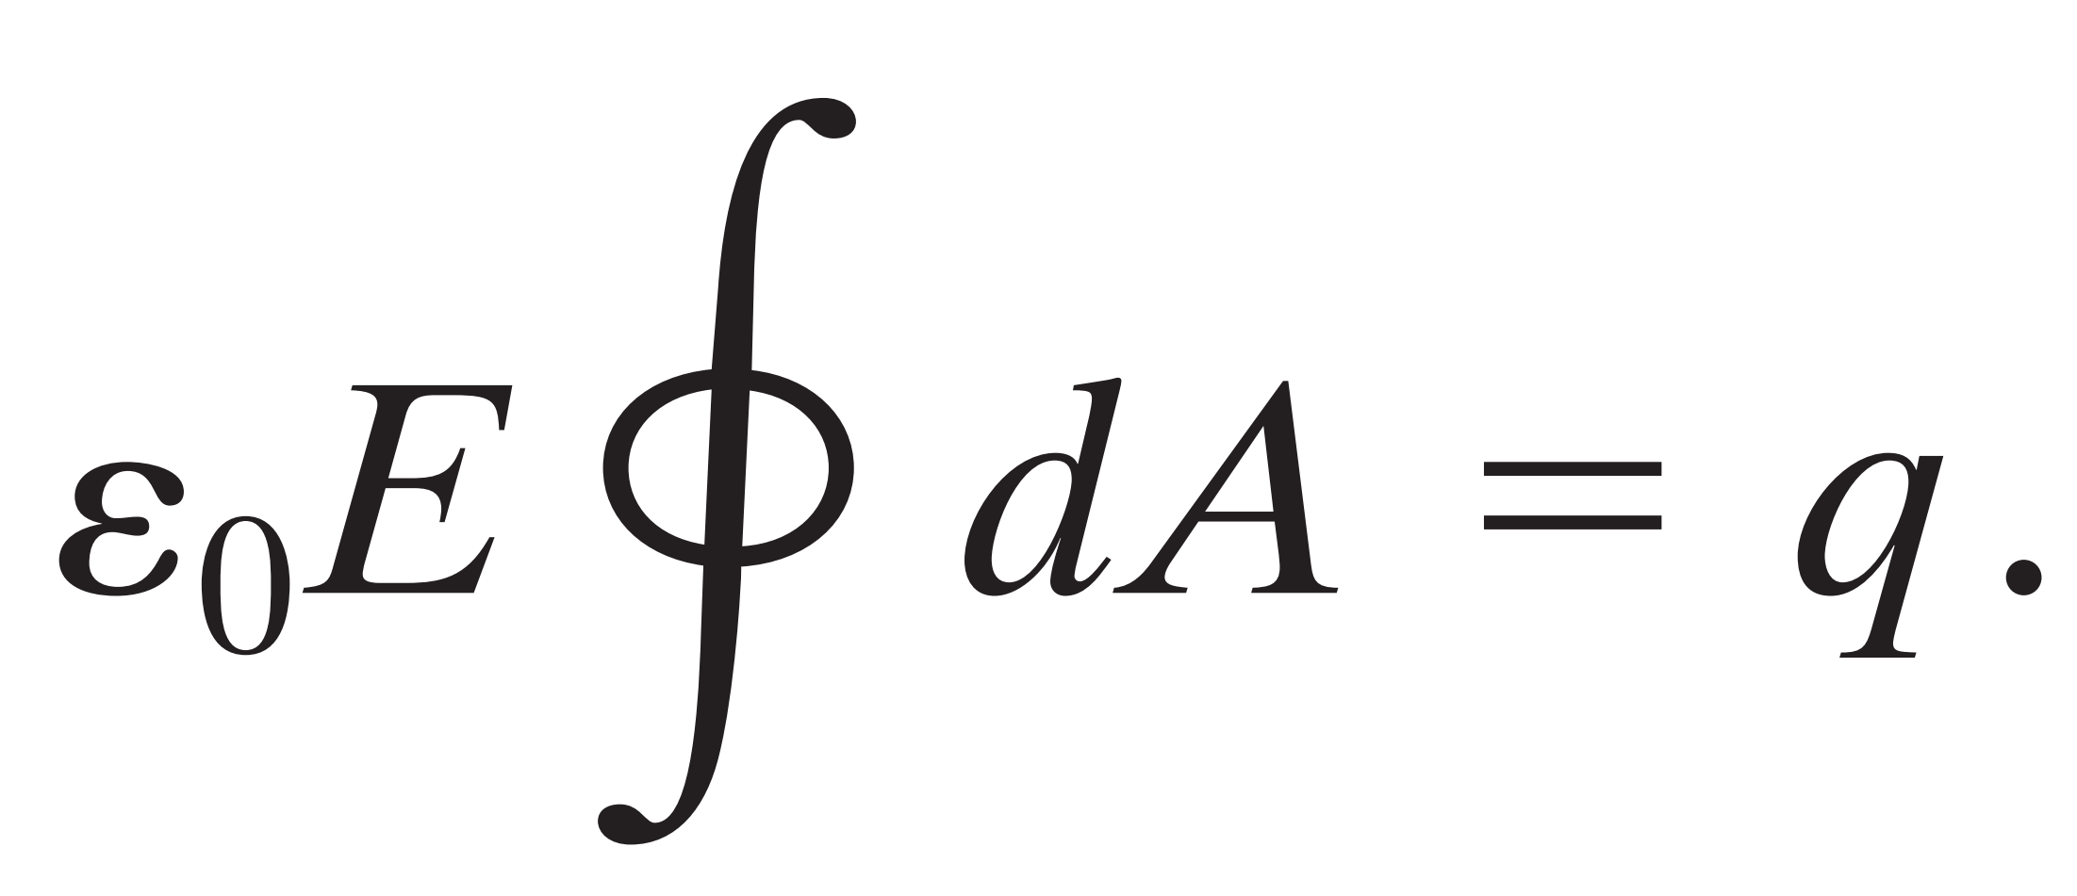
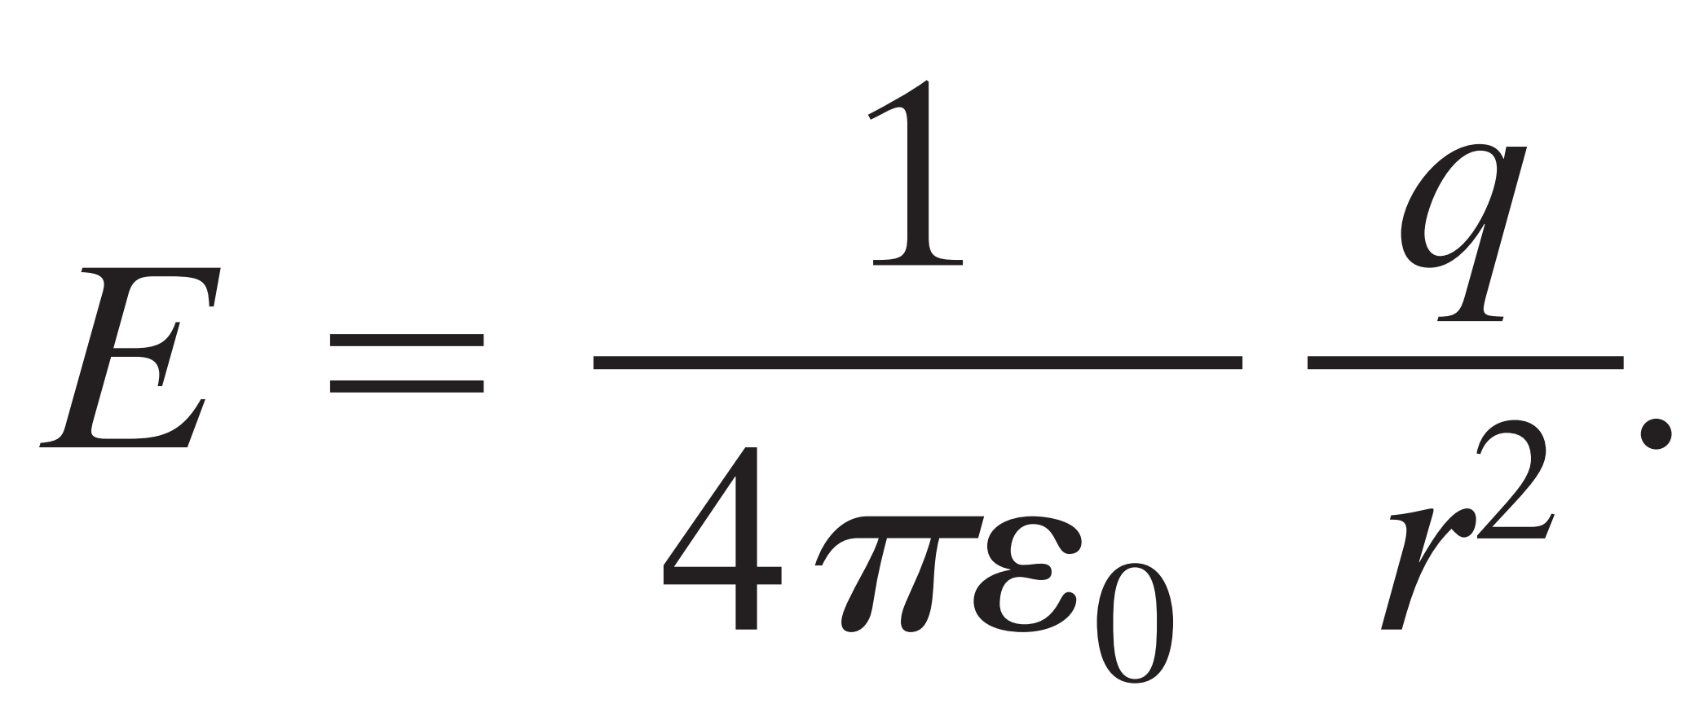
Gauss’ Law and Coulomb’s Law

Slide 11
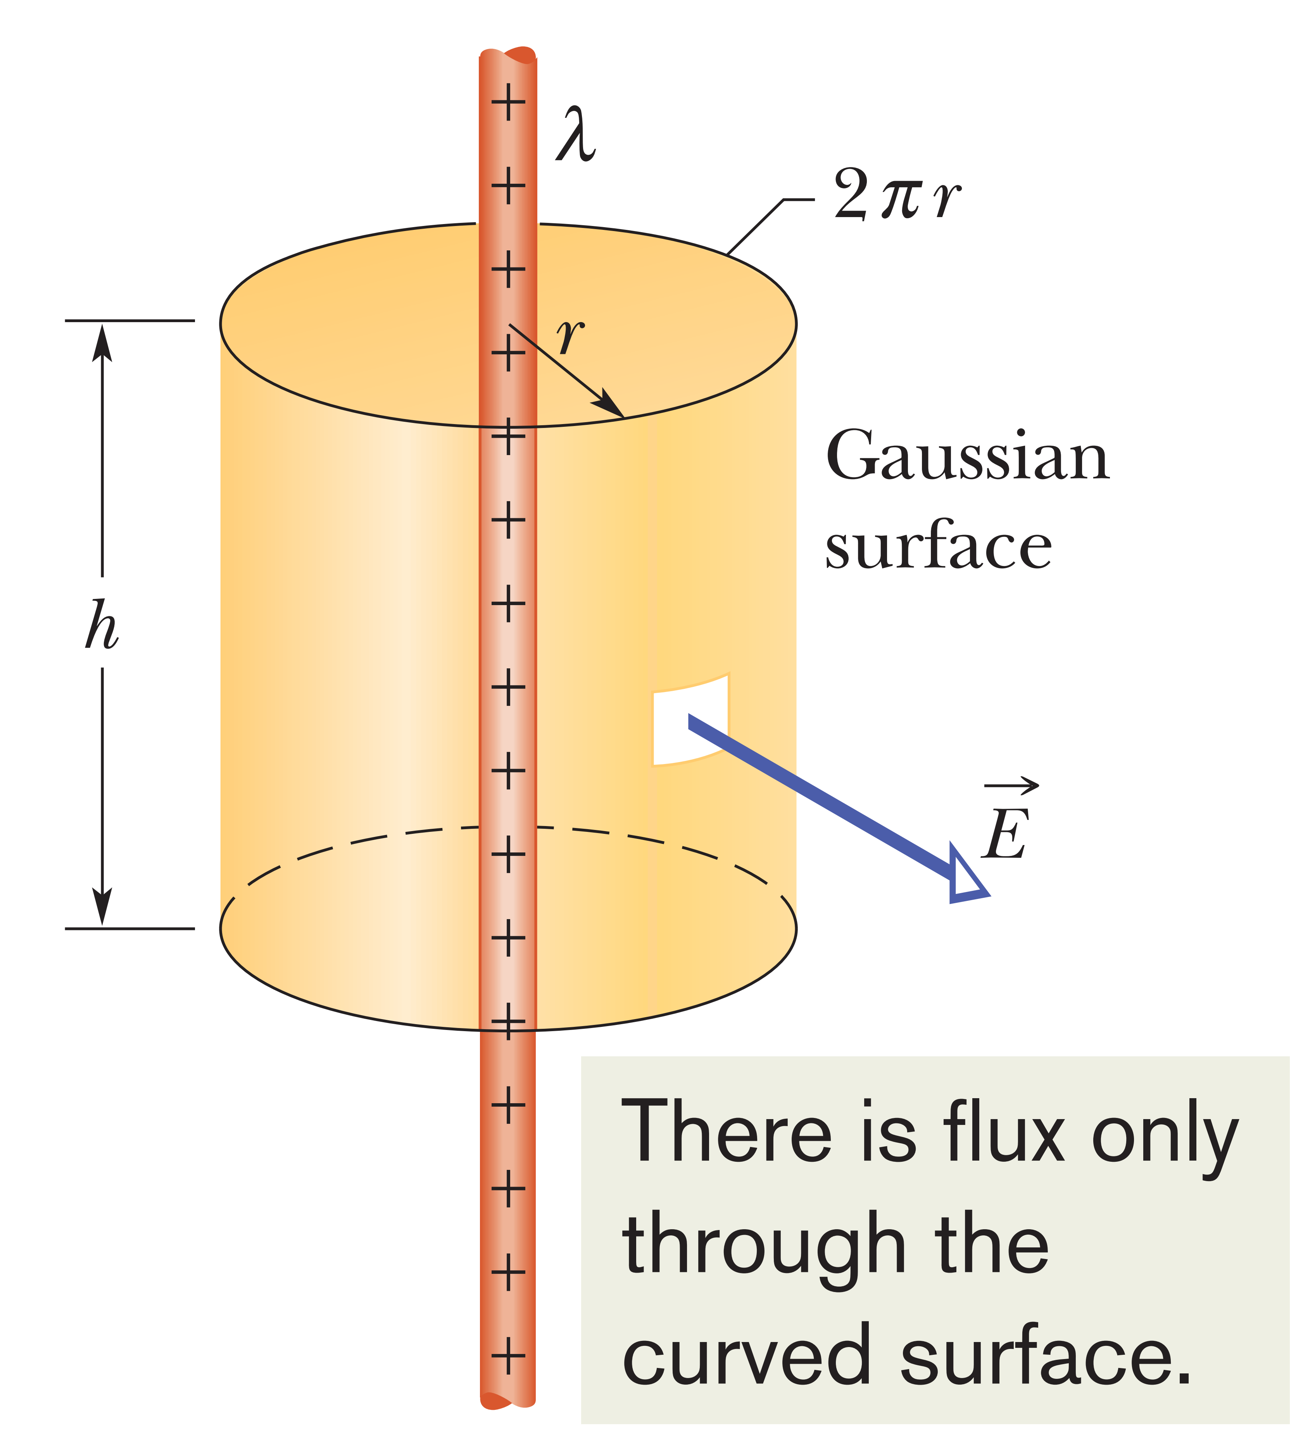
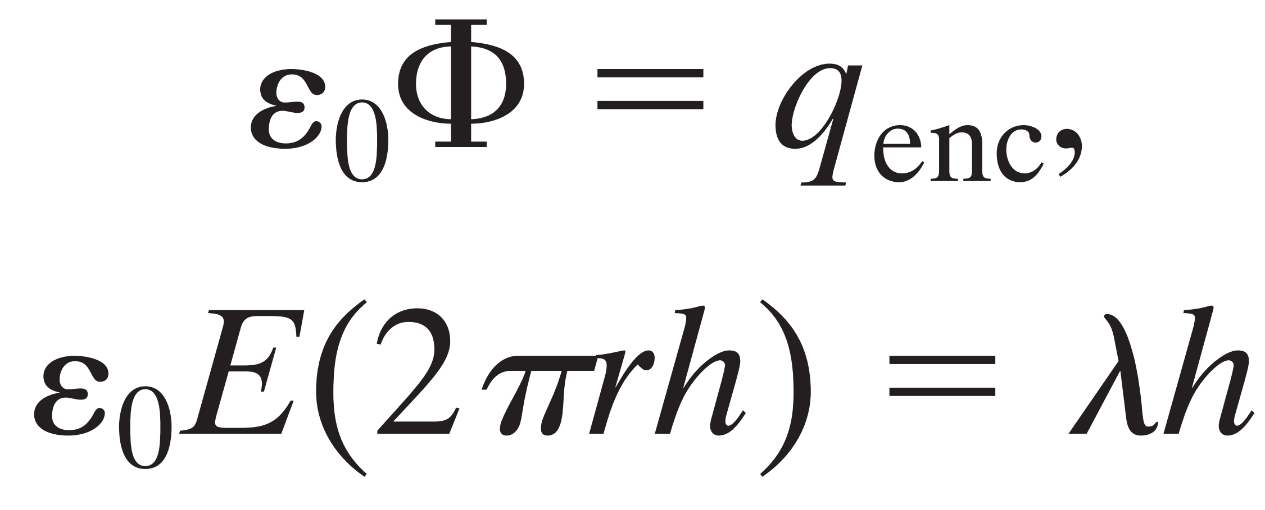
Applying Gauss’ Law: Cylindrical Symmetry
Total flux is $Φ=\int{\vec{E}.d\vec{A}}$
The angle between $\vec{E}$ for any patch element on surface and
area vector $d\vec{A}$ is zero. Therefore
Gauss’ law
the linear charge density (charge per unit length, remember) is uniform.

Slide 12
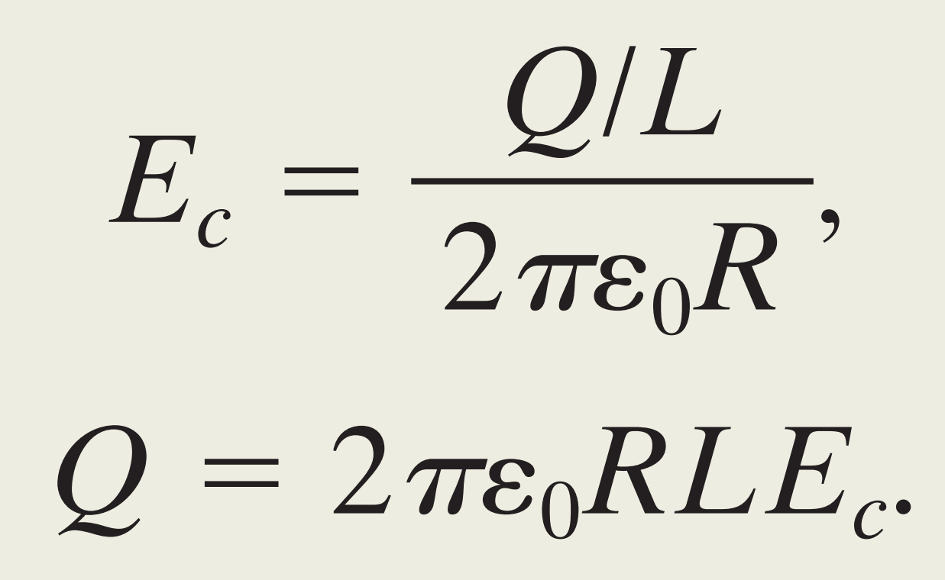
Problem (2-2) vertical cylinder of height $L =1.8m$ and radius $R=0.10m$. The electrical breakdown would have occurred between the cylinder (her) and the could if the electric field magnitude along her body had exceeded the critical value $E_{c}=2.4 MN/C$. What value of $Q$ would have put the air along her body on the verge of breakdown?
When $r=R$, $E_{c}=E$ and Ratio $Q/L$for linear charge density $λ$
Substitute given values

