Slide 1
Chapter Two Electrostatics Coulomb’s Law & Electric Field
Electricity and Magnetism
Zubayda S Saifaldeen, PhD
Physics Department, College of Science, University of Duhok
Emails: Zubayda.saifaldeen@uod.ac
Notes:
what exactly is electricity? This is a very complicated question, and as you dig deeper and ask more questions, there really is not a definitive answer, only abstract representations of how electricity interacts with our surroundings.
Static electricity is an imbalance of positive and negative charges.
weak force is responsible for radioactive decay, specifically, beta decay where a neutron within the nucleus changes into a proton and an electron, which is ejected from the nucleus

Slide 2
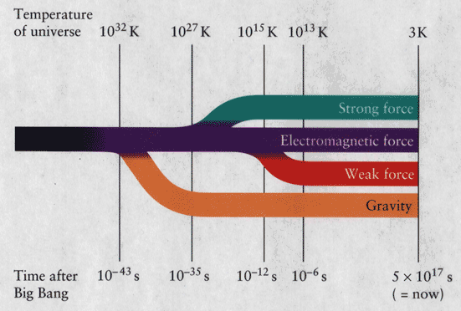
Four Fundamental Forces of Nature
Notes:
In fact all known forces (or interactions) in the universe can be grouped into four basic types. Strong nuclear, This force is responsible for binding of nuclei.
Electromagnetism force, this is the force which exists between all particles which have an electric charge. For example, electrons (negative charge) bind with nucleus of an atom, due to the presence of protons (positive charge). The force is long range, in principle extending over infinite distance.

Slide 3
Notes:
The forces of gravity and electromagnetism are familiar in everyday life. Two new forces are introduced when discussing nuclear phenomena: the strong and weak interactions. When two protons encounter each other, they experience all four of the fundamental forces of nature simultaneously. The weak force governs beta decay and neutrino interactions with nuclei. The strong force, which we generally call the nuclear force, is actually the force that binds quarks together to form baryons (3 quarks) and mesons (a quark and an anti-quark). The nucleons of everyday matter, neutrons and protons consist of the quark combinations uud and udd, respectively. The symbol u represents a single up quark, while the symbol d represents a single down quark.

Slide 4
Electromagnetism Timeline
1747: Ben Franklin (1706-1790) discovers there are two kinds of charges; positive and negative charges.
1785: Charles Austin de Coulomb (1736-1806) documents Coulomb's Law.
1780: Luigi Galvani (1737-1790) discovers electricity from two different metals causes frog legs to twitch.
1790: Alessandro Volta (1745-1827) finds chemistry acting on two dissimilar metals generates electricity. He later invents the voltaic pile battery.
1820: Hans Christian Oersted (1777-1851) electric current affects compass needle.
1820: Andre Marie Ampere (1775-1836) in Paris finds that wires carrying current produce forces on each other.
1820: Michael Faraday (1791-1867) at Royal Society in London develops idea of electric field and studies the effect of currents on magnets and magnets inducing electric currents.
1860: James Clerk Maxwell (1831-1879), a Scottish physicist and mathematician, puts the theory of electromagnetism on mathematical basis.
1873: Maxwell publishes "Treatise on Electricity and Magnetism" in which he summarizes and synthesizes the discoveries of Coloumb, Oersted, Ampere, Faraday, et. al. in four mathematical equations. Maxwell's Equations are used today as the basis of electromagnetic theory.
1885: Heinrich Hertz shows Maxwell was correct and generates and detects electromagnetic waves.
1895: Guglielmo Marconi puts the discovery to practical use by sending messages over long distances by means of radio signals. i.e. the "Wireless".
Notes:
When an atom contains the same number of protons and electrons, the atom has no overall charge, but is neutral.
Electrons move around about the nucleus, and sometimes bail out on the atom altogether and move to a different atom.
Some materials hold their electrons very closely, not allowing the electrons to move through them well. These materials are known as insulators. Materials that do allow their electrons to move through them easily are called conductors. Cloth is a good insulator, while metals generally are good conductors.

Slide 5
First Section What’s Electricity
Notes:
In the middle of each atom is a nucleus. That's where the protons and neutrons hang out. Electrons, on the other hand, are even smaller than protons and neutrons, and orbit around the nucleus of the atom.
EElectricity figures everywhere in our lives. Electricity lights up our homes, cooks our food, powers our computers, television sets, and other electronic devices. Electricity from batteries keeps our cars running.

Slide 6
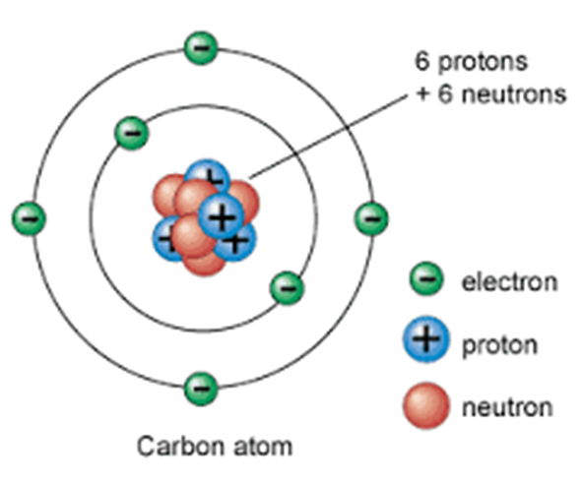
Structure of Atoms
An atom is composed of a tiny dense nucleus located at the center surrounded by electrons.
The Nucleus contains protons and neutrons
Protons (p)
Neutron (n)
Electrons (e)

Slide 7
Electric Charge
Protons are positively (+) charged.
Electrons are negatively (-) charged.
Neutrons are neutral (net charge is zero).
Unit of charge is Coulomb (C).
Charge on proton = charge on electron = 1.6 X 10 ^-19 C.
Notes:
Each atom has a specific number of electrons, protons and neutrons. But no matter how many particles an atom has, the number of electrons usually needs to be the same as the number of protons. If the numbers are the same, the atom is called balanced, and it is very stable.
Some kinds of atoms have loosely attached electrons. An atom that loses electrons has more protons than electrons and is positively charged. An atom that gains electrons has more negative particles and is negatively charge. A "charged" atom is called an "ion."

Slide 8
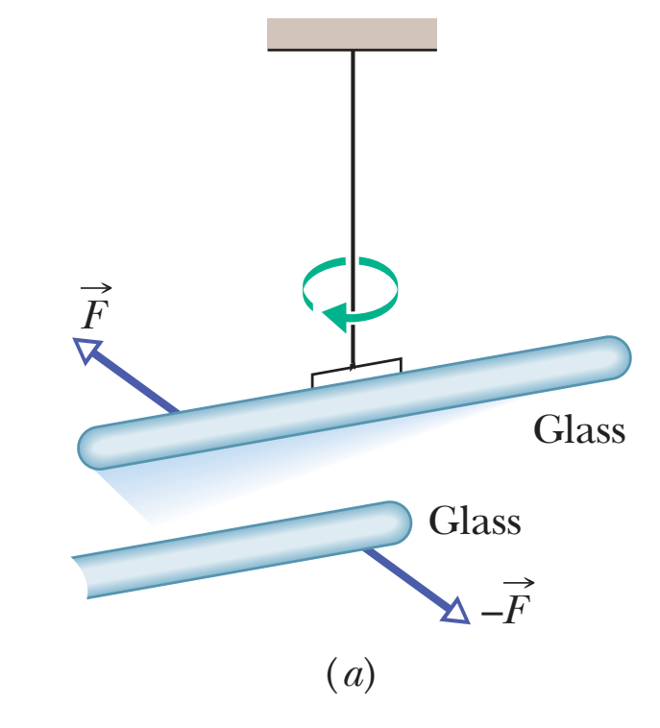
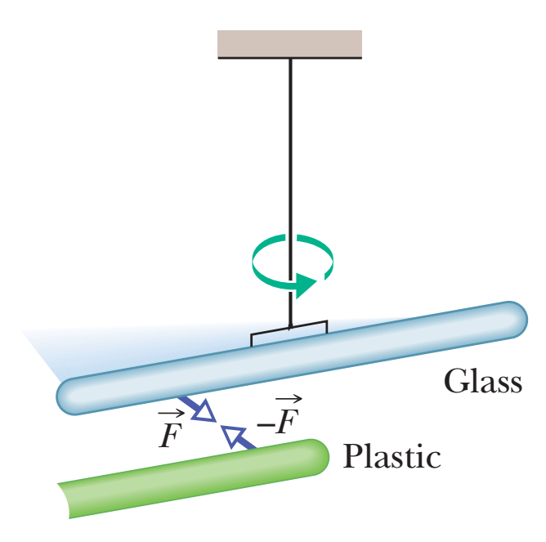
A glass rod is hanging by thread. If you rub the glass rob by silk cloth (on a day when the humidity is low). Then, bring another glass rod and rub it by silk cloth.
If the second rub is brought near the hanging one, The hanging one will move away.
If the second rod is replaced with a plastic rod that has been rubbed with fur. This time, the hanging rod moves toward the nearby rod.
Why that happen ? since there is no contact with that rod, no breeze to push on it, and no sound wave to disturb it.
In the first demonstration, the force on the hanging rod was repulsive, and in the second, attractive.

Slide 9
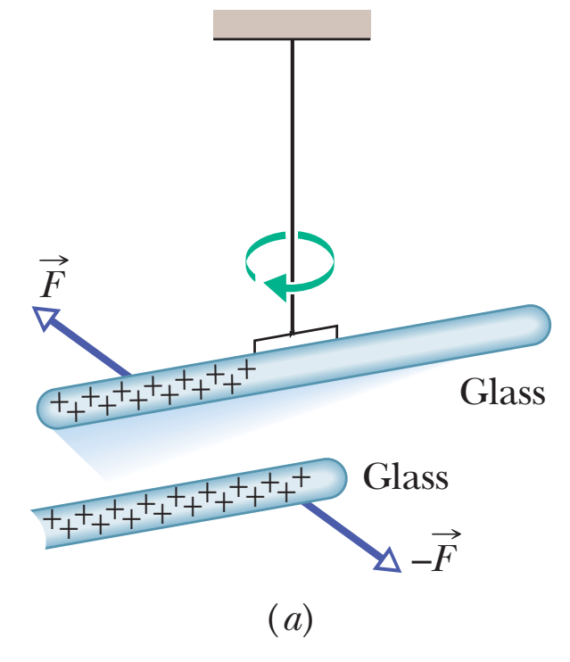
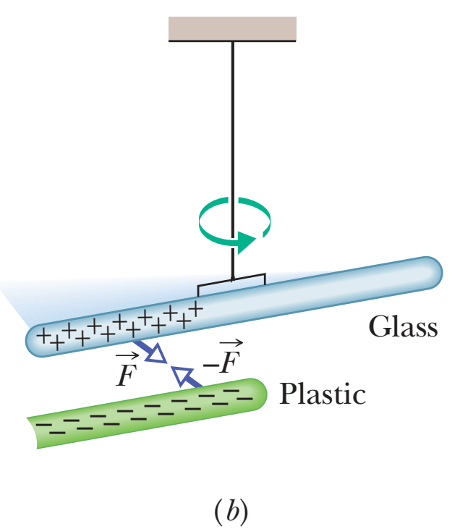
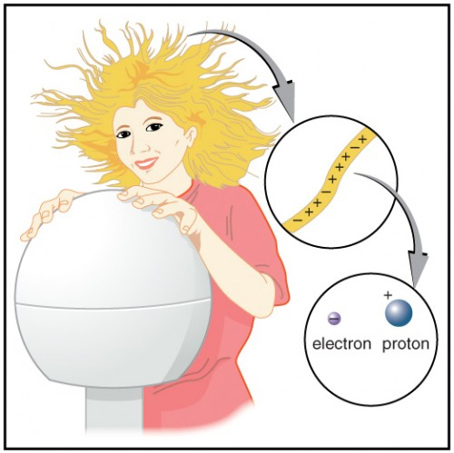
After a great many investigations, scientists figured out that the forces in these types of demonstrations are due to the electric charge that we set up on the rods when they are in contact with silk or fur.
Electric charge is an intrinsic property of the fundamental particles that make up objects such as the rods, silk, and fur.

Slide 10
Two Types. There are two types of electric charge, named by the American scientist and statesman Benjamin Franklin as positive charge and negative charge.
Excess Charge. Normally most objects are approximately neutral. However, if an object gain positive charge (charging) or lose negative charges (discharge) will becomes positively charge or gain negative charge ((charging) or lose positive charges (discharge) will become negatively charge.
Two of the grand mysteries in physics are (1) why does the universe have particles with electric charge (what is it, really?) and (2) why does electric charge come in two types (and not, say, one type or three types). We just do not know.

Slide 11
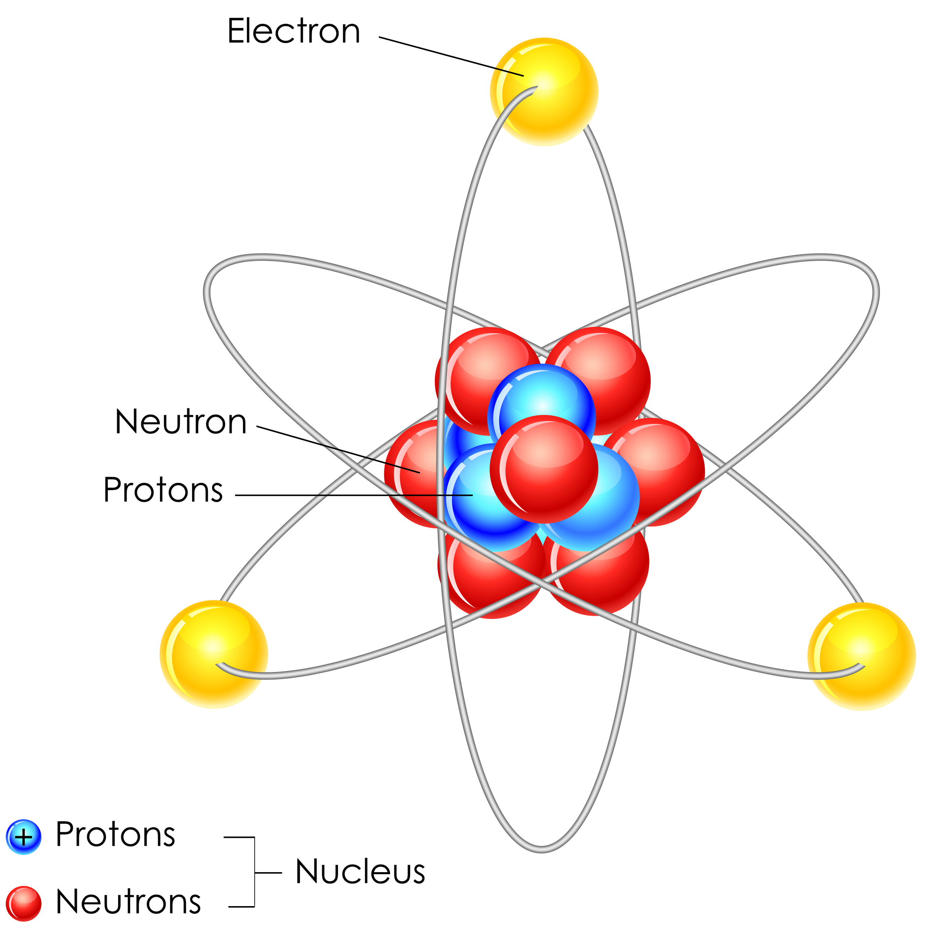
We can classify materials generally according to the ability of charge to move through them. Conductors are materials through which charge can move rather freely; examples include metals (such as copper in common lamp wire), the human body, and tap water. Nonconductors—also called insulators—are materials through which charge cannot move freely; examples include rubber (such as the insulation on common lamp wire), plastic, glass, and chemically pure water. Semiconductors are materials that are intermediate between conductors and insulators; examples include silicon and germanium in computer chips. Superconductors are materials that are perfect conductors, allowing charge to move without any hindrance.

Slide 12
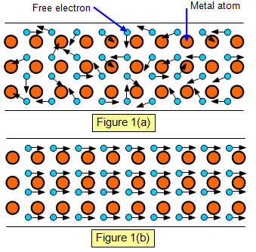
Conducting Path. Always conductive objects tend to be electrically neutral. Conductor objects eliminate the excess charges through dis-charging to ground to spread out it.
Charged Particles. When atoms of a conductor like copper come together to form the solid, some of their outermost (and so most loosely held) electrons become free to wander about within the solid, leaving behind positively charged atoms ( positive ions). We call the mobile electrons conduction electrons. There are few (if any) free electrons in a nonconductor.

Slide 13
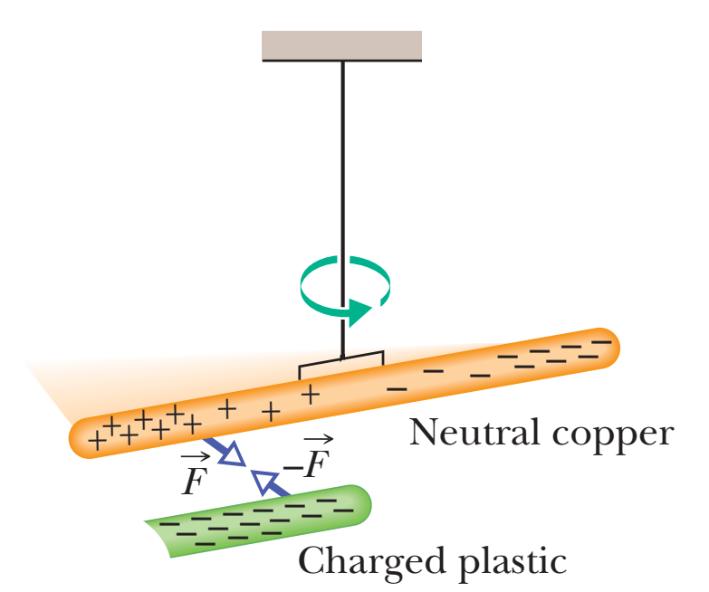
Induced Charge. Note that only conduction electrons, with their negative charges, can move; positive ions are fixed in place. Thus, an object becomes positively charged only through the removal of negative charges.

Slide 14
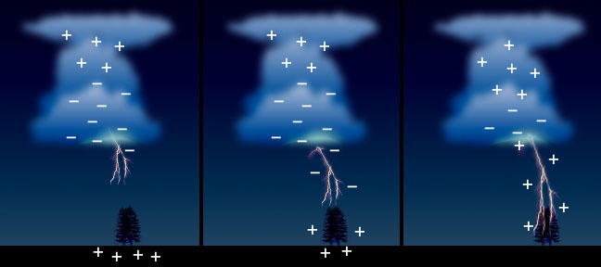
Static Electricity
Electrostatics: is the study of charges at rest.
Static electricity originates from the build up of charges on the surface of an object.
The static charge doesn’t flow.
The static electricity is stored as potential energy.
Notes:
Electrons can be made to move from one atom to another. When those electrons move between the atoms, a current of electricity is created. The electrons move from one atom to another in a "flow." One electron is attached and another electron is lost.

Slide 15
Electrostatic charging
The three ways of static charging (static electricity) are:
1. Friction: Rub two objects together to make one positive and the other negative.
2. Conduction: Touch a charged object to another object to get the same charge on each one.
3. Induction: Bring a charged object close to a neutral one to get the opposite charge on the neutral one.

Slide 16
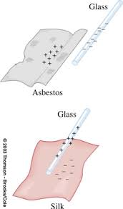
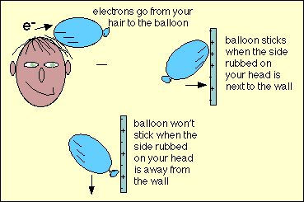
Charging by Friction
Notes:
Rubbing two objects can transfer charge from one to the other. When two plastic rods were each rubbed with a piece of fur, they repelled. Conclusion: Since they were prepared the same way, they should have the same kind of charge. Thus: “Like charges repel.
On the other hand, the plastic rods were attracted to the fur. There must be a different kind charge such that: “Unlike charges attract.”

Slide 17
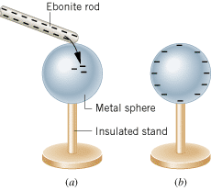
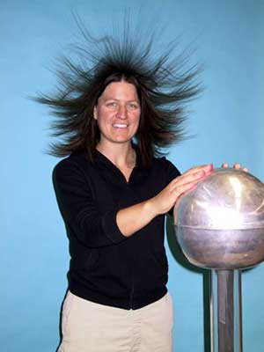
Charging by Conduction

Slide 18
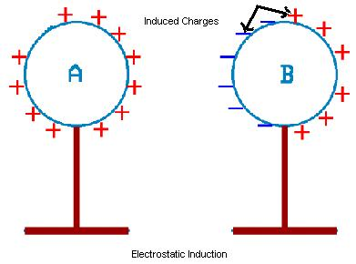
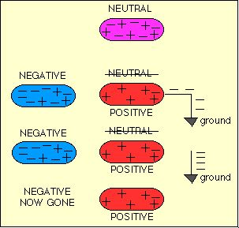
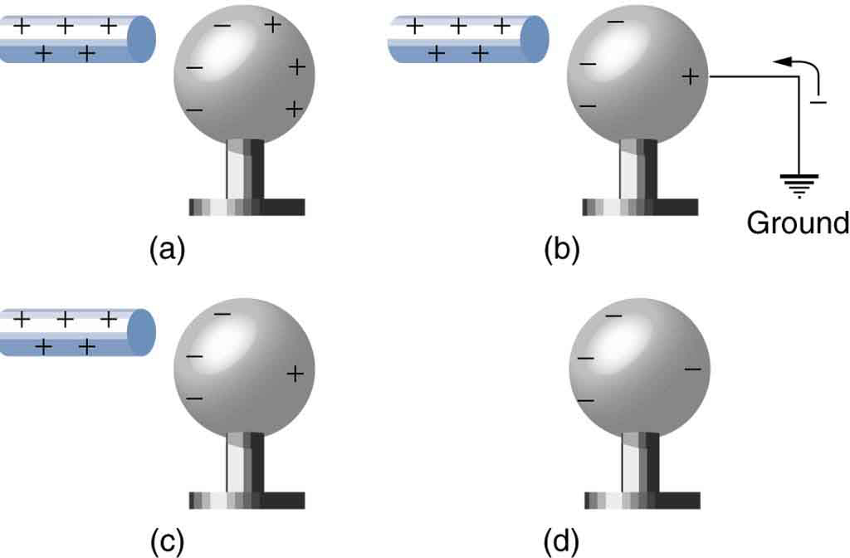
Charging by Induction
Notes:
A charged object is needed to charge an object by induction. Yet there is never any contact made between the charged object and the object being charged.
Only conductors can be charged by the induction process. The process relies on the fact that a charged object can force or induce the movement of electrons about the material being charged.
The object being charged ends up with a charge which is the opposite of the object being used to charge it.
A ground must be used to charge on the object. The ground allows for electron movement into or out of the object being charged.

Slide 19
Homework #1
Please try some of the previous examples at home to see if you can charge an object.

Slide 20
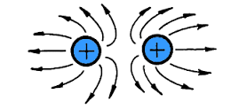
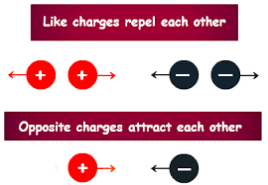
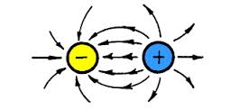
Electric Force

Slide 21
Relationship between the strength of the electrostatic forces of two charged particles and the distances between them.
Inverse square law
F α 1/r^2

Slide 22
Coulomb’s Law
Coulomb's law, or Coulomb's inverse-square law, is a law of physics describing the electrostatic interaction between electrically charged particles.
The law was first published in 1785 by French physicist Charles Augustin de Coulomb and was essential to the development of the theory of electromagnetism.
Notes:
As you probably already know, the interaction between electric charges at rest is described by Coulomb’s law: two stationary electric charges repel or attract one another with a force proportional to the product of the magnitude of the charges and inversely proportional to the square of the distance between them

Slide 23
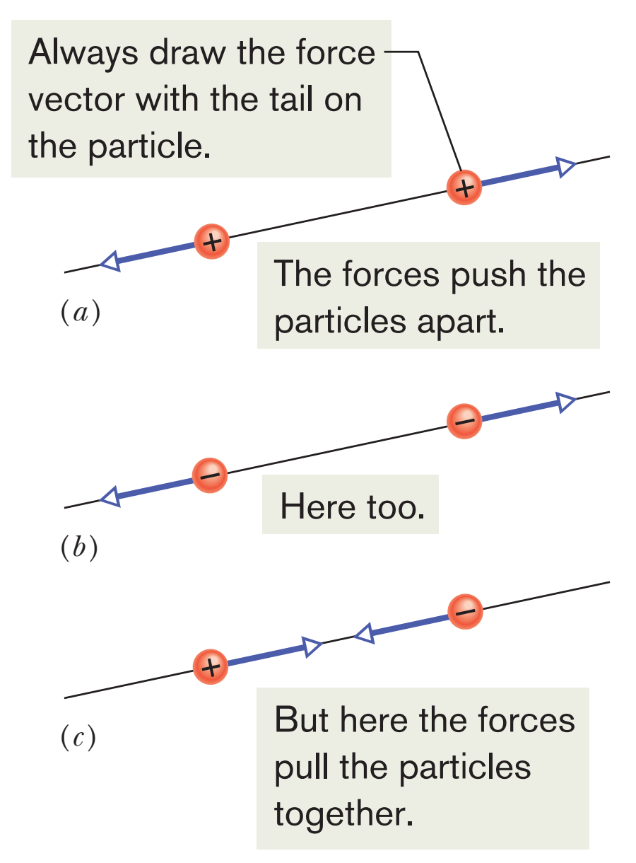
Coulomb’s law of electrostatic force (or electric force) between charged particles. The term electrostatic is used to emphasize that, relative to each other, the charges are either stationary or moving only very slowly.
This equation works for only charged particles
If two charged particles are brought near each other, they each exert an electrostatic force on the other. The direction of the force vectors depends on the signs of the charges. If both hold same sign, it will be repelling force. However, if both hold different sign, it will be attractive force.

Slide 24
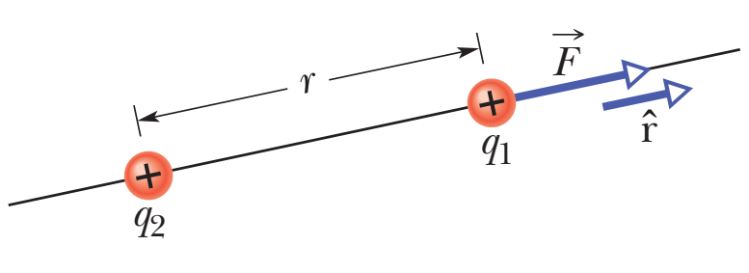
The Coulomb’s law equation in vector form
Where particle 1 has charge $q1$ and particle 2 has charge $q2$. Let’s also focus on particle 1 and write the force acting on it in terms of a unit vector that points $\hat{r}$ along a radial axis extending through the two particles, radially away from particle 2.
Where $r$ is the separation between the particles and $k$ is a positive constant called the $electrostatic constant$or the $Coulomb constant$. $q$ is particle charge and its unit is $1 C (1 A)(1 s)$.
Force Magnitude.
The quantity $ε_{o}$, called the permittivity constant,

Slide 25
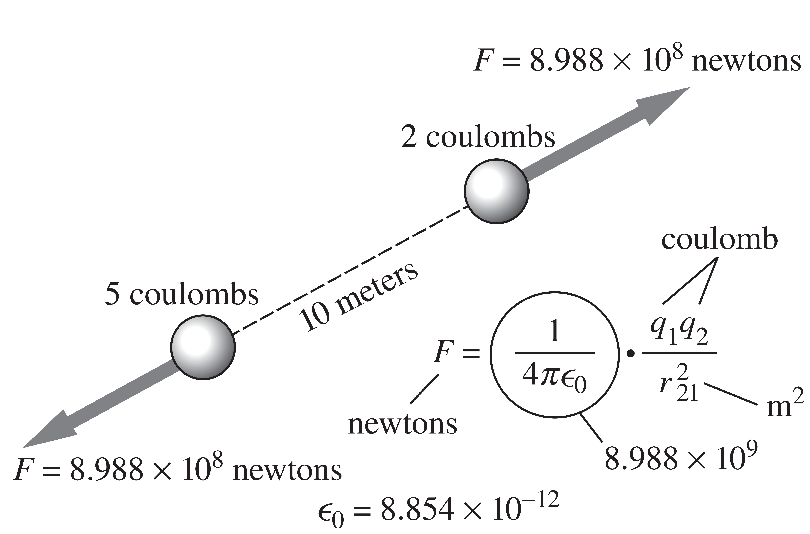
Multiple Forces. the electrostatic force obeys the principle of superposition. Suppose we have n charged particles near a chosen particle called particle 1; then the net force on particle 1 is given by the vector sum
in which, for example,$F_{14}$ is the force on particle 1 due to the presence of particle 4.

Slide 26
Problem (1-1) shows two positively charged particles fixed in place on an x axis. The charges are $q_{1}= 1.60×{10}^{−19}C$and $q_{2}=3.20×{10}^{−19}C$, and the particle separation is $R=0.0200 m$. What are the magnitude and direction of the electrostatic force on particle 1 from particle 2?
$$q_{1}$$
$$q_{2}$$
${\overset{⃑}{F}}_{12}=k_{e}\frac{\left|q_{1}\right|\left|q_{2}\right|}{r^{2}}\hat{r}$
X axis
+
+
$$R$$
$$F_{12}=8.99×{10}^{9} N.\frac{m^{2}}{C^{2}} \frac{\left(1.60×{10}^{−19}C\right)\left(3.2×{10}^{−19}C\right)}{{\left(0.02 m\right)}^{2}}=1.15×{10}^{−24} N$$
Thus, the direction of force ${\overset{⃑}{F}}_{12}$ on particle 1 is away from particle 2, in the negative direction of the x axis.
We can write ${\overset{⃑}{F}}_{12}$ in unit-vector notations as ${\overset{⃑}{F}}_{12}=−(1.15×{10}^{−24} N) \hat{i}$

Slide 27
Problem (1-2) is identical to problem (1-1) except that particle 3 now lies on the x axis between particles 1 and 2. Particle 3 has charge $q_{3}=−3.2×{10}^{−19}C$ and is at a distance $\frac{3}{4}R$ from particle 1. What is the net electrostatic force ${\vec{F}}_{1,net}$ on particle 1 due to particle 2 and 3 ?
${\overset{⃑}{F}}_{13}=k_{e}\frac{\left|q_{1}\right|\left|q_{3}\right|}{{(\frac{3}{4}R)}^{2}}\hat{r}$
$$q_{1}$$
$$q_{3}$$
$$q_{2}$$
X axis
+
-
+
$$\frac{3}{4}R$$
$F_{13}=8.99×{10}^{9} N.\frac{m^{2}}{C^{2}} \frac{\left(1.6×{10}^{−19}\right)\left(3.2×{10}^{−19}\right)}{{\left(\frac{3}{4}\right)}^{2} {\left(0.02\right)}^{2}}=2.05×{10}^{−24} N$
We also can write ${\overset{⃑}{F}}_{13}$ in unit-vector notation
$${\overset{⃑}{F}}_{13}=\left(2.05×{10}^{−24} N\right)\hat{i}$$
The net force ${\vec{F}}_{1,net}$ on particle 1 is the vector sum of ${\overset{⃑}{F}}_{12}$ and ${\overset{⃑}{F}}_{13}$
$${\vec{F}}_{1,net}={\overset{⃑}{F}}_{12}+{\overset{⃑}{F}}_{13}$$
$$= −\left(1.15×{10}^{−24} N\right)\hat{i}+\left(2.05×{10}^{−24} N\right)\hat{i}=\left(9.00×{10}^{−25} N\right)\hat{i}$$

Slide 28
Problem (1-3) is identical to problem (1-1) except that particle 4 is included. It has charge $q_{4}=−3.2×{10}^{−19} C$, is at a distance $\frac{3}{4}R$ from particle 1, and lie on a line that makes an angle $θ={60}^{o}$ with $x$ axis. What is the net electrostatic force ${\vec{F}}_{1,net}$ on particle 1 due to particle 2 and 4 ?
Y axis
$$q_{4}$$
${\overset{⃑}{F}}_{14}=k_{e}\frac{\left|q_{1}\right|\left|q_{4}\right|}{{(\frac{3}{4}R)}^{2}}\hat{r}$
-
$$\frac{3}{4}R$$
$F_{14}=8.99×{10}^{9} N.\frac{m^{2}}{C^{2}} \frac{\left(1.6×{10}^{−19}\right)\left(3.2×{10}^{−19}\right)}{{\left(\frac{3}{4}\right)}^{2} {\left(0.02\right)}^{2}}=2.05×{10}^{−24} N$
$$θ={60}^{o}$$
$$q_{1}$$
$$q_{2}$$
+
+
X axis
The net force on particle is ${\vec{F}}_{1,net}={\overset{⃑}{F}}_{12}+{\overset{⃑}{F}}_{14}$
Because the forces and are not directed along the same axis, we cannot sum simply by combining their magnitudes. Instead, we must add them as a vectors.
$${\vec{F}}_{14}=\left(F_{14}\cos{θ}\right)\hat{i}+\left(F_{14}\sin{θ}\right)\hat{j}$$
Substituting $2.05×{10}^{−24} N$ for ${\vec{F}}_{14}$ and ${60}^{o}$ for $θ$, this becomes
$${\vec{F}}_{14}=\left(1.025×{10}^{−24}\right)\hat{i}+\left(1.775×{10}^{−24}\right)\hat{j}$$

Slide 29
Then we sum
$${\overset{⃑}{F}}_{14}$$
$${\vec{F}}_{1,net}={\overset{⃑}{F}}_{12}+{\overset{⃑}{F}}_{14}$$
$$=−\left(1.15×{10}^{−24}N\right)\hat{i}+(1.025×{10}^{−24}N)\hat{i}+\left(1.775×{10}^{−24}N\right)\hat{j}$$
$$≈\left(−1.25×{10}^{−25}N\right)\hat{i}+(1.78×{10}^{−24N})\hat{j}$$
To find the direction of ${\vec{F}}_{1,net}$, we take
$θ=\tan^{−1}{\frac{F_{1,net,y}}{F_{1,net,x}}}+{180}^{o}={94.0}^{o}$

